Slide 1


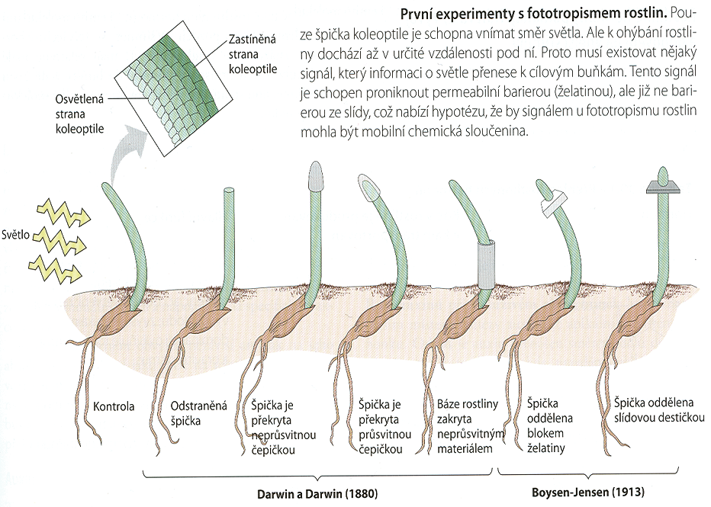
Auxin - discovery
Ústav experimentální botaniky AVČR, v.v.i., Praha
Katedra fyziologie rostlin PřF UK, Praha
The oldest known phytohormone
Darwin 1880, Boysen-Jensen 1913, Went 1928 – Avena coleoptile tests demonstrated the existence of the effective compound that induces cell elongation (auxein=growth in Greek)
Kögl 1933 – identification of the compound in human urine as indole-3-acetic acid (IAA), 1946 confirmed in higher plants
Shaded side
First experiments with plant phototropism. Only tip of the coleoptile is able to perceive light signal. This signal must be transported from the tip downward.There must exist a mobile compound transducing the signal.
Illuminated side
Light
Control
Tip removed
Covered tip
Tip covered with transparent material
Covered base
Tip separated with gelatine block
Tip separated with mica plate
Notes:
1

Slide 2
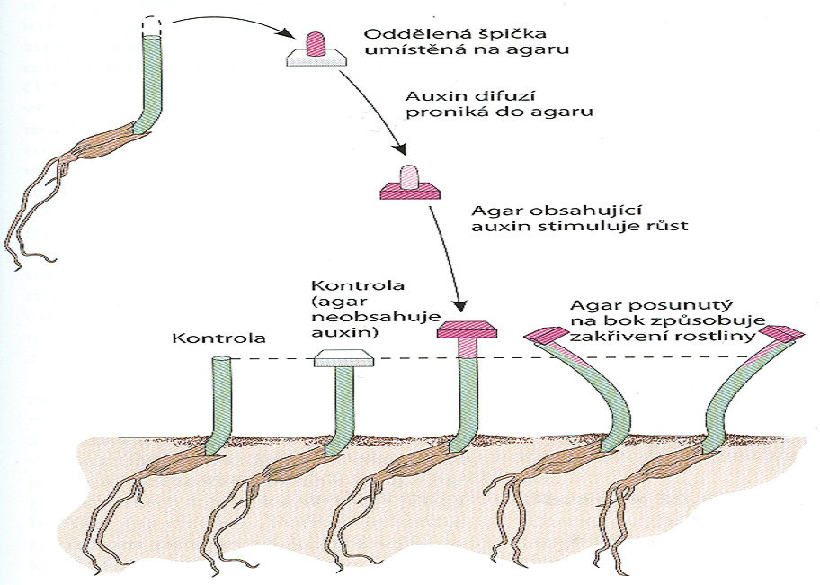
Auxin - discovery
Ústav experimentální botaniky AVČR, v.v.i., Praha
Katedra fyziologie rostlin PřF UK, Praha
F.W. Went,
1924-1928, Avena curvature test
Separated tip placed on agar block
Auxin diffusion into agar block
Auxin-containing agar stimulates growth
Control with agar block without auxin
Auxin in agar block placed on one side induces curvature
Control
Notes:
2

Slide 3
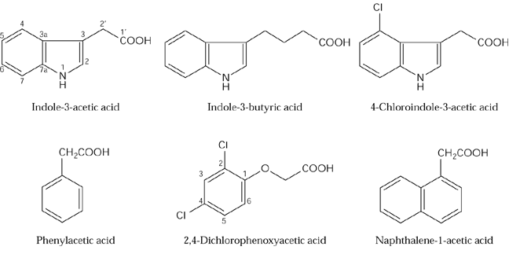
Auxins - low molecular weight organic acids
Ústav experimentální botaniky AVČR, v.v.i., Praha
Katedra fyziologie rostlin PřF UK, Praha
Native auxins are weak organic acids, biosynthesis in young, dividing cells, i.e. in meristems, embryos and developing fruits.
Indole-3-acetic acid (IAA)
Phenylacetic acid
Indole-3-butyric acid (IBA)
4-Chloroindole-3-acetic acid

Slide 4
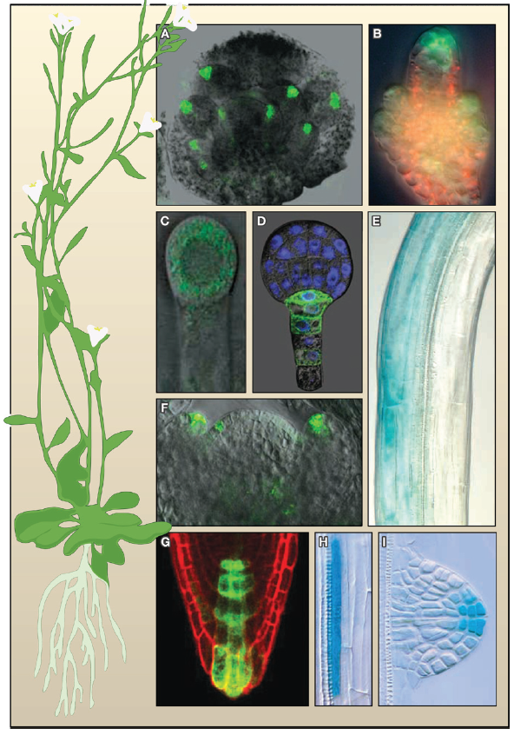
Auxin - the „morphogen“ of seed plants
Auxin
(indole-3-acetic acid, IAA)
weak organic acid
Vanneste and Friml, Cell 136, 1005-1016, 2009
Lacek et al., eLS, 2017
Notes:
Morphogenic action of auxin
Plant hormone auxin is fundamental for almost all aspects of plant development. From early embryogenesis, throught the development of root and shoot, lateral organs to the generative development. In a very general view, auxin concentration gradients controls at several levels mainly the processes of cell elongation and cell division.
Figure 1. Patterns of Auxin Distribution during Arabidopsis Development Distribution of auxin activity as visualized by the activity of auxin response reporters expressing green fluorescent protein (DR5rev::GFP) (A, B, C, D, F, and G) and DR5::GUS (E, H, and I). The following are locations of auxin activity: (A) tips of floral organ primordia within developing flowers, (B) the tip of the ovule primordium, (C) the apical cell of a divided zygote, (D) a root pole of the globular stage embryo, (E) the shade side of the photostimulated hypocotyls, (F) the position of incipient organ initiation and tips of flower primordia at the shoot meristem, (G) the root apical meristem, (H) lateral root initiation site, (I) and the tip of the emerging lateral root primordium. Image in (C) is reprinted with permission from Macmillan Publishers Ltd: Nature 426, 147–153, copyright (2003).
Image in (D) is reprinted with permission from Macmillan Publishers Ltd: Nature 415, 806–809, copyright (2002).

Slide 5
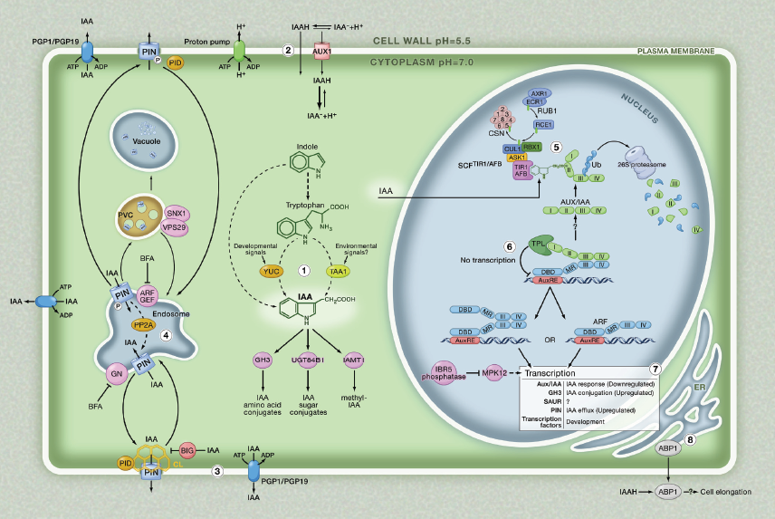
Auxin action
Weijers and Friml, Cell 136, 1172, 2009
Notes:
Concentration gradients of auxin within plant tissues are generated by local biosynthesis, metabolic conversions as well as directional transport. Auxin action - downstream efects.

Slide 6
Auxin - physiological effects
Ústav experimentální botaniky AVČR, v.v.i., Praha
Katedra fyziologie rostlin PřF UK, Praha
It plays the role in almost all stages of plant development from the embryogenesis, through the correct development of roots, stems, leafs and flowers, to the fruit development and abscission
Embryogenesis
- auxin in the apical cell after the zygote cell division, later on the maximum is shifted into the hypophysis and uppermost suspensor cell
DR5rev::GFP
DR5::GFP
Friml et al., Nature 426, 147-153, 2003

Slide 7
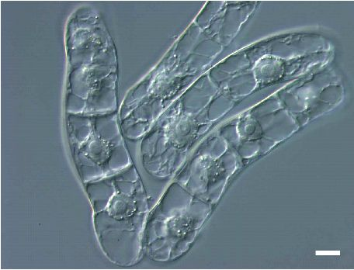
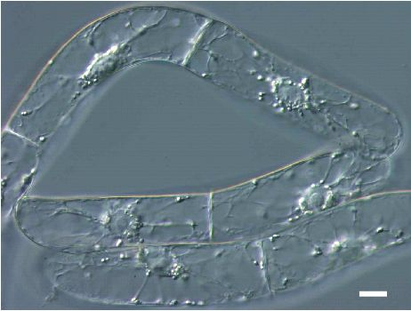
Auxin - physiological effects
Ústav experimentální botaniky AVČR, v.v.i., Praha
Katedra fyziologie rostlin PřF UK, Praha
It is essential for the cell division in the in vitro-grown plant cell suspensions
DR5rev::GFP
+ Auxin
- Auxin
Suspension culture of tobacco BY-2

Slide 8
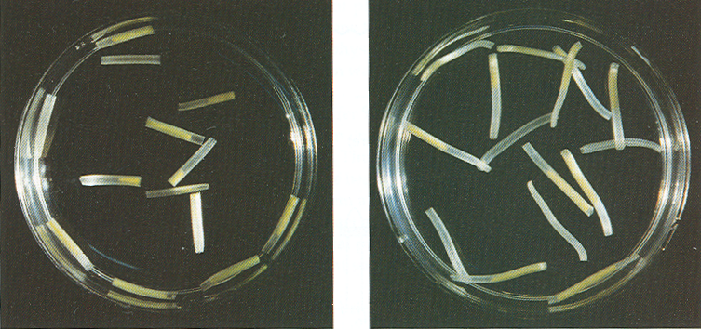
Auxin - physiological effects
Ústav experimentální botaniky AVČR, v.v.i., Praha
Katedra fyziologie rostlin PřF UK, Praha
Stimulation of elongation growth – oat coleoptile segments
H₂O
IAA
Notes:
8

Slide 9
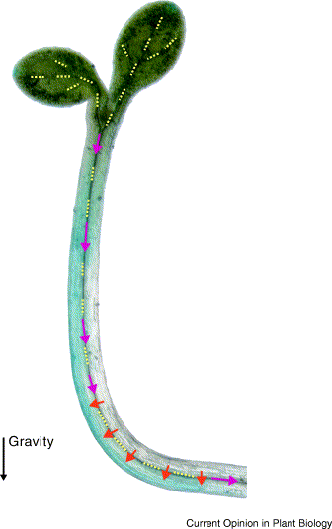
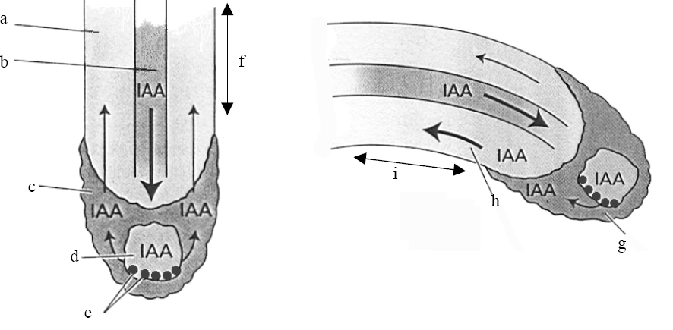
Auxin - physiological effects
Ústav experimentální botaniky AVČR, v.v.i., Praha
Katedra fyziologie rostlin PřF UK, Praha
Regulation of tropisms – root positive gravitropism and shoot negative gravitropism
Root gravitropism – downward bending:
- increasing amount of auxin at the lower side, where this concentration inhibits cell elongation
Shoot gravitropism – upward bending:
- increasing amount of auxin at the lower side, where this concentration activates cell elongation
DR5rev::GFP
Paciorek et al. 2005, Nature 435 (7046), 1251-1256
Friml 2003, Current Opinion in Plant Biology 6, 1-6
Notes:
9

Slide 10
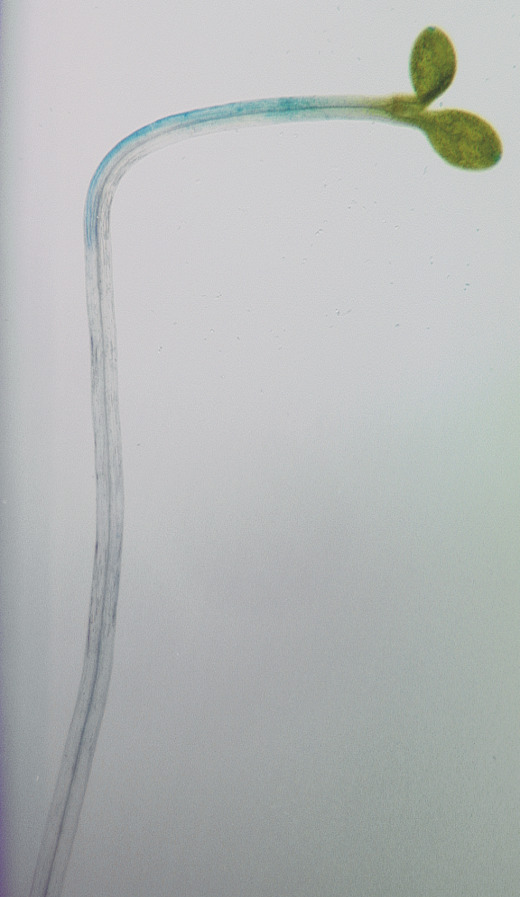
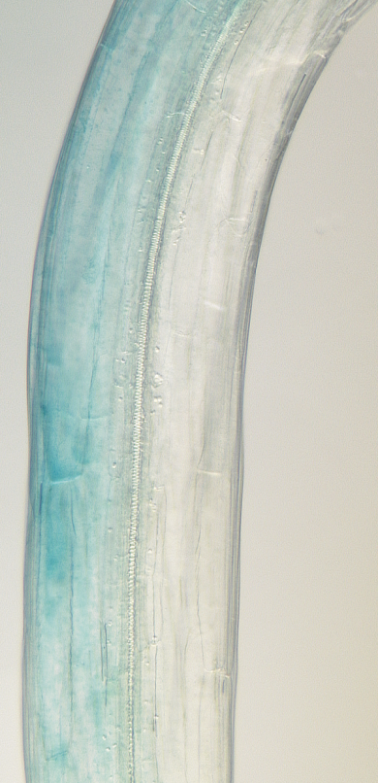
Auxin - physiological effects
Ústav experimentální botaniky AVČR, v.v.i., Praha
Katedra fyziologie rostlin PřF UK, Praha
DR5::GUS
light
Regulation of tropisms – shoot phototropism:
- accumulation of auxin at the shaded side of the stem, where this concentration stimulates cell elongation
- auxin relocation is seemingly related to the phosphorylation cascades triggered by light perception with phototropin
Notes:
10

Slide 11
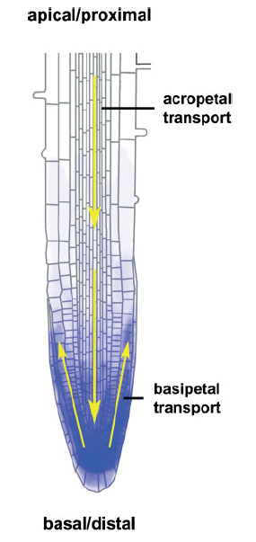
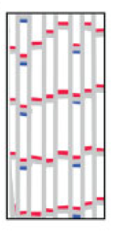
Auxin - directional transport
Ústav experimentální botaniky AVČR, v.v.i., Praha
Katedra fyziologie rostlin PřF UK, Praha
Plant
Direction of auxin flow
Root
Auxin efflux carrier
Auxin influx carrier
Parenchyma protophloem cells
(Modified from Grebe, BioEssays 26, 719, 2004)
Notes:
11

Slide 12
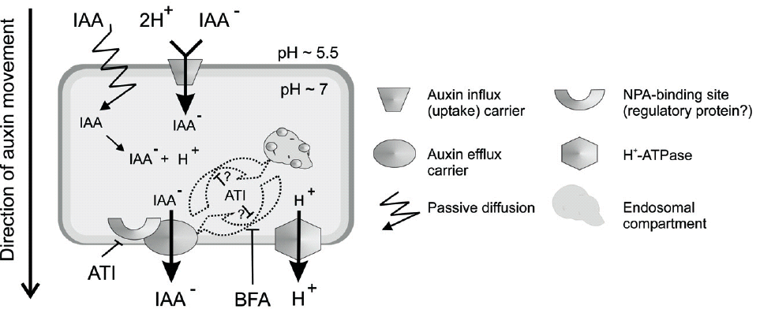
Auxin - directional transport
Ústav experimentální botaniky AVČR, v.v.i., Praha
Katedra fyziologie rostlin PřF UK, Praha
Besides long distance transport in vasculatore, specializes auxin influx and efflux carriers are used for transport of auxin across membrane
Petrášek and Zažímalová 2006, Tobacco BY-2 Cells: From Cellular Dynamics to Omics
Series: Biotechnology in Agriculture and Forestry Vol. 58, 107-115

Slide 13
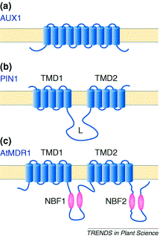
Auxin - directional transport
Ústav experimentální botaniky AVČR, v.v.i., Praha
Katedra fyziologie rostlin PřF UK, Praha
Besides passive diffusion in undissociated form molecules of auxin (IAA⁻) are transported across membrane by specialized active transporters:
- AUX1/LAX – auxin influx carriers (a)
- PINs – auxin efflux carriers (b). Contain two transmembrane domains and one hydrophilic regulatory loop.
- MDRs (PGPs) – auxin efflux carriers (c). Contain two transmembrane domains (TMD) and two nucleotide binding folds (NBF) for ATP binding.
Luschnig, Trends in Plant Science 7, 329-332, 2006

Slide 14
Co-operation of auxin transporters in planta
Petrášek and Friml, Development 136, 2675-2688, 2009
Notes:
Although a numerous developmental roles of PINFORMED (PIN) auxin efflux carriers are well established, there is still very limited knowledge on mechanisms defining their distribution and function within the plasma membrane (PM). In planta, individual members of PIN protein family facilitate cell-to-cell auxin transport in various cell types, being important for patterning processes as well as response to many environmental cues. These functions are described largely based on the tissue-specific expression of individual PINs and their differential intracellular trafficking, rather than based on their PM distribution within specific nanodomains. Moreover, there is still complete lack of plant experimental systems allowing direct comparison of auxin carrier auxin-transporting role in one cell type.

Slide 15
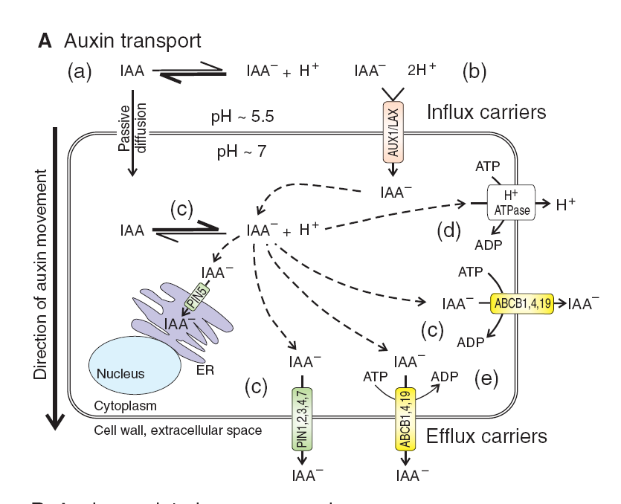
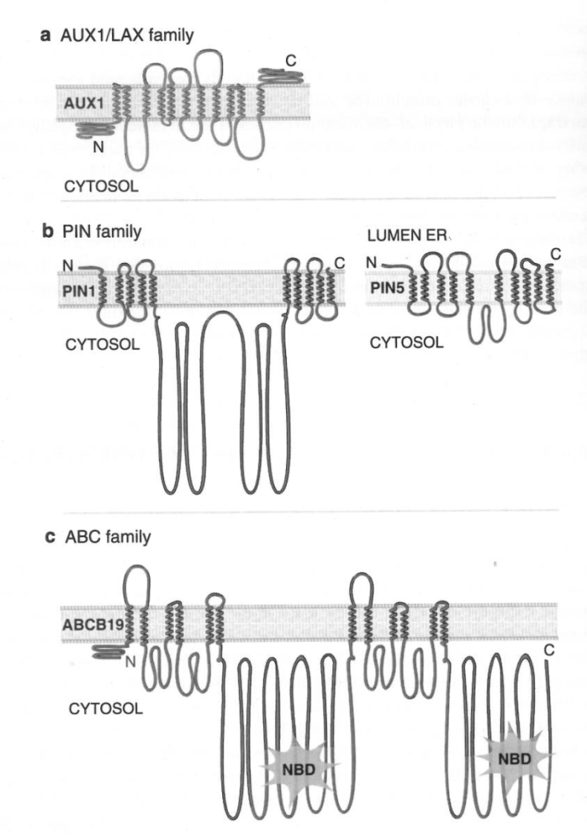
Transport of auxin across membranes
Petrášek and Friml, Development 136, 2675-2688, 2009
Petrášek et al., Signaling and Communication in Plants 7, 255-290, Springer, 2011
Notes:
Morphogenic action of auxin has been shown to be regulated by carrier-mediated cell-to-cell auxin transport.
Besides diffusion, auxin is transported across plasma membrane by the carrier-mediated transport.
Auxin carriers transport auxin across the plasma membrane (PM) as well as across some endomembranes.
They are integral plasma membrane (PM) proteins that are constitutively recycled between the PM and endosomal compartments.

Slide 16
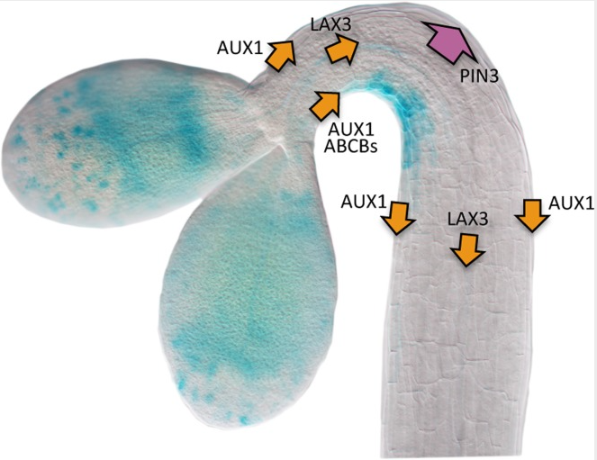
Carrier-mediated auxin influx during
apical hook development
Ústav experimentální botaniky AVČR, v.v.i., Praha
Katedra fyziologie rostlin PřF UK, Praha
Abbas et al., Frontiers in Plant Science 4:441, 2013

Slide 17
Auxin - directional transport
Ústav experimentální botaniky AVČR, v.v.i., Praha
Katedra fyziologie rostlin PřF UK, Praha
The dynamics of the accumulation of radiactively-labelled auxin inside tobacco cells reflects the activity of auxin carriers as well as diffusion across membrane. After inhibition of auxin efflux carrier with NPA or BFA, auxin is accumulated inside cells.
BFA
NPA
0.8
2
1.6
0.6
Net ³H-NAA accumulation
(pmol . 10⁻⁶ cells)
1.2
0.4
0.8
0.2
0.4
0
0
Time (min)
Time (min)
Petrášek et al., Plant Physiology 131, 254-263, 2003

Slide 18
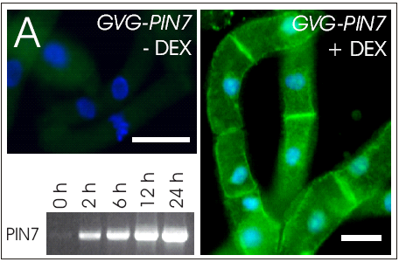
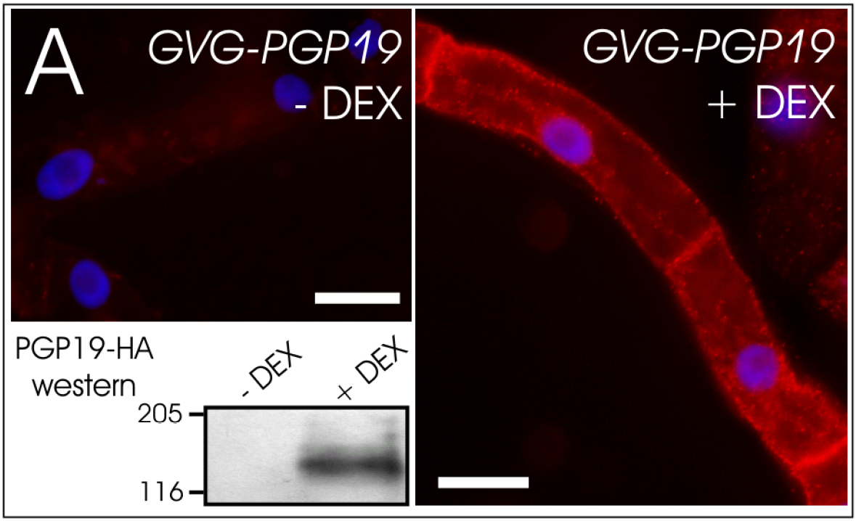
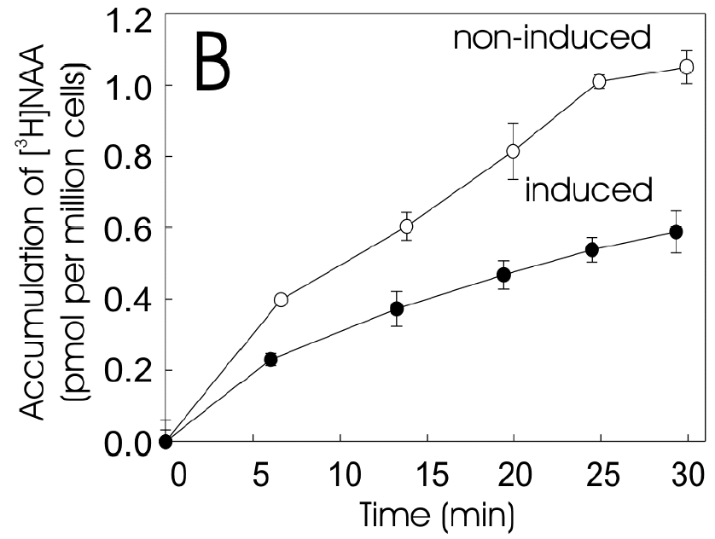
Carrier-mediated auxin efflux
Ústav experimentální botaniky AVČR, v.v.i., Praha
Katedra fyziologie rostlin PřF UK, Praha
PIN and PGP auxin efflux carriers expressed in model tobacco cells transport auxin out of cells (cells accumulate less of auxin)
Petrášek et al. 2006, Science 312, 914-918

Slide 19
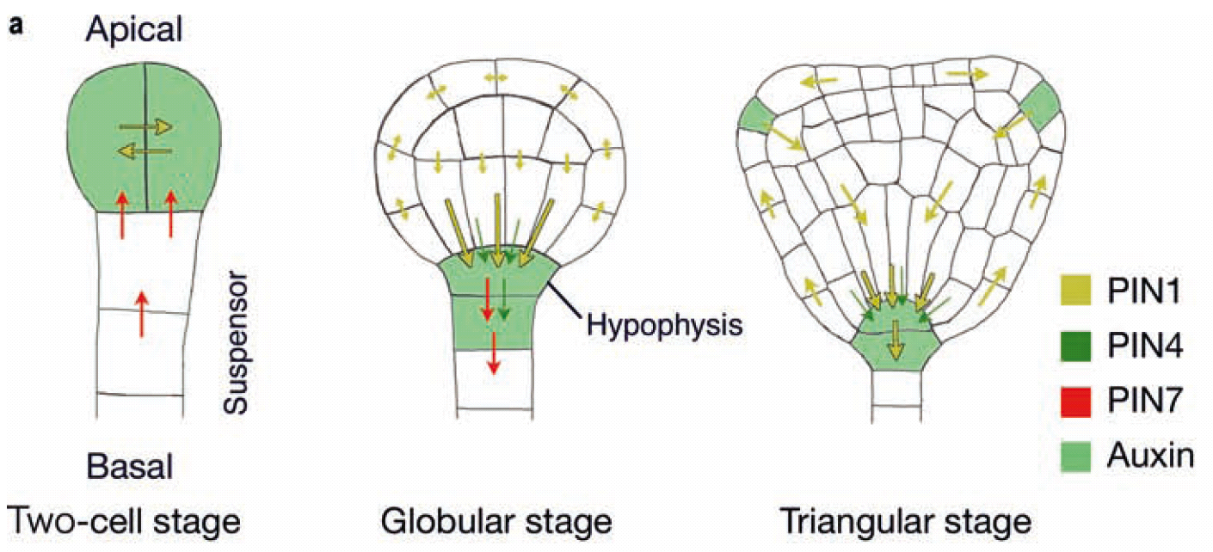
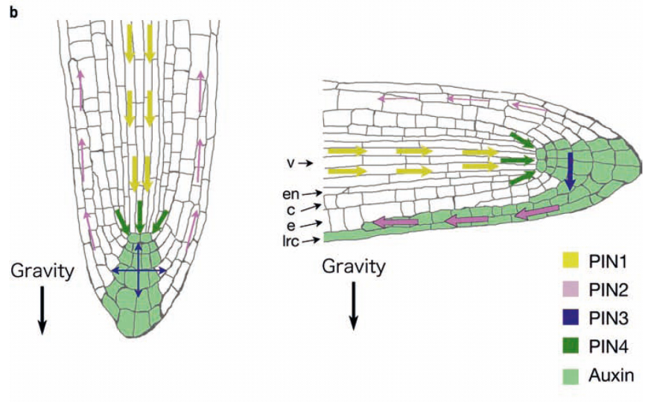
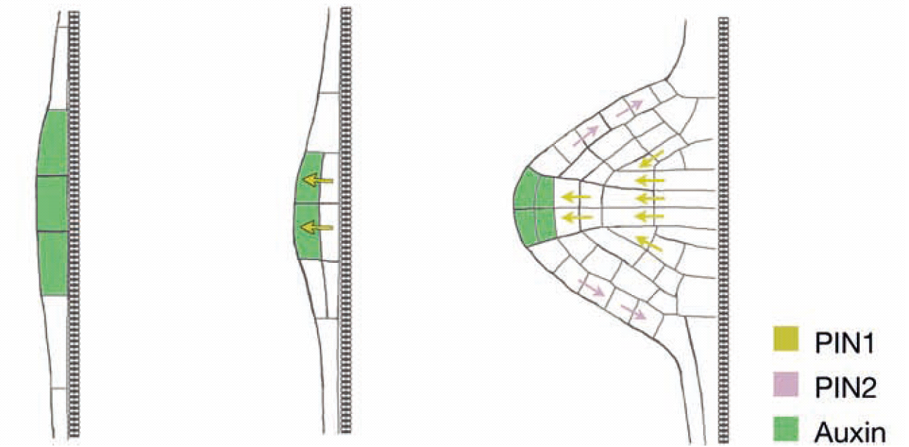
Auxin as morphogen
Ústav experimentální botaniky AVČR, v.v.i., Praha
Katedra fyziologie rostlin PřF UK, Praha
Setting and maintenance of plant morphogenesis is under the control of IAA gradients
Tanaka et al.,.Cell. Mol. Life Sci. 63, 2738–2754, 2006

Slide 20
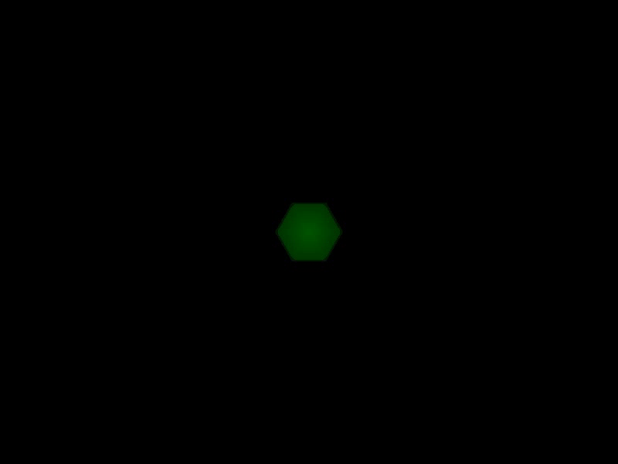
Auxin as morphogen
Ústav experimentální botaniky AVČR, v.v.i., Praha
Katedra fyziologie rostlin PřF UK, Praha
Phyllotaxis is influenced by the directional flow of auxin maintained by auxin transporters
Smith, R.S. et al. PNAS 103, 1301–1306, 2006
Kuhlemeier et al., Trends Plant Sci 12, 143 -150, 2007.

