Slide 1





2. Experimental data processing procedures, practical hints and tips
2.1 Organization of work, type of data
Necessity of continuous processing of experimental data
- Avoid following approach: „ I am experimenting this year. During the next one I am going to evaluate what I got“
- Miscellaneous software is in every-day use
Types od data:
- Numerical data - raw data or data converted to the numerical form, may be obtained with simple tools (ruler etc.) or more complex instrumentation (spectrophotometer, etc.)
- Graphical data - very frequent type of data, their quantification is extremely important
- Structural data - analytical data, outcomes from sequencing machines, mass spectrometers, etc.
B130P16E: Practical basics of scientific work Department of Experimental Plant Biology, FS CU https://lhr.ueb.cas.cz/petrasek/B130P16E.htm

Slide 2
2. Experimental data processing procedures, practical hints and tips
2.1 Organization of work, type of data
Software used in modern laboratory:
- Software controlling machines - very often quite complex. For the user, the most important is the form of the output (table, text)
- General, „office“-type software - text and spreadsheet editors, graphical software, presentation software, typically products of Microsoft at the Charles University
- Specialized software - very important in the field of image analysis and processing of sequence data
- Open source software - very good tools, often problems with the compatibility
- Online software - mainly in bioinformatics, structure analysis, but there are also a plenty of software available for various office applications
B130P16E: Practical basics of scientific work Department of Experimental Plant Biology, FS CU https://lhr.ueb.cas.cz/petrasek/B130P16E.htm

Slide 3
2. Experimental data processing procedures, practical hints and tips
2.1 Organization of work, type of data
Windows Explorer or similar software (Windows Commander)
Individual folders should be named according to their date, ideally as YYMMDD (211104). The date must correspond well to the one in the laboratory book.
Never modify folder with raw data - copying to the folder with other files accompanying the experiment.
Back up data - external HDD, shared laboratory HDD drives, or online cloud repositories.
Do not postpone back-uping!!!
Experiment must be always finished with complete documentation, do not start the new one without finishing the previous.
B130P16E: Practical basics of scientific work Department of Experimental Plant Biology, FS CU https://lhr.ueb.cas.cz/petrasek/B130P16E.htm

Slide 4
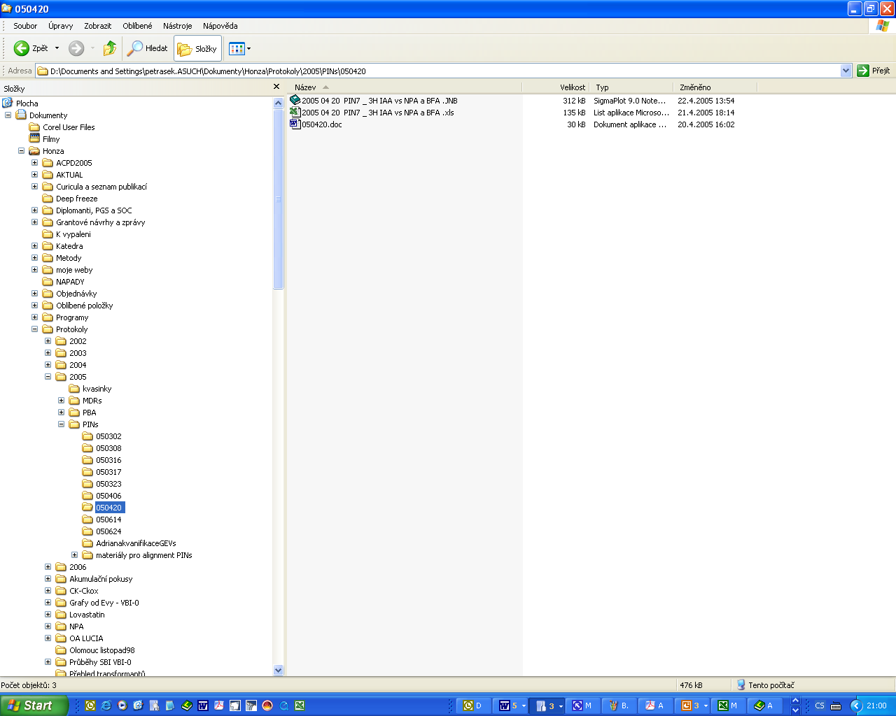
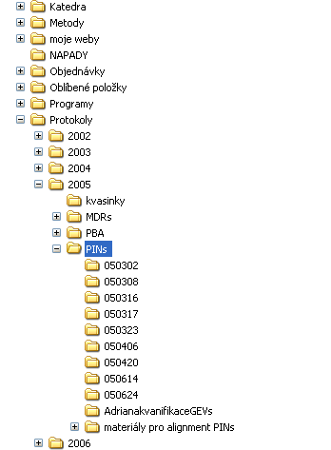
2. Experimental data processing procedures, practical hints and tips
2.2 Data explorers, correct data handling and saving
Windows Explorer
B130P16E: Practical basics of scientific work Department of Experimental Plant Biology, FS CU https://lhr.ueb.cas.cz/petrasek/B130P16E.htm

Slide 5
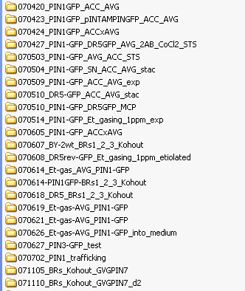
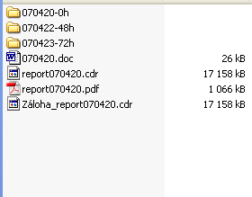
2. Experimental data processing procedures, practical hints and tips
2.2 Data explorers, correct data handling and saving
B130P16E: Practical basics of scientific work Department of Experimental Plant Biology, FS CU https://lhr.ueb.cas.cz/petrasek/B130P16E.htm

Slide 6
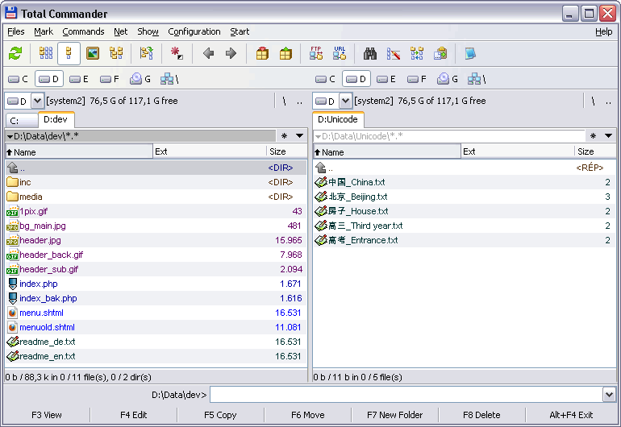

2. Experimental data processing procedures, practical hints and tips
2.2 Data explorers, correct data handling and saving
Total Commander
- shareware
- the biggest advantage is the existence of two identical windows
B130P16E: Practical basics of scientific work Department of Experimental Plant Biology, FS CU https://lhr.ueb.cas.cz/petrasek/B130P16E.htm

Slide 7





2. Experimental data processing procedures, practical hints and tips
2.3 Spreadsheets, statistical software, graph editors
Bulk data processing, their editing and graphical output
Microsoft Excel - suitable for all basic operations including statistics and various graphical outputs
Specialised mathematical or statistical software - Statgraphics, NCSS, Matlab, or the open source alternative R
B130P16E: Practical basics of scientific work Department of Experimental Plant Biology, FS CU https://lhr.ueb.cas.cz/petrasek/B130P16E.htm

Slide 8
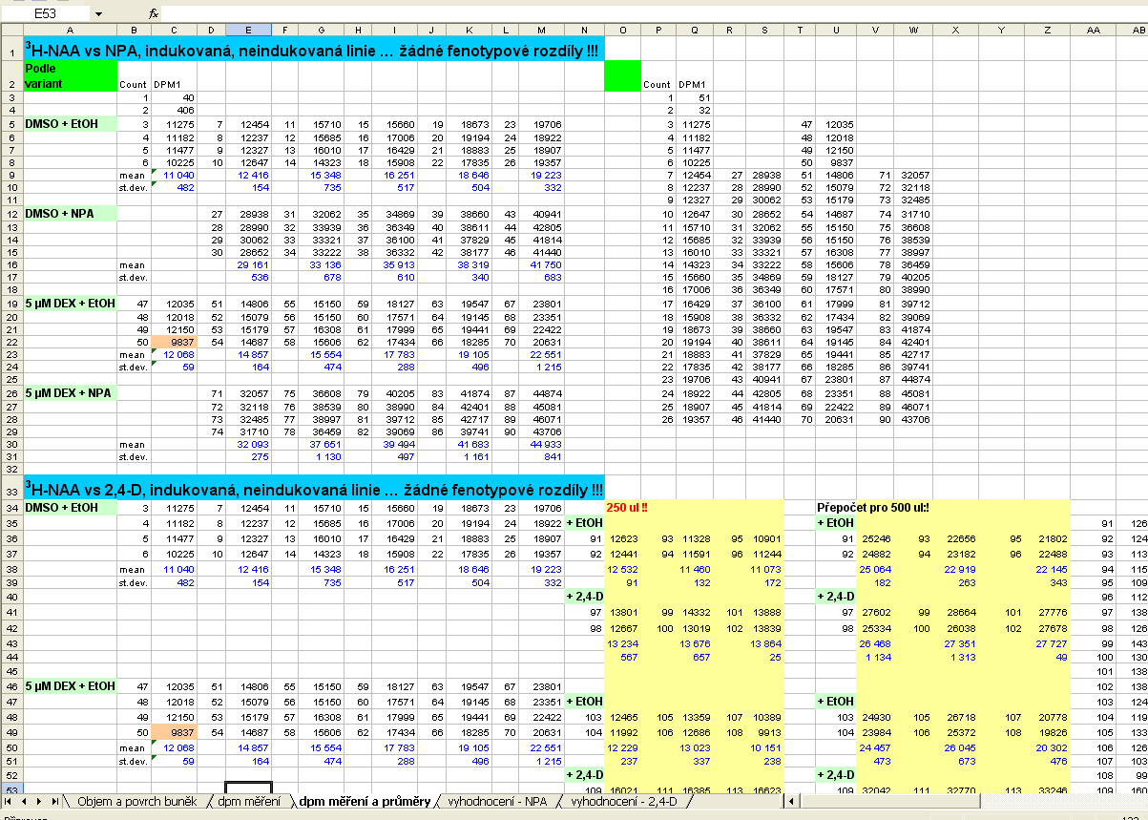
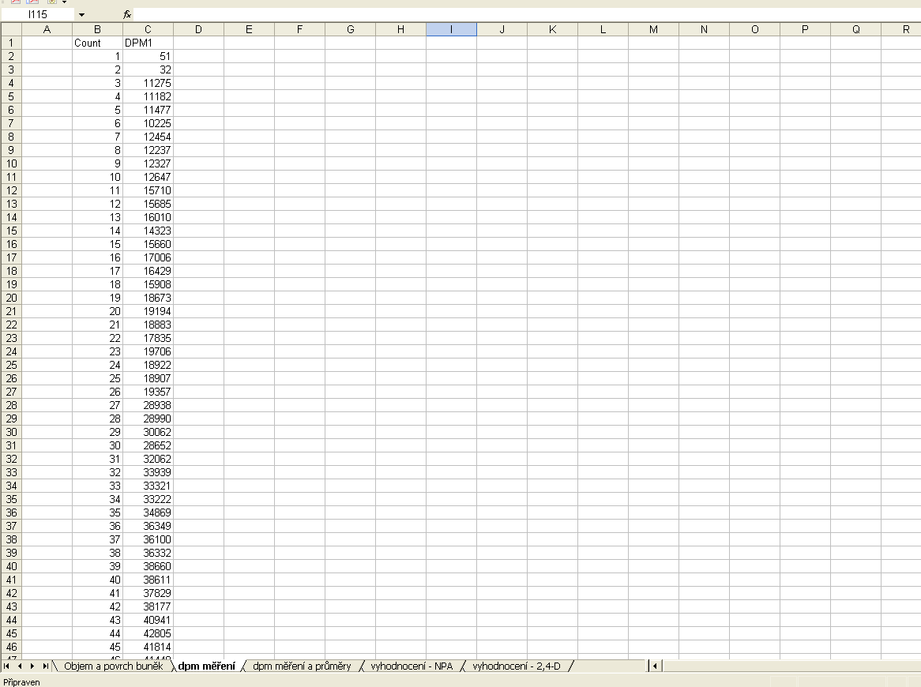
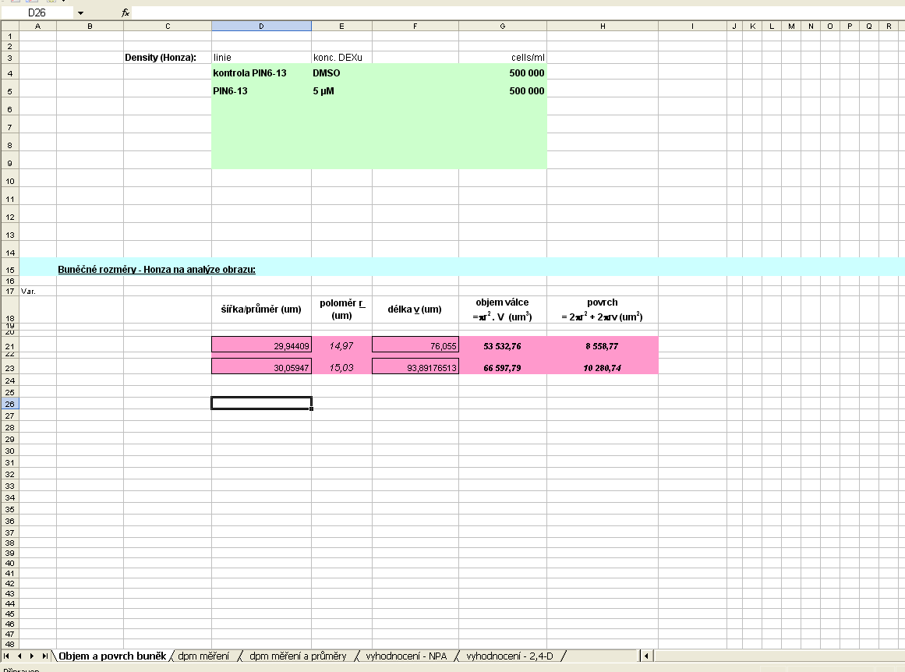
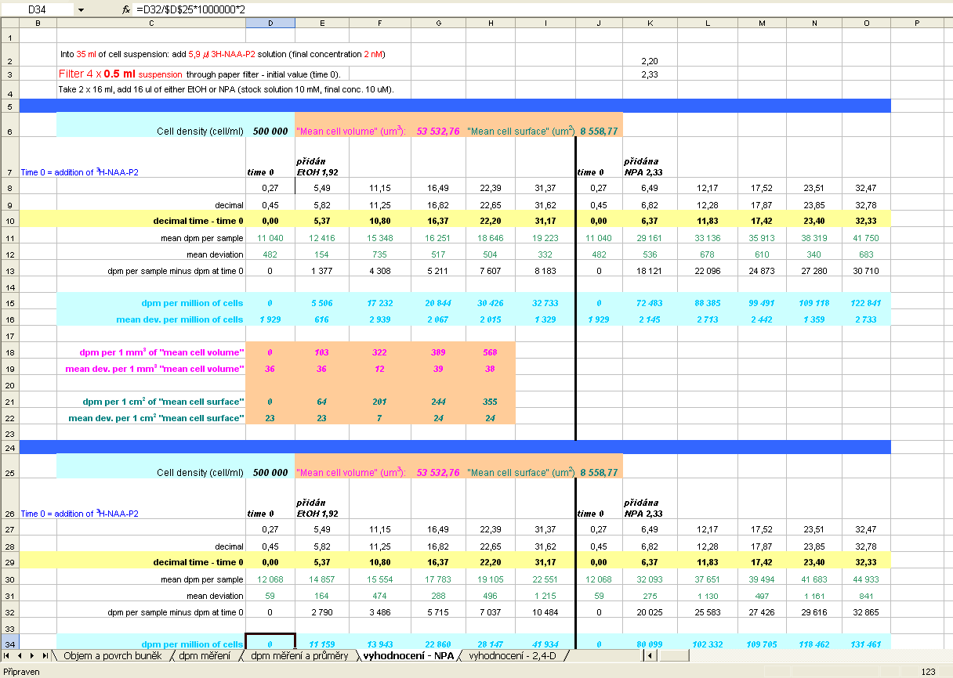
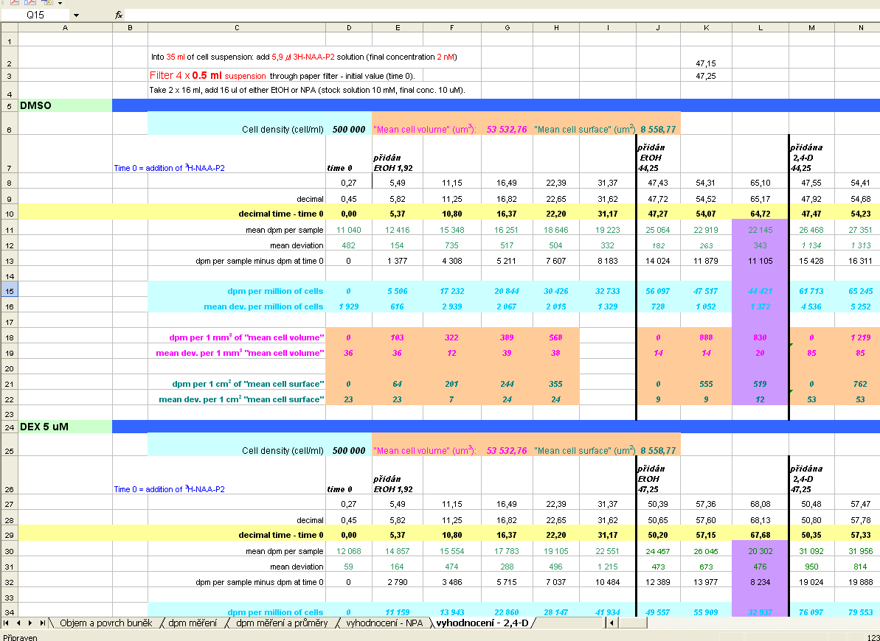
2. Experimental data processing procedures, practical hints and tips
2.3 Spreadsheets, statistical software, graph editors
Keeping a complete log of the experiment, automation of numerical operations
B130P16E: Practical basics of scientific work Department of Experimental Plant Biology, FS CU https://lhr.ueb.cas.cz/petrasek/B130P16E.htm

Slide 9
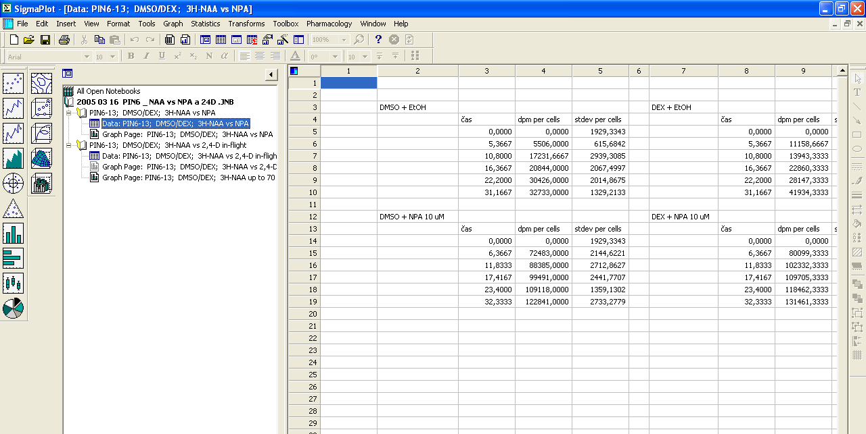
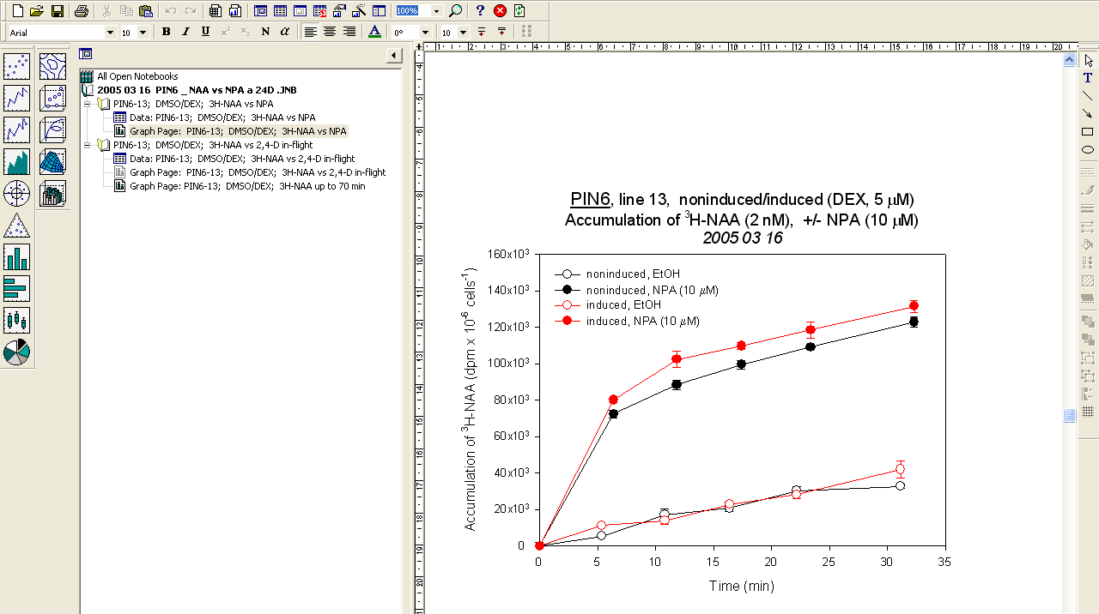
2. Experimental data processing procedures, practical hints and tips
2.3 Spreadsheets, statistical software, graph editors
Keeping a complete log of the experiment, automation of numerical operations
B130P16E: Practical basics of scientific work Department of Experimental Plant Biology, FS CU https://lhr.ueb.cas.cz/petrasek/B130P16E.htm

Slide 10
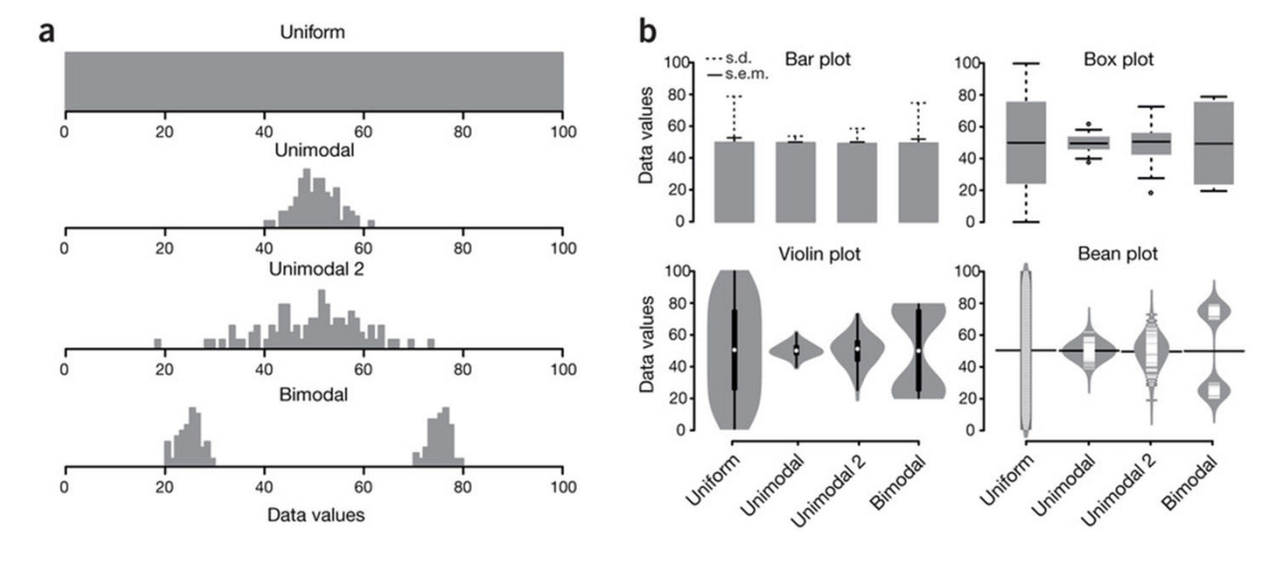
2. Experimental data processing procedures, practical hints and tips
2.3 Spreadsheets, statistical software, graph editors
Bar plot versus box plot - why is better?
Spitzer M, Wildenhain J, Rappsilber J, Tyers M (2014) BoxPlotR: a web tool for generation of box plots. Nat Methods 11:121–122.
B130P16E: Practical basics of scientific work Department of Experimental Plant Biology, FS CU https://lhr.ueb.cas.cz/petrasek/B130P16E.htm

Slide 11

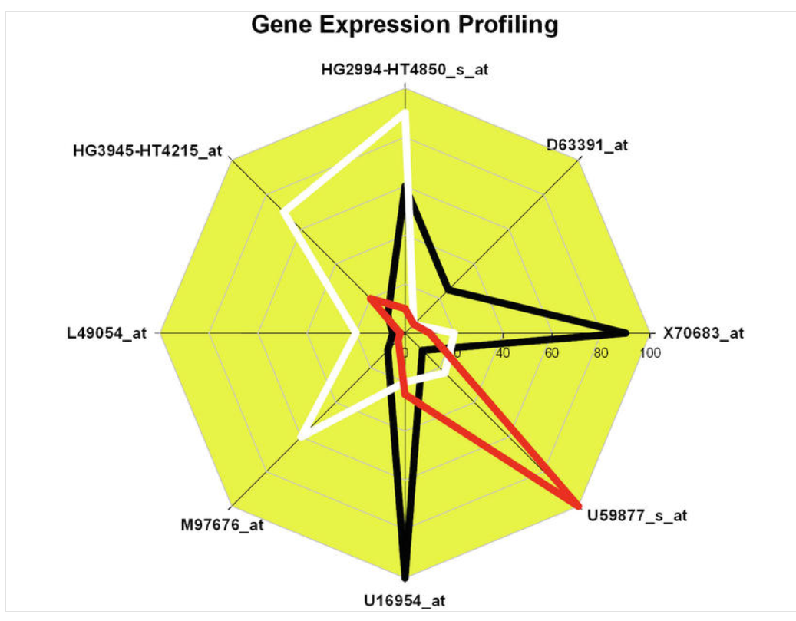
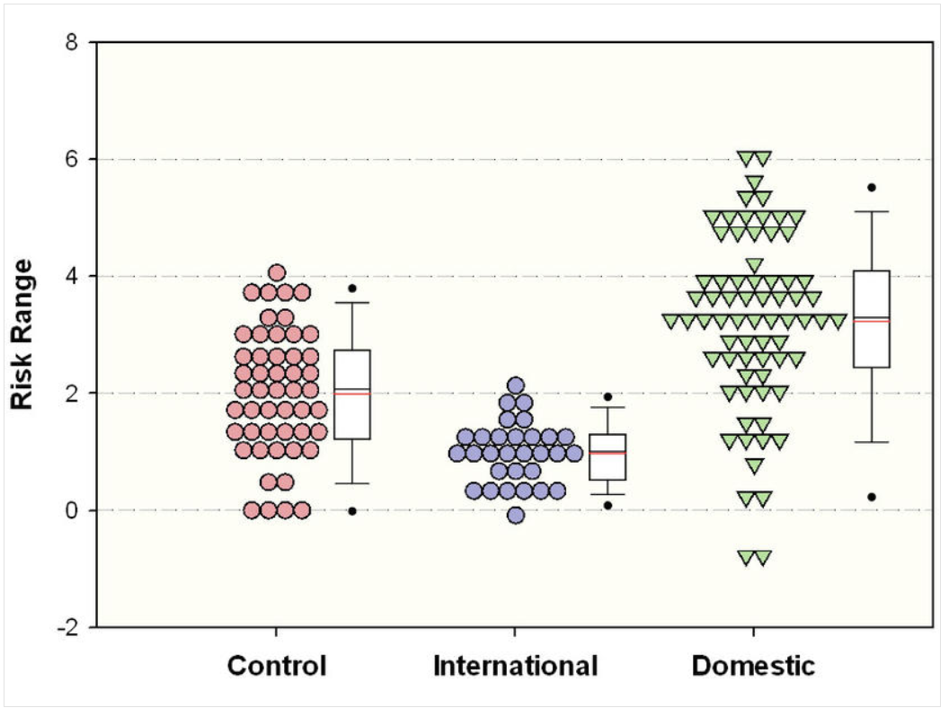
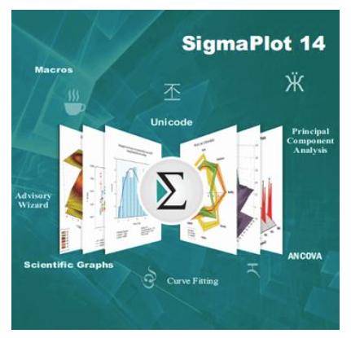
2. Experimental data processing procedures, practical hints and tips
2.3 Spreadsheets, statistical software, graph editors
Creating graphs - line/scatter plots, bar charts, box plots, histograms
B130P16E: Practical basics of scientific work Department of Experimental Plant Biology, FS CU https://lhr.ueb.cas.cz/petrasek/B130P16E.htm

Slide 12

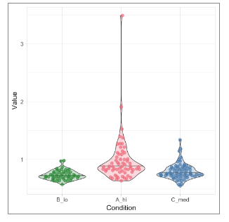
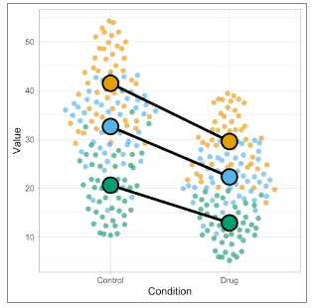
2. Experimental data processing procedures, practical hints and tips
2.3 Spreadsheets, statistical software, graph editors
Creating graphs - line/scatter plots, bar charts, box plots, histograms
In biology, it is good to plot all data together with their summaries and statistics
Shiny apps - R-based web tools for creating plots
PlotsOfData
SuperPlotsOfData
B130P16E: Practical basics of scientific work Department of Experimental Plant Biology, FS CU https://lhr.ueb.cas.cz/petrasek/B130P16E.htm

Slide 13
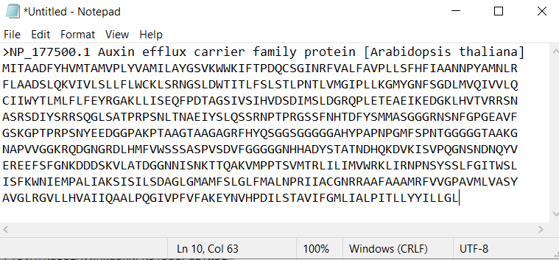
2. Experimental data processing procedures, practical hints and tips
2.4 Processing of structural and sequence data
Notepad - a digital notebook, which is still an invaluable helper
It is important not to use formatting to write nucleotide or amino acid sequences
The most commonly used is the so-called FASTA format
B130P16E: Practical basics of scientific work Department of Experimental Plant Biology, FS CU https://lhr.ueb.cas.cz/petrasek/B130P16E.htm

Slide 14
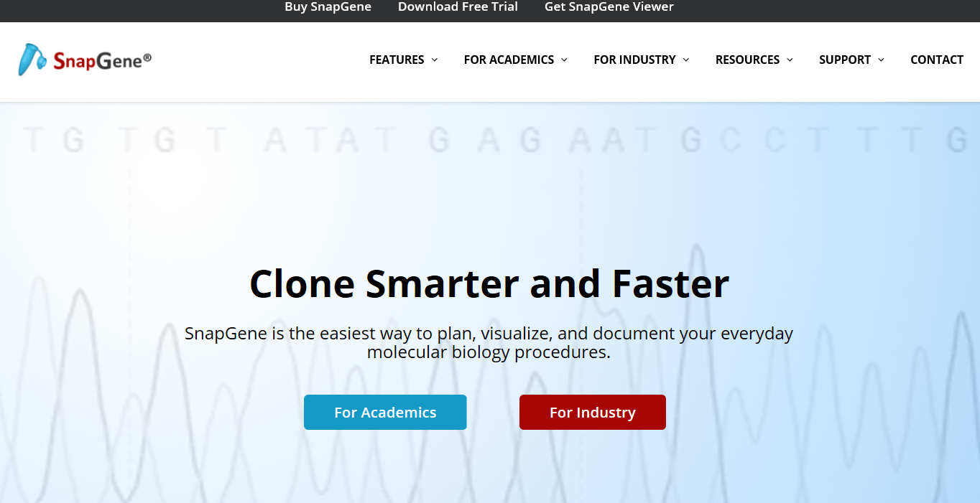
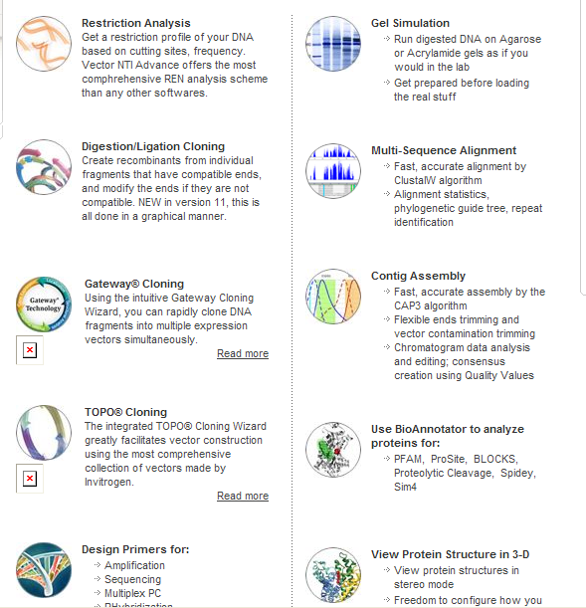

2. Experimental data processing procedures, practical hints and tips
2.4 Processing of structural and sequence data
SnapGene
Geneious
B130P16E: Practical basics of scientific work Department of Experimental Plant Biology, FS CU https://lhr.ueb.cas.cz/petrasek/B130P16E.htm

Slide 15
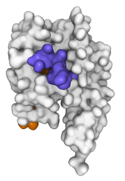
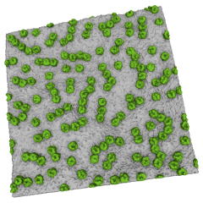
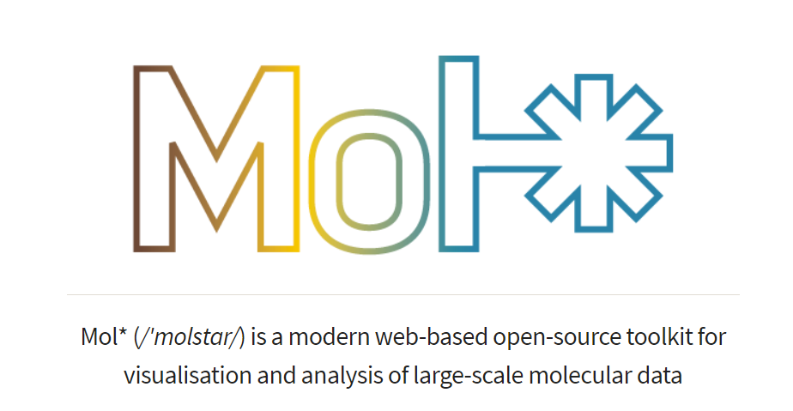
2. Experimental data processing procedures, practical hints and tips
2.4 Processing of structural and sequence data
3D structures of macromolecules – Molstar viewer
Sehnal et al., Nucleic Acids Res 49:W431–W437, 2021
B130P16E: Practical basics of scientific work Department of Experimental Plant Biology, FS CU https://lhr.ueb.cas.cz/petrasek/B130P16E.htm

Slide 16

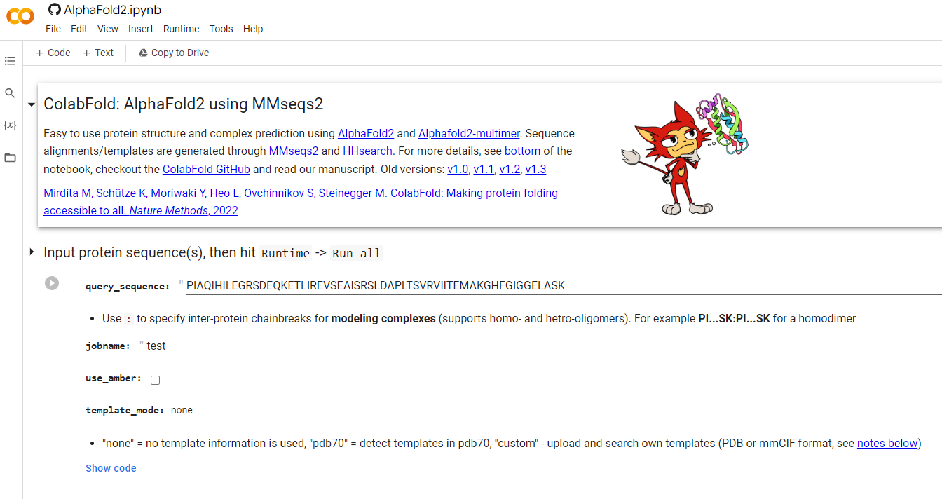
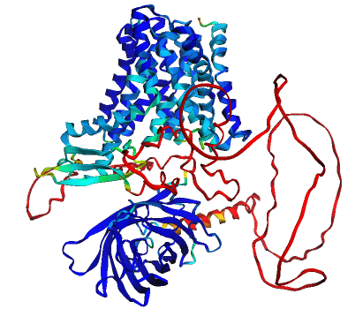
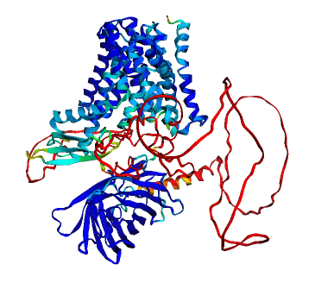
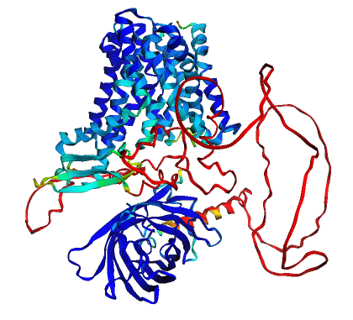
2. Experimental data processing procedures, practical hints and tips
2.4 Processing of structural and sequence data
3D structures of macromolecules - AI-based solution for „in silico“ translation
NtPIN2T
NtPIN3bT
NtPIN11T
B130P16E: Practical basics of scientific work Department of Experimental Plant Biology, FS CU https://lhr.ueb.cas.cz/petrasek/B130P16E.htm

Slide 17
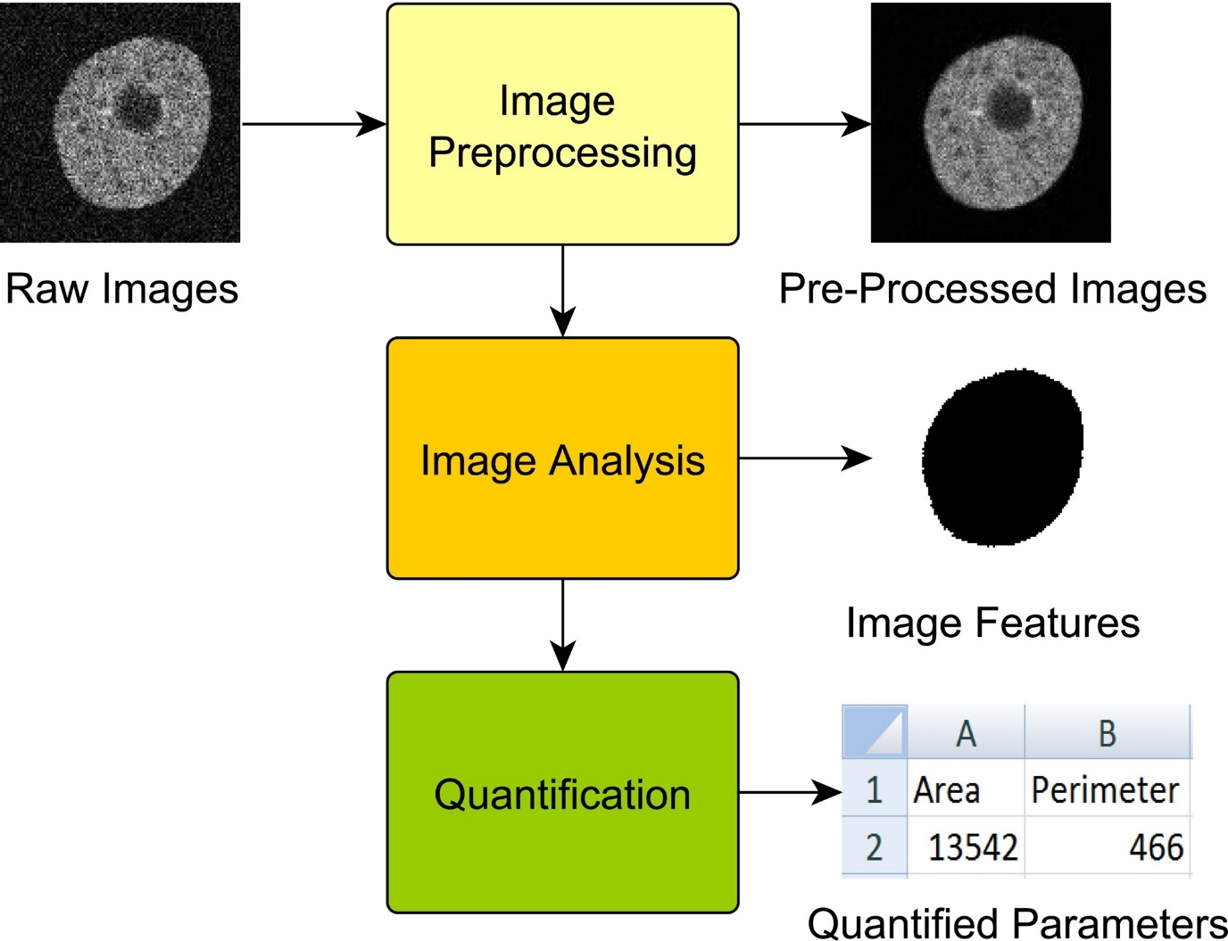
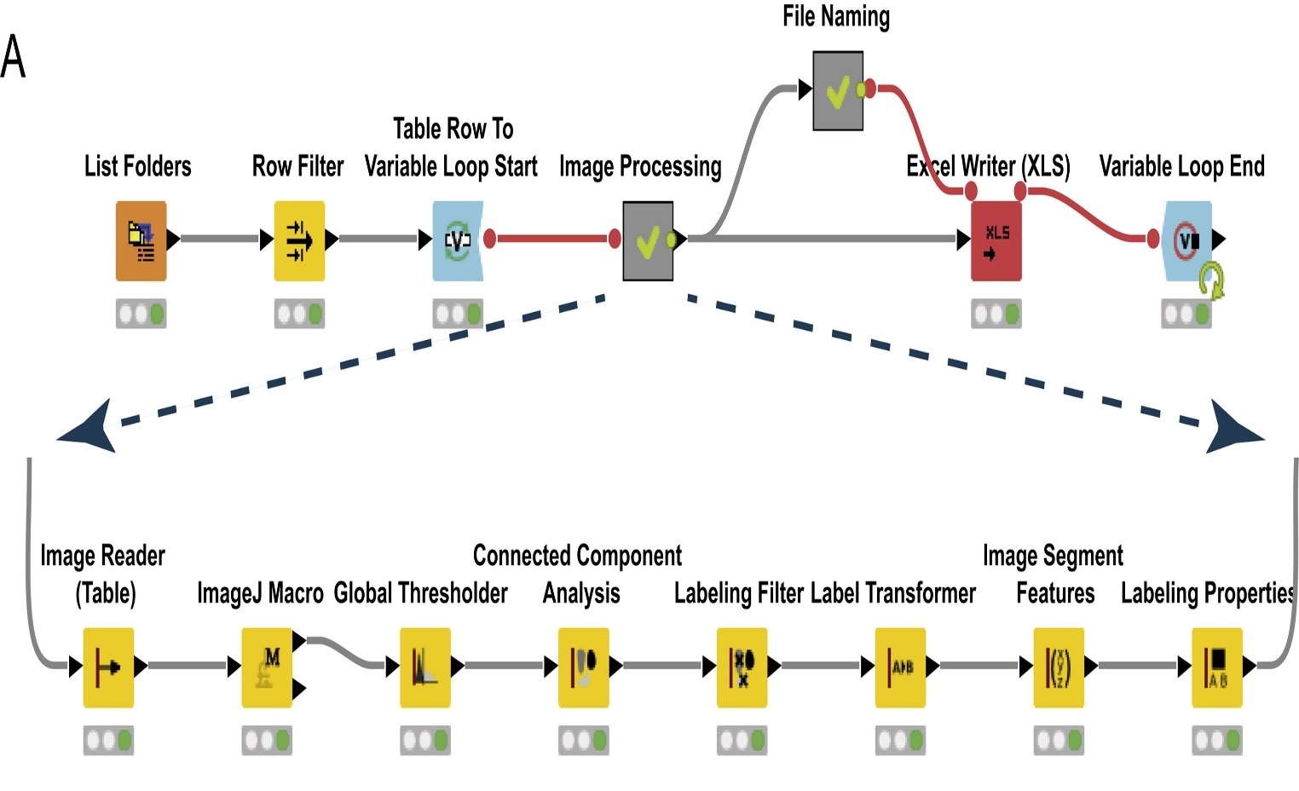
2. Experimental data processing procedures, practical hints and tips
2.5 Image analysis, graphical software, presentation software
The task of image analysis is to evaluate features that are often not apparent at first glance
Wollmann T et al., J Biotechnol 261:70-75, 2017
B130P16E: Practical basics of scientific work Department of Experimental Plant Biology, FS CU https://lhr.ueb.cas.cz/petrasek/B130P16E.htm

Slide 18
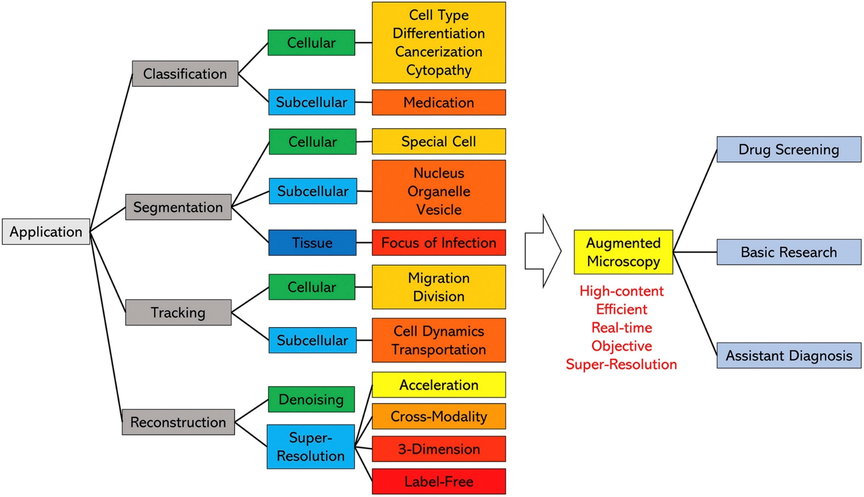
2. Experimental data processing procedures, practical hints and tips
2.5 Image analysis, graphical software, presentation software
Artificial intelligence in image analysis
Liu et al., Comput Biol Med 134:104523, 2021
B130P16E: Practical basics of scientific work Department of Experimental Plant Biology, FS CU https://lhr.ueb.cas.cz/petrasek/B130P16E.htm

Slide 19
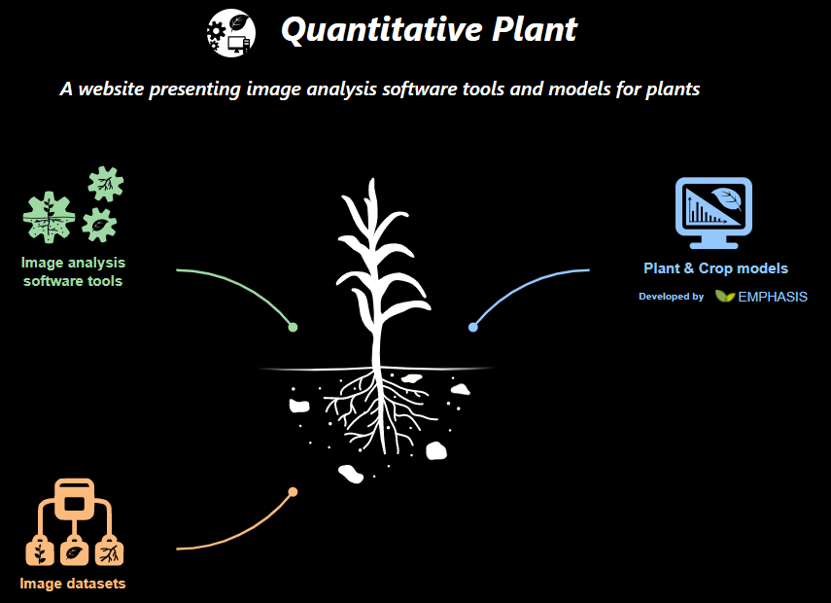
2. Experimental data processing procedures, practical hints and tips
2.5 Image analysis, graphical software, presentation software
Summary of image analysis tools for plant research
B130P16E: Practical basics of scientific work Department of Experimental Plant Biology, FS CU https://lhr.ueb.cas.cz/petrasek/B130P16E.htm

Slide 20
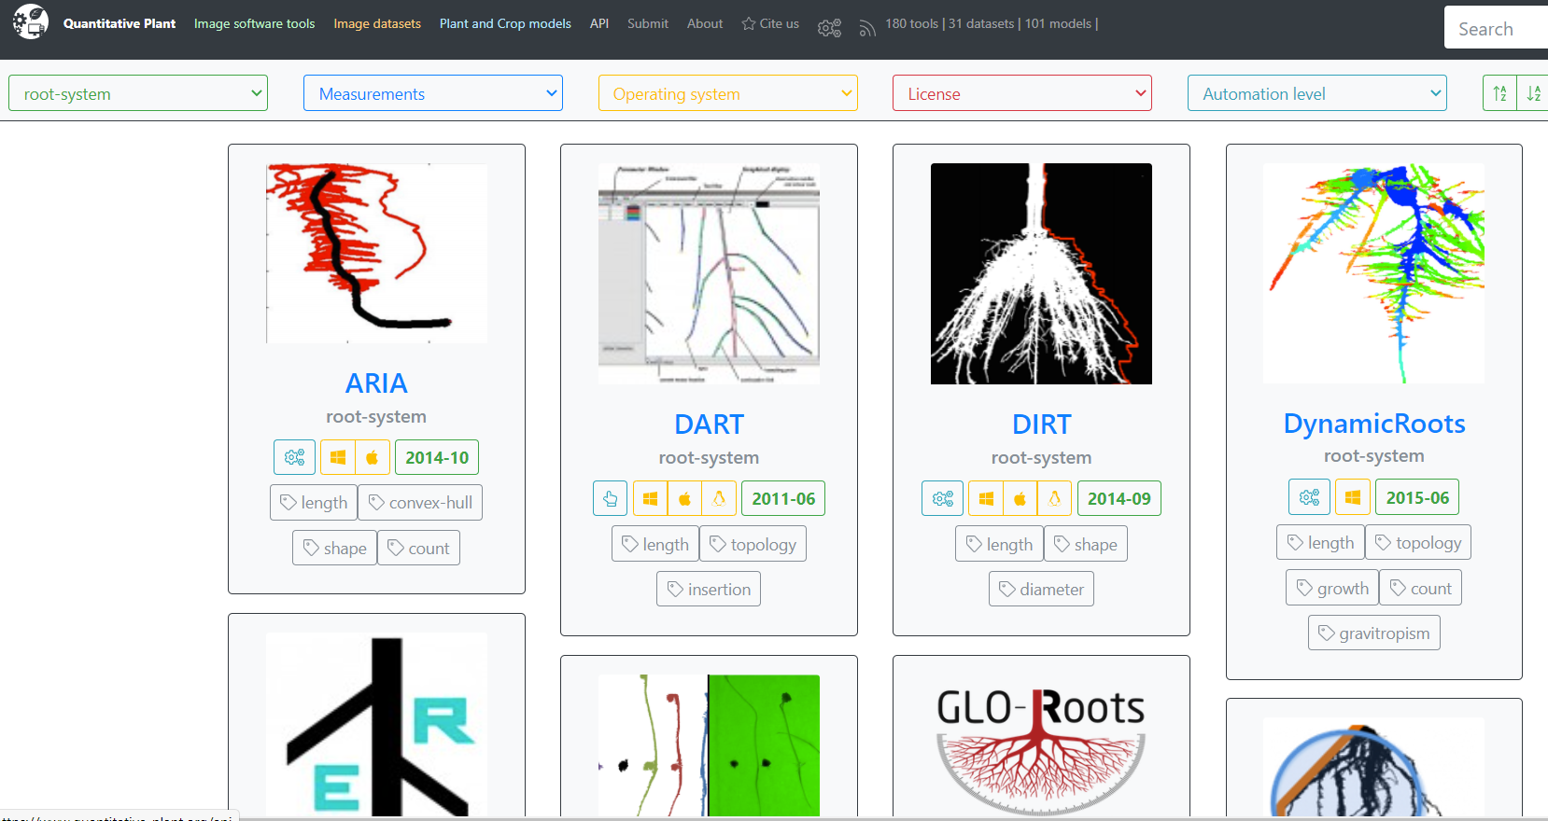
2. Experimental data processing procedures, practical hints and tips
2.5 Image analysis, graphical software, presentation software
Summary of image analysis tools for plant research
B130P16E: Practical basics of scientific work Department of Experimental Plant Biology, FS CU https://lhr.ueb.cas.cz/petrasek/B130P16E.htm

Slide 21
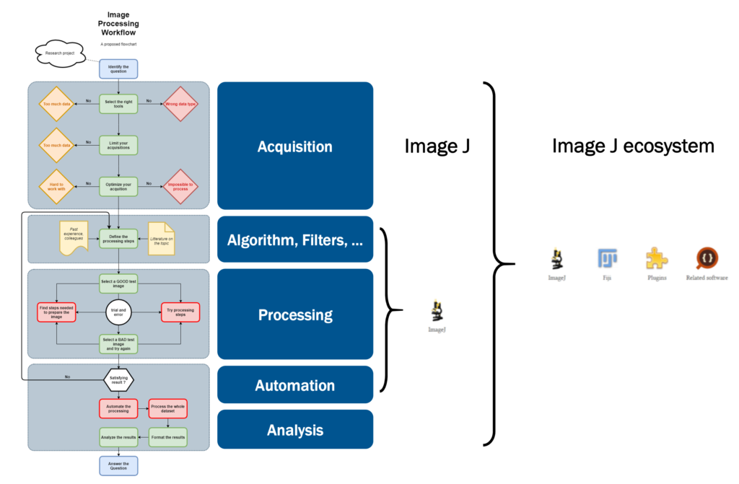
2. Experimental data processing procedures, practical hints and tips
2.5 Image analysis, graphical software, presentation software
ImageJ - open source image analysis
https://cif.unil.ch/cif-wiki/several-image-processing-workflow-examples/
B130P16E: Practical basics of scientific work Department of Experimental Plant Biology, FS CU https://lhr.ueb.cas.cz/petrasek/B130P16E.htm

Slide 22
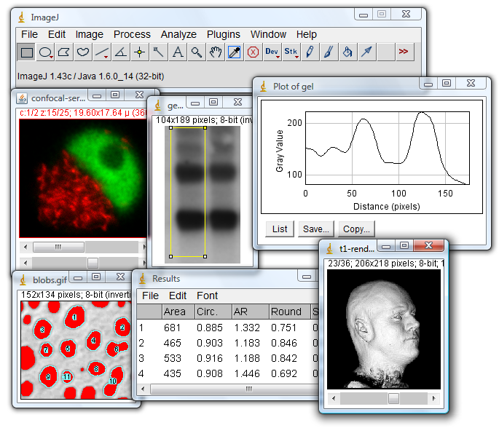


2. Experimental data processing procedures, practical hints and tips
2.5 Image analysis, graphical software, presentation software
ImageJ (NIH)
Fiji
Imaging tutorials
Scientific Imaging Tutorials (imagej.net)
http://rsb.info.nih.gov/ij/docs/concepts.html
B130P16E: Practical basics of scientific work Department of Experimental Plant Biology, FS CU https://lhr.ueb.cas.cz/petrasek/B130P16E.htm

Slide 23
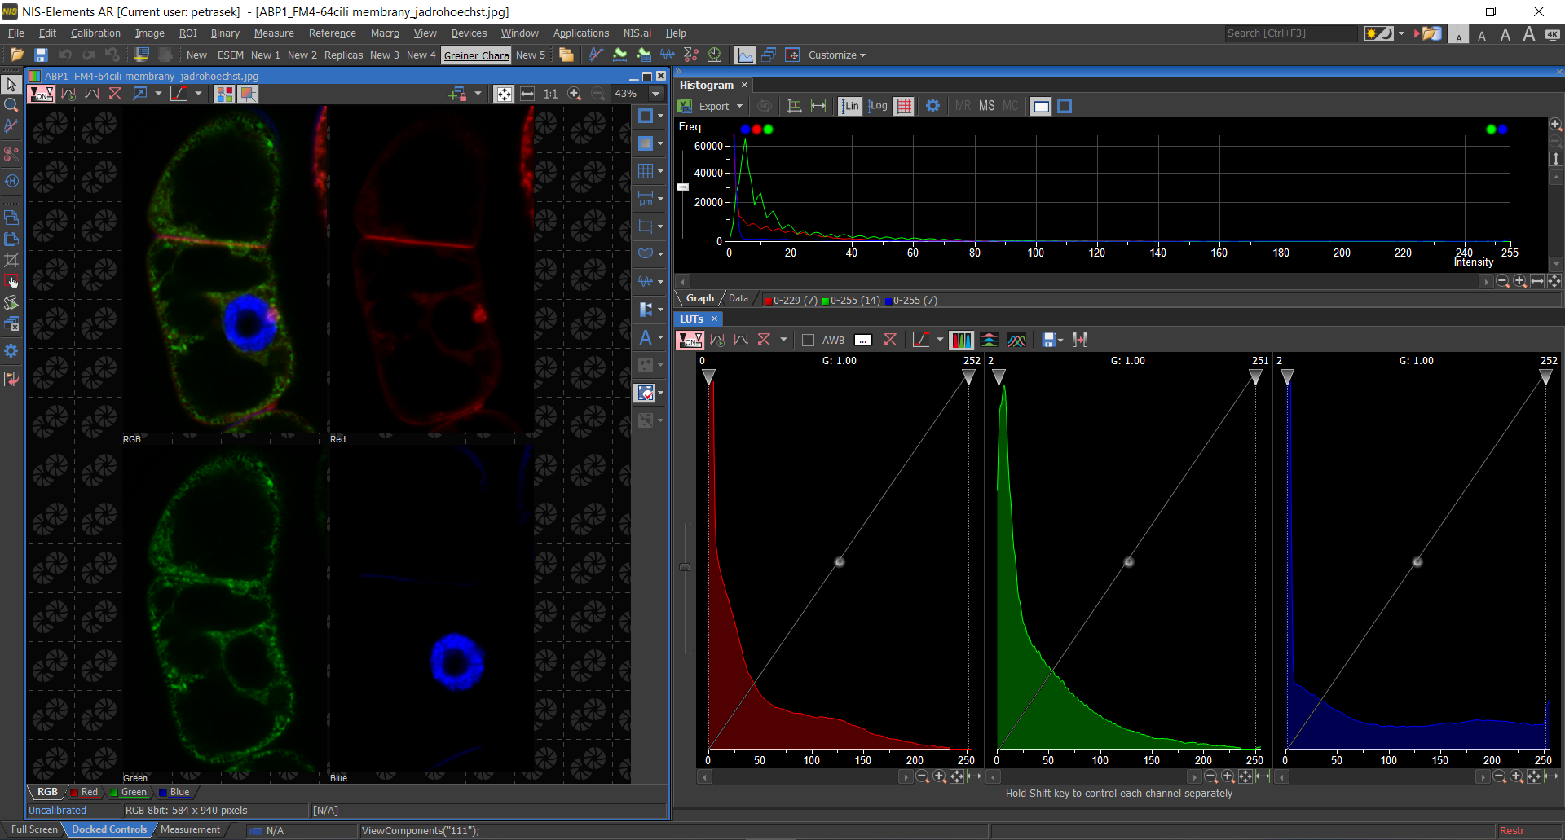
2. Experimental data processing procedures, practical hints and tips
2.5 Image analysis, graphical software, presentation software
NIS Elements – good example of commercially available, comprehensive image analysis tool
B130P16E: Practical basics of scientific work Department of Experimental Plant Biology, FS CU https://lhr.ueb.cas.cz/petrasek/B130P16E.htm

Slide 24
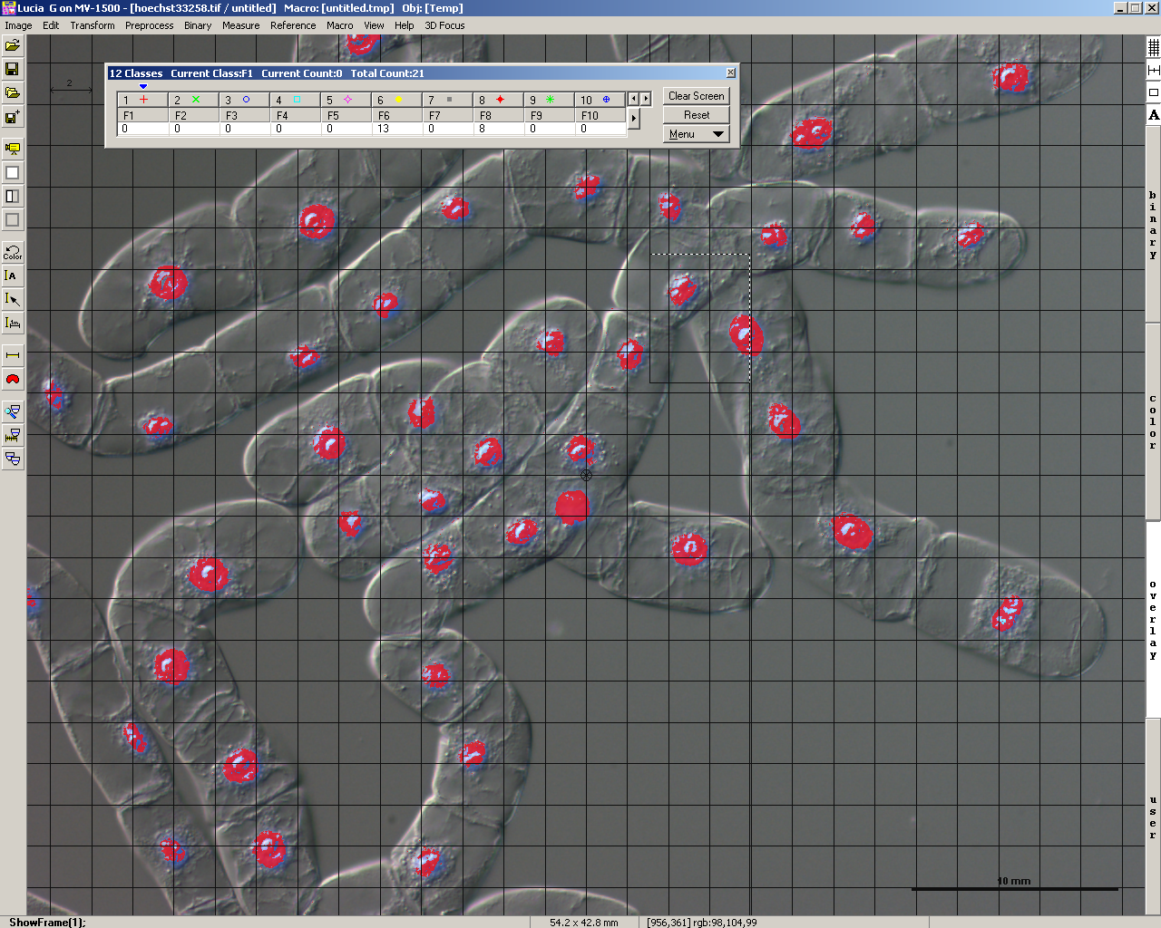
2. Experimental data processing procedures, practical hints and tips
2.5 Image analysis, graphical software, presentation software
NIS Elements – good example of commercially available, comprehensive image analysis tool
B130P16: Praktické základy vědecké práce Katedra experimentální biologie rostlin PřF UK https://lhr.ueb.cas.cz/petrasek/B130P16.htm

Slide 25
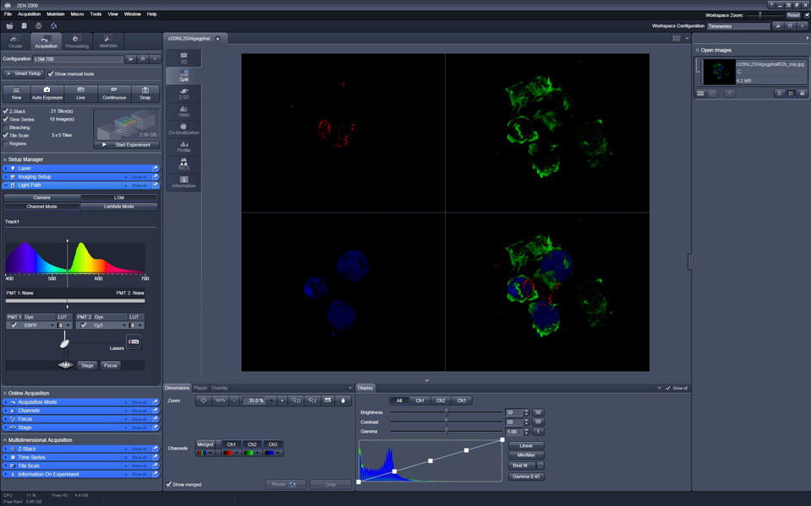




2. Experimental data processing procedures, practical hints and tips
2.5 Image analysis, graphical software, presentation software
Graphical software for grabbing and processing of micro- and macroscopical images
Leica
Zeiss
Nikon
Olympus
B130P16E: Practical basics of scientific work Department of Experimental Plant Biology, FS CU https://lhr.ueb.cas.cz/petrasek/B130P16E.htm

Slide 26
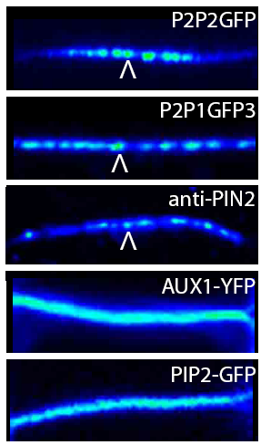

2. Experimental data processing procedures, practical hints and tips
2.5 Image analysis, graphical software, presentation software
Colour depth in biological imaging
8 bit - 256 levels of grey (2⁸)
12 bit - 4096 levels of grey (2¹²)
16 bit - 65536 levels of grey (2¹⁶)
24 bit - 16 777 216 levels of grey (2²⁴)
A suitable LUT, i.e. Look Up Table, is the key to correct presentation of the image
Kleine-Vehn, Mol Syst Biol 7:540, 2011
B130P16E: Practical basics of scientific work Department of Experimental Plant Biology, FS CU https://lhr.ueb.cas.cz/petrasek/B130P16E.htm

Slide 27
2. Experimental data processing procedures, practical hints and tips
2.5 Image analysis, graphical software, presentation software
Analysis of colocalization
Jelínková et al., Plant Journal 61, 883-891, 2009
B130P16E: Practical basics of scientific work Department of Experimental Plant Biology, FS CU https://lhr.ueb.cas.cz/petrasek/B130P16E.htm

Slide 28
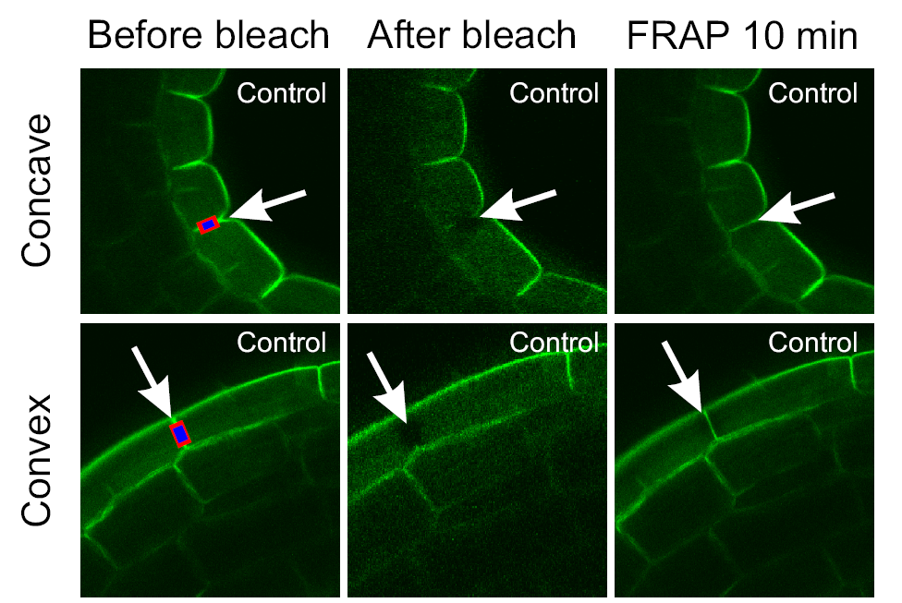
2. Experimental data processing procedures, practical hints and tips
2.5 Image analysis, graphical software, presentation software
Analysis of intracellular protein dynamics
Vandenbussche et al., 2009, Development 137, 597-606
B130P16E: Practical basics of scientific work Department of Experimental Plant Biology, FS CU https://lhr.ueb.cas.cz/petrasek/B130P16E.htm

Slide 29
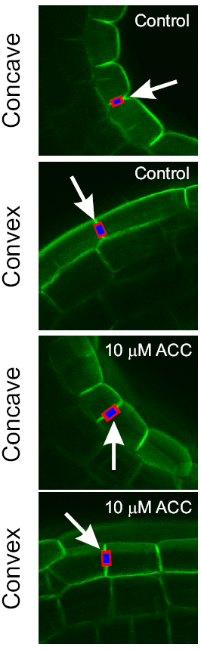
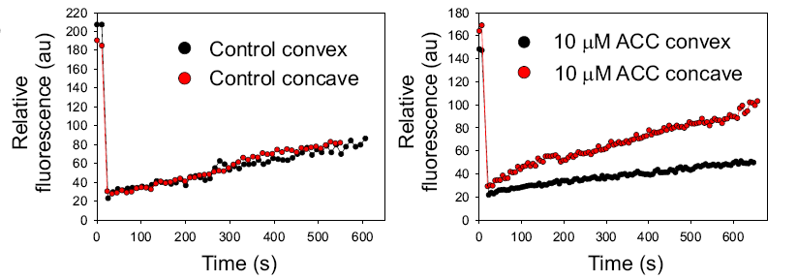
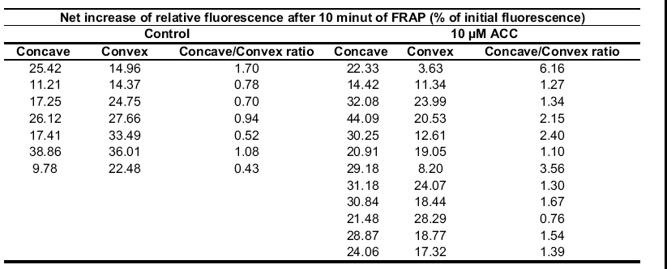
2. Experimental data processing procedures, practical hints and tips
2.5 Image analysis, graphical software, presentation software
Analysis of intracellular protein dynamics
Vandenbussche et al., 2009, Development 137, 597-606
B130P16E: Practical basics of scientific work Department of Experimental Plant Biology, FS CU https://lhr.ueb.cas.cz/petrasek/B130P16E.htm

Slide 30
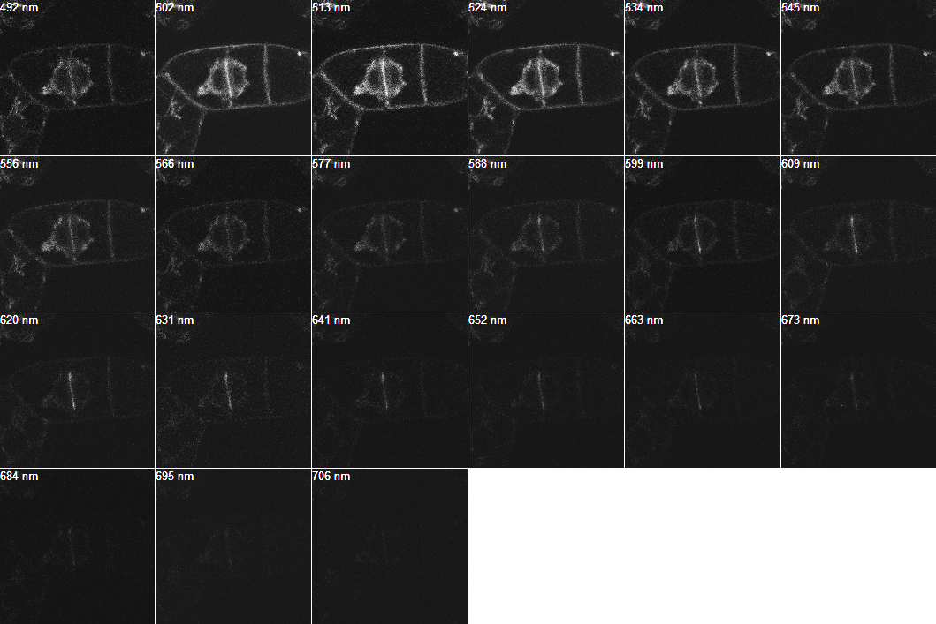
2. Experimental data processing procedures, practical hints and tips
2.5 Image analysis, graphical software, presentation software
Interaction between two proteins - FRET analysis in vivo (PIN1-ADL1)
GFP peak
RFP peak
Spectral detection using ZEISS META 510 detector, laser 477 nm
B130P16E: Practical basics of scientific work Department of Experimental Plant Biology, FS CU https://lhr.ueb.cas.cz/petrasek/B130P16E.htm

Slide 31
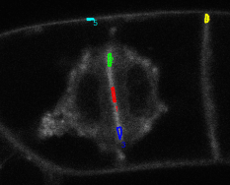
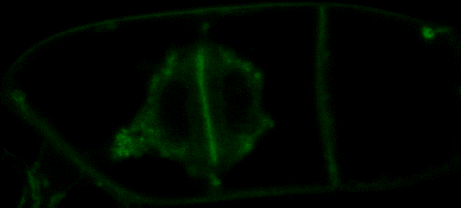

2. Experimental data processing procedures, practical hints and tips
2.5 Image analysis, graphical software, presentation software
Interaction between two proteins - FRET analysis in vivo (PIN1-ADL1)
5
Average fluorescence intensity measured over the emission spectrum in the following region of interests:
ROI1 - middle cell plate
ROI2, ROI3 - growing ends of the cell plate
ROI4, ROI5 - transversal and longitudinal plasma membranes
4
2
1
3
500-520 nm unmixed
ROI1 - low FRET
ROI2, ROI3 - high FRET
ROI4, ROI5 - no FRET
600-620 nm unmixed
B130P16E: Practical basics of scientific work Department of Experimental Plant Biology, FS CU https://lhr.ueb.cas.cz/petrasek/B130P16E.htm

Slide 32
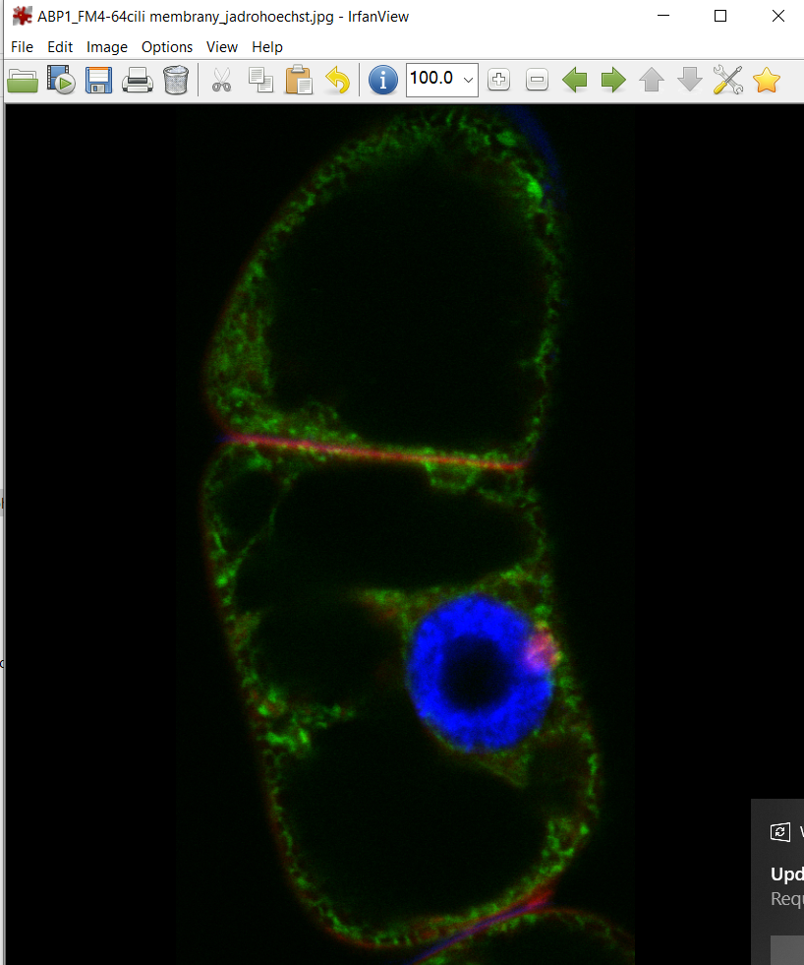
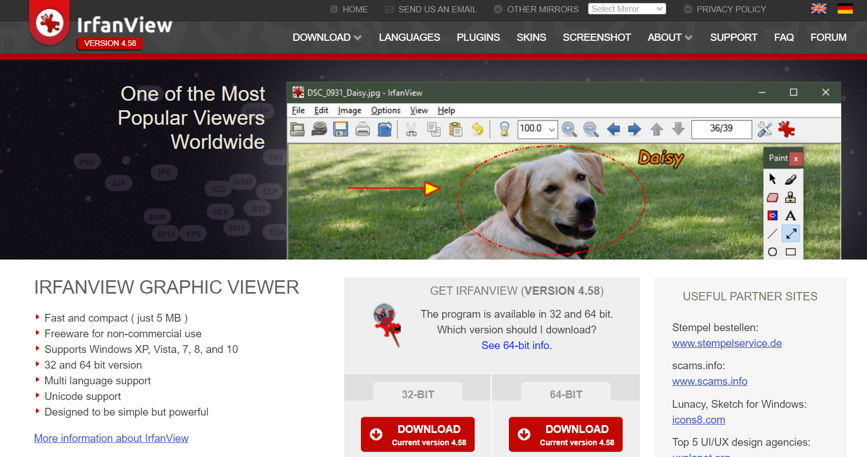
2. Experimental data processing procedures, practical hints and tips
2.5 Image analysis, graphical software, presentation software
Irfan View - the ideal tool for daily viewing of experimental documentation
B130P16E: Practical basics of scientific work Department of Experimental Plant Biology, FS CU https://lhr.ueb.cas.cz/petrasek/B130P16E.htm

Slide 33
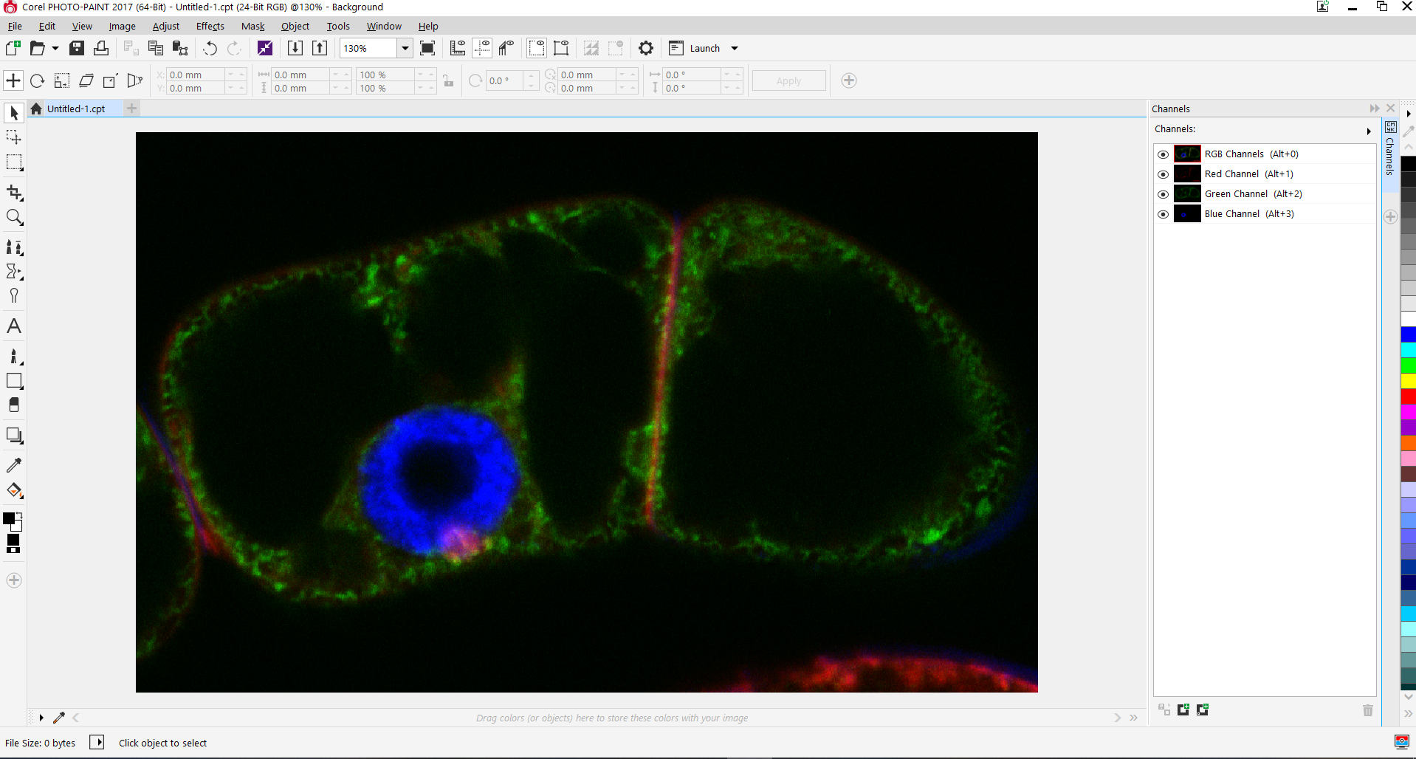
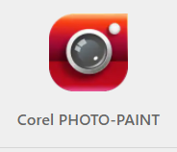

2. Experimental data processing procedures, practical hints and tips
2.5 Image analysis, graphical software, presentation software
Raster graphics a its editing using software editors
Corel Photo Paint
Adobe Photoshop
B130P16E: Practical basics of scientific work Department of Experimental Plant Biology, FS CU https://lhr.ueb.cas.cz/petrasek/B130P16E.htm

Slide 34

2. Experimental data processing procedures, practical hints and tips
2.5 Image analysis, graphical software, presentation software
Beware of too extensive modifications!!!!
B130P16E: Practical basics of scientific work Department of Experimental Plant Biology, FS CU https://lhr.ueb.cas.cz/petrasek/B130P16E.htm

Slide 35



2. Experimental data processing procedures, practical hints and tips
2.5 Image analysis, graphical software, presentation software
Vector graphics combined with raster graphics - ideal for creating images for scientific publications
Corel Draw
Adobe Illustrator
B130P16E: Practical basics of scientific work Department of Experimental Plant Biology, FS CU https://lhr.ueb.cas.cz/petrasek/B130P16E.htm

Slide 36


2. Experimental data processing procedures, practical hints and tips
2.6 Open source graphical software
Both vector and raster graphics can be edited using freely available programs, but for the purpose of presenting scientific outputs these tools are rather not suitable
GIMP
Inkscape
B130P16E: Practical basics of scientific work Department of Experimental Plant Biology, FS CU https://lhr.ueb.cas.cz/petrasek/B130P16E.htm

