Slide 1
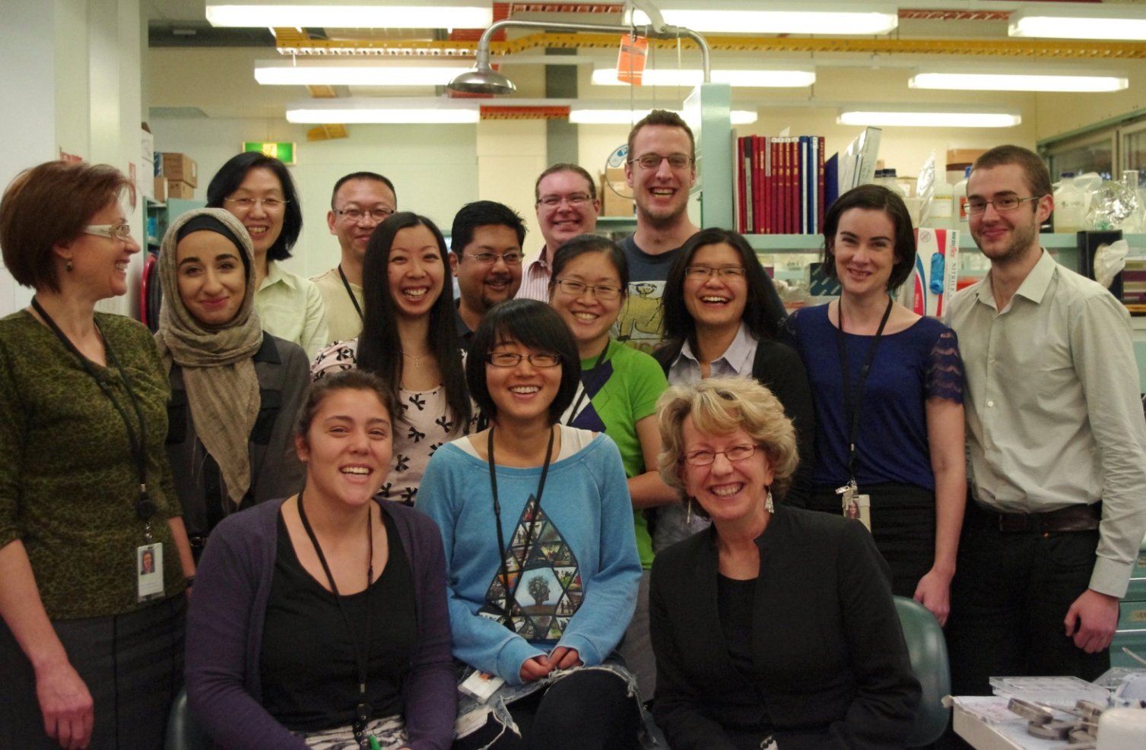






1. Basics of research work
1.3. Scientific institutions and organizations, scientific conferences
What is the character of the experimental scientific work?
Individuals are very rare, they bring new ideas, but they could not be competitive in performing all necessary experiments or observations
Scientific research is a typical team work
http://www.centenary.org.au/p/ourresearch/immunity/tcellbiology/
B130P16E: Practical basics of scientific work Department of Experimental Plant Biology, FS CU https://lhr.ueb.cas.cz/petrasek/B130P16E.htm

Slide 2
1. Basics of research work
1.3. Scientific institutions and organizations, scientific conferences
What institutions are involved in the scientific research?
1) Universities
The symbiosis of pedagogical and scientific activities.
Positive correlation between the quality of research and teaching.
With respect to the quality of the scientific research the best universities are located in the USA and UK
The evaluation of the quality of the particular university might be rather dependent on the purpose of the evaluation.
B130P16E: Practical basics of scientific work Department of Experimental Plant Biology, FS CU https://lhr.ueb.cas.cz/petrasek/B130P16E.htm

Slide 3


1. Basics of research work
1.3. Scientific institutions and organizations, scientific conferences
World University Rankings according to the quality of their research and teaching activities
Harvard, Yale, Cambridge and Oxford are usually among the top 5
B130P16E: Practical basics of scientific work Department of Experimental Plant Biology, FS CU https://lhr.ueb.cas.cz/petrasek/B130P16E.htm

Slide 4

1. Basics of research work
1.3. Scientific institutions and organizations, scientific conferences
Scientific research is usually inherent part of the mission of good university
B130P16E: Practical basics of scientific work Department of Experimental Plant Biology, FS CU https://lhr.ueb.cas.cz/petrasek/B130P16E.htm

Slide 5
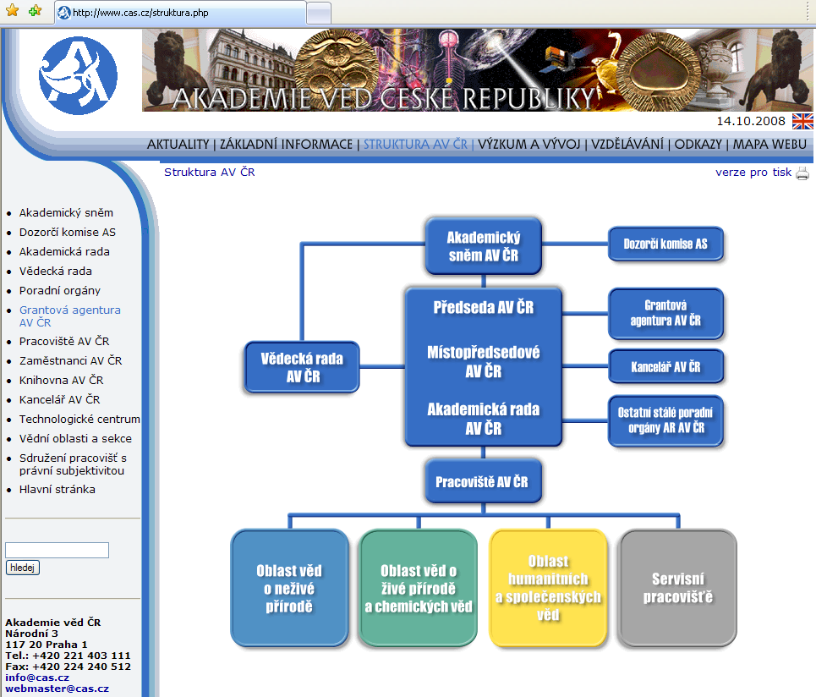
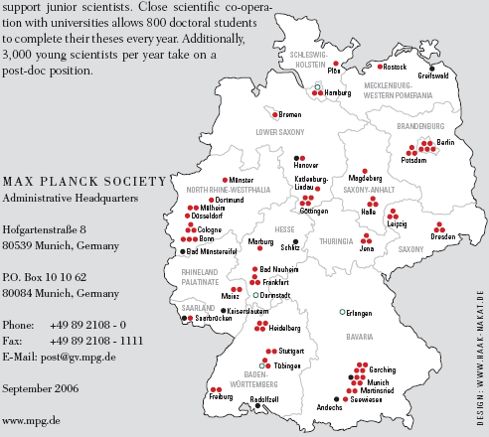

1. Basics of research work
1.3. Scientific institutions and organizations, scientific conferences
2) Specialized research institutions
- In contrast to universities the emphasis is on the scientific research
- They are often involved in Ph.D. programs and collaborate closely with universities
- Some examples of well known research institutions:
- Max Planck Society, Germany
- RIKEN, Japan
- Academy of Sciences, Czech Republic
- Governmental or private research centres
B130P16E: Practical basics of scientific work Department of Experimental Plant Biology, FS CU https://lhr.ueb.cas.cz/petrasek/B130P16E.htm

Slide 6

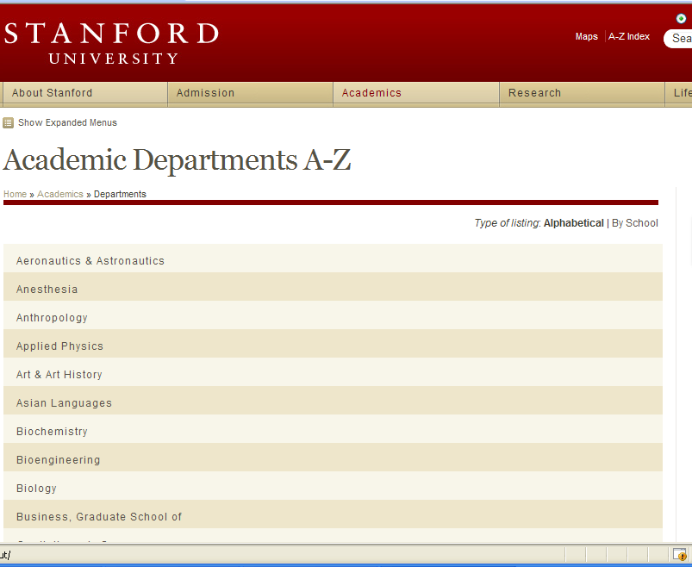
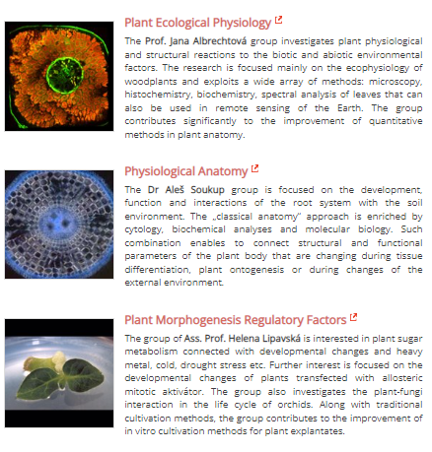
1. Basics of research work
1.3. Scientific institutions and organizations, scientific conferences
Scientific team – constitutes a basic unit of every scientific institution, it is usually iinternational
The interconnection between individual teams within the institution is crucial for the efficiency of the whole institution.
The composition of research teams:
- is the result of the existence of scientific authorities in the field
- is the result of certain strategy, e.g. modern topics, applicability, etc.
B130P16E: Practical basics of scientific work Department of Experimental Plant Biology, FS CU https://lhr.ueb.cas.cz/petrasek/B130P16E.htm

Slide 7
1. Basics of research work
1.3. Scientific institutions and organizations, scientific conferences
What is the structure of „healthy” research team?
- Group leader - he/she is responsible for the scientific quality of the research, co-ordinates the work, he/she is usually the holder of some important degree like Professor or Associated Professor
- Research assistants, postdocs – they represent the main „power” of the team, they are usually in their best age (untill 35 or 40), the most frequently asked temporary positions around the world
- Specialists - experts in certain methods, they do not have their own scientific ambitions
- Ph.D. students - they work on their thesis under the supervision of the leader or some of the postdocs, the thesis must fit into the profile of the team.
- Diploma students - they work on their diploma thesis, topic might be broader
- Younger students (bachelors) - temporary help with the laboratory work, very good for the orientation in the field
- Laboratory technicians - essential for the keeping the lab in good shape. Sometimes the success of crucial experiments depends purely on their skills.
B130P16E: Practical basics of scientific work Department of Experimental Plant Biology, FS CU https://lhr.ueb.cas.cz/petrasek/B130P16E.htm

Slide 8
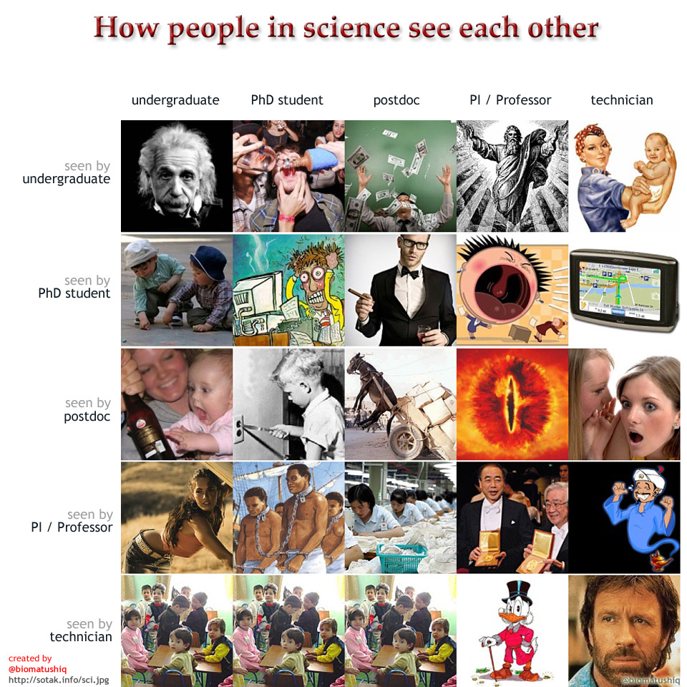
1. Basics of research work
B130P16E: Practical basics of scientific work Department of Experimental Plant Biology, FS CU https://lhr.ueb.cas.cz/petrasek/B130P16E.htm

Slide 9
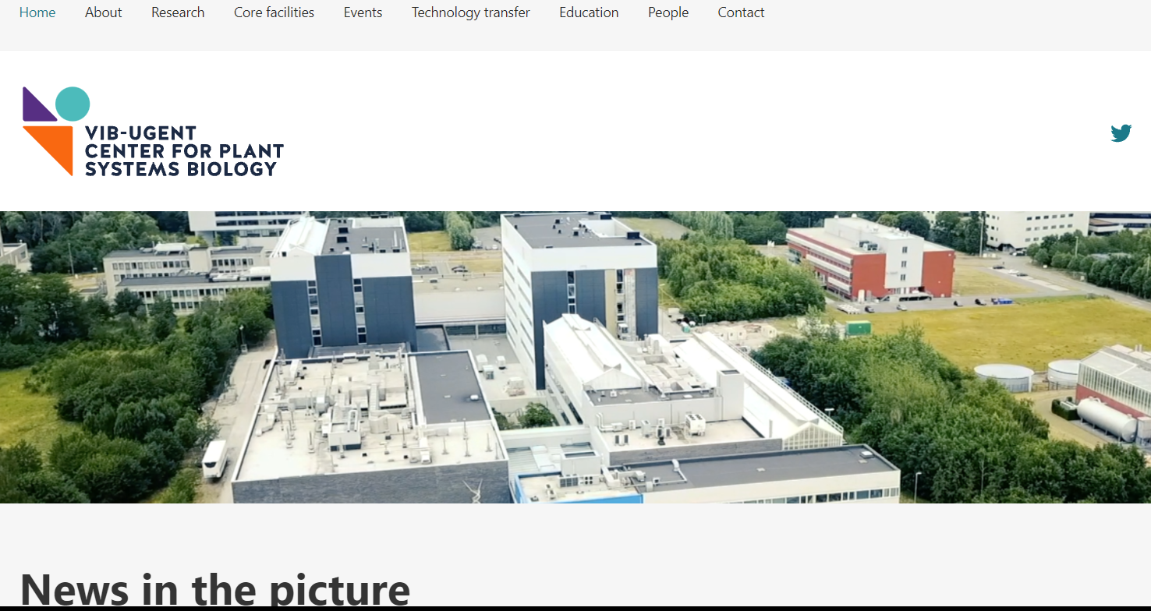
1. Basics of research work
1.3. Scientific institutions and organizations, scientific conferences
What is the structure of „healthy” research team?
The structure is not rigid, it is gradually changed depending on the improvement of the students and quality of the group leader
The relationship between teacher and pupil (master/apprentice) is crucial for the transfer of knowledge
B130P16E: Practical basics of scientific work Department of Experimental Plant Biology, FS CU https://lhr.ueb.cas.cz/petrasek/B130P16E.htm

Slide 10
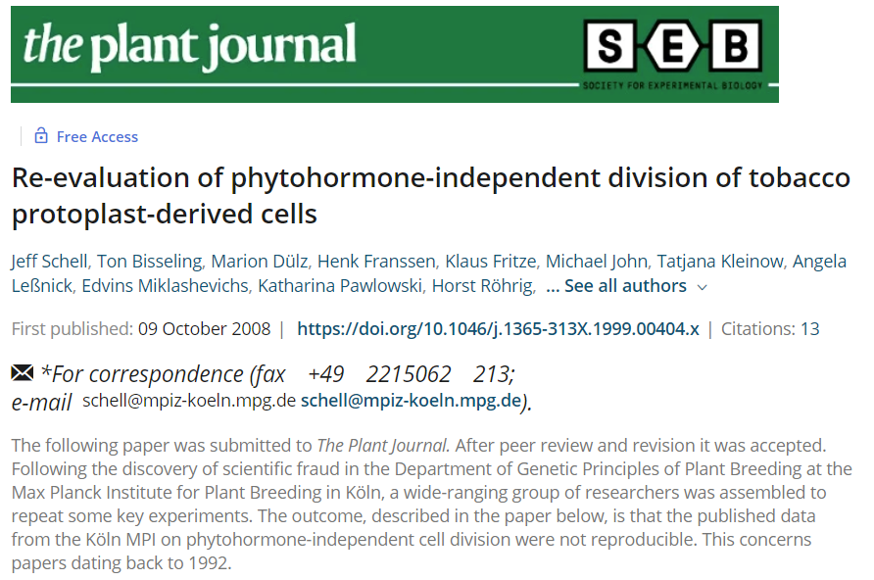
1. Basics of research work
1.3. Scientific institutions and organizations, scientific conferences
What is wrong in the team profile?
- Too many scientific topics or their inconsistency
- The absence of students or too many students
- The inability of group leader to properly lead and discuss all individual research projects in the group. This could lead to the fatal consequences like scientific frauds, overlooking mistakes, etc.
B130P16E: Practical basics of scientific work Department of Experimental Plant Biology, FS CU https://lhr.ueb.cas.cz/petrasek/B130P16E.htm

Slide 11

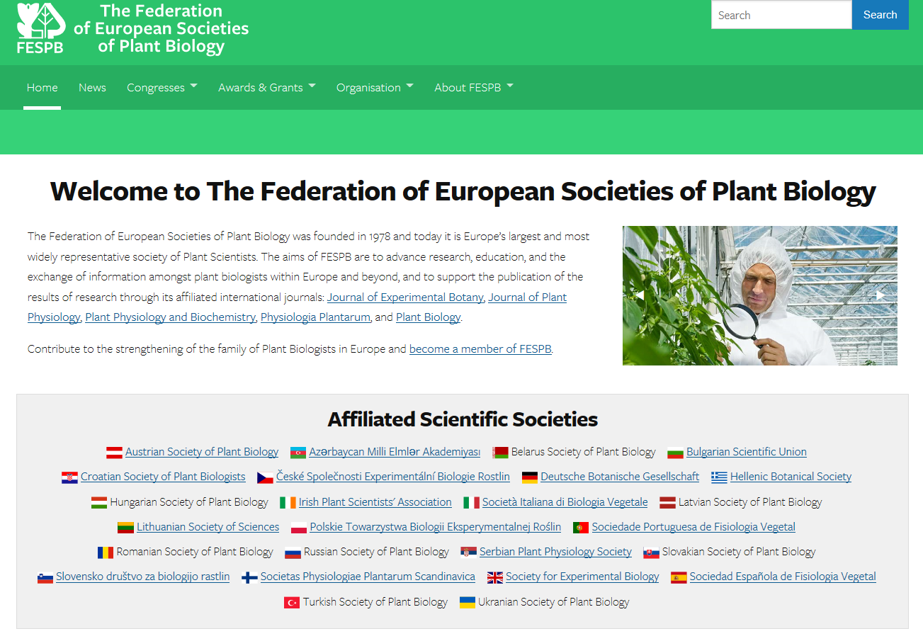
1. Basics of research work
1.3. Scientific institutions and organizations, scientific conferences
Scientific organizations/societies
- connect researchers according to their research field
- their significance is often more important for the research team than the interaction with other teams in the same building
- ironically, the membership is often payed from the private money of the researcher
- support of collegiality needed for the evaluation of research grants and papers, organization of conferences, etc.
Examples of the main scientific societies in the field of plant experimental biology:
- FESPB - Federation of European Societies of Plant Biologist
- ASPB – American Society of Plant Biologists
B130P16E: Practical basics of scientific work Department of Experimental Plant Biology, FS CU https://lhr.ueb.cas.cz/petrasek/B130P16E.htm

Slide 12

1. Basics of research work
1.3. Scientific institutions and organizations, scientific conferences
Scientific meetings
- Ideal platform for the effective and fast exchange of information and experience
- congresses, symposia, seminars, courses (workshops), etc.
- Congresses in the field of plant experimental biology: FESPB, ASPB
- Conferences/symposia:
Gordon Research Conferences - around 300/year
Keystone Symposia - around 100/year
Cold Spring Harbor Conferences
- Be careful about dubious conferences,
„trading“ with „scientific tourims“ as a phenomenon of these years
B130P16E: Practical basics of scientific work Department of Experimental Plant Biology, FS CU https://lhr.ueb.cas.cz/petrasek/B130P16E.htm

Slide 13
1. Basics of research work
1.4. Ethical code of scientific work
Personal motivation to become a scientist
- Creative activity, uncovering yet unexplored facts and rules, there is no manual for the solution
- Research might be understood as a kind of craft
- Private hobby for which one might be payed for
- Making „carrier“ is usually not the reason
How is the particular topic selected and determined?
- Following the teacher or professor, respected authority in the field
- Private interest
- Public acceptance and scientific relevance - phenomenon of the „scientific fashion“
- By the provider of the money
B130P16E: Practical basics of scientific work Department of Experimental Plant Biology, FS CU https://lhr.ueb.cas.cz/petrasek/B130P16E.htm

Slide 14
1. Basics of research work
1.4. Ethical code of scientific work
When doing research one should:
- start from the existing knowledge, groundbreaking discovery might be done through the falsification of accepted theory
- avoid the repetitive discovery of already discovered facts
- do not formulate hypothesis without a good knowledge of the literature
- bring the public good, reduce the private interest and regularly publish results (according to what you promise during matriculation)
Although there is no well-established ethical codex for the research work there are several rules that should be followed:
- accepting the priority of scientific discovery
- acknowledging ideas and results of others
- avoiding excessive editing and hiding of results
B130P16E: Practical basics of scientific work Department of Experimental Plant Biology, FS CU https://lhr.ueb.cas.cz/petrasek/B130P16E.htm

Slide 15
1. Basics of research work
1.4. Ethical code of scientific work
The most frequent mistakes:
- intentional ignorance of already known facts
- hiding the intellectual source
- „suitable“ adjusting of results - e.g. hiding of unclear results
- premature publishing or repeated publishing of the same results
- pretending the practical applicability
- plagiarism - both in case of original contributions and projects
B130P16E: Practical basics of scientific work Department of Experimental Plant Biology, FS CU https://lhr.ueb.cas.cz/petrasek/B130P16E.htm

Slide 16


1. Basics of research work
B130P16E: Practical basics of scientific work Department of Experimental Plant Biology, FS CU https://lhr.ueb.cas.cz/petrasek/B130P16E.htm

Slide 17
1. Basics of research work
B130P16E: Practical basics of scientific work Department of Experimental Plant Biology, FS CU https://lhr.ueb.cas.cz/petrasek/B130P16E.htm

Slide 18


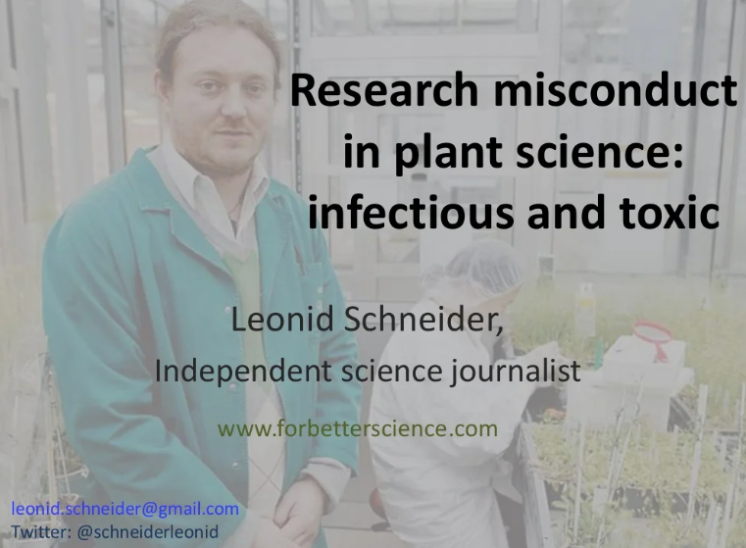
1. Basics of research work
B130P16E: Practical basics of scientific work Department of Experimental Plant Biology, FS CU https://lhr.ueb.cas.cz/petrasek/B130P16E.htm

Slide 19

1. Basics of research work
1.4. Ethical code of scientific work
Retraction watch
B130P16E: Practical basics of scientific work Department of Experimental Plant Biology, FS CU https://lhr.ueb.cas.cz/petrasek/B130P16E.htm

Slide 20

1. Basics of research work
PUBPEER - online Journal club
B130P16E: Practical basics of scientific work Department of Experimental Plant Biology, FS CU https://lhr.ueb.cas.cz/petrasek/B130P16E.htm

Slide 21
1. Basics of research work
1.5. Financing the scientific research
Financial resources - public (governmental)
- private
Type of financing - direct support of research institutions
- direct support of individual researchers
Ideally,
grant, institutional support and resources from applied research, spin off companies,
they all should be combined.
B130P16E: Practical basics of scientific work Department of Experimental Plant Biology, FS CU https://lhr.ueb.cas.cz/petrasek/B130P16E.htm

Slide 22
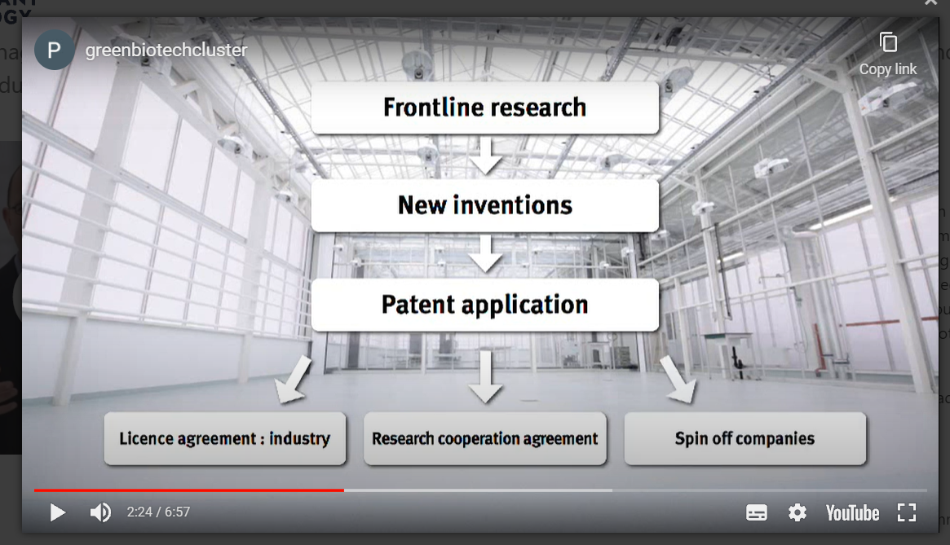
1. Basics of research work
1.5. Financing the scientific research
Technology transfer - basic research institution could be financially supported through the licences, patents and foundation of spin off companies
B130P16E: Practical basics of scientific work Department of Experimental Plant Biology, FS CU https://lhr.ueb.cas.cz/petrasek/B130P16E.htm

Slide 23
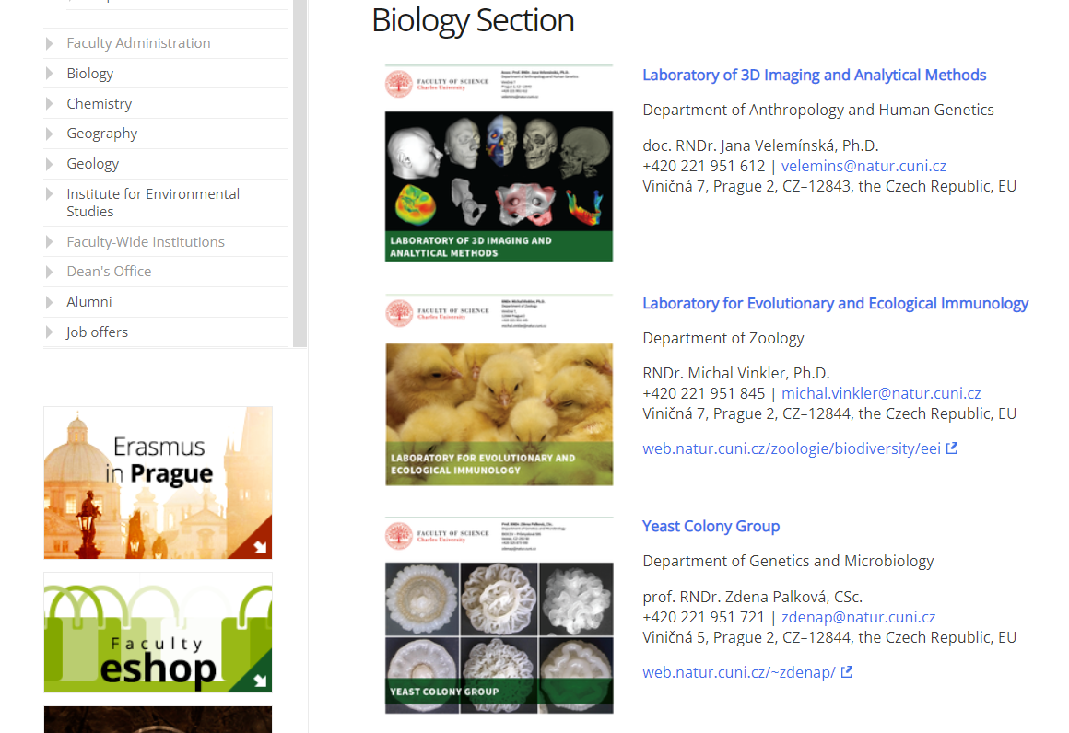
1. Základní pravidla vědecké práce
1.5. Financing the scientific research
Technology transfer at our faculty
B130P16E: Practical basics of scientific work Department of Experimental Plant Biology, FS CU https://lhr.ueb.cas.cz/petrasek/B130P16E.htm

Slide 24
1. Basics of research work
1.5. Financing the scientific research
Grant projects:
Student, doctoral, starting or junior research projects - for one to three years, young student or freshly graduated scientists
- Standard research projects - the most frequent form, three to five years.
- Specialized projects - travel or publication expenses
- Integration projects - interconnection of several research groups, at least for five years. Overlap with the classical research projects.
B130P16E: Practical basics of scientific work Department of Experimental Plant Biology, FS CU https://lhr.ueb.cas.cz/petrasek/B130P16E.htm

Slide 25
1. Basics of research work
1.5. Financing the scientific research
Grant agencies:
- Local (internal) Grant Agency - serves as a money-distributing organization within a specific institution
- The grant agency of the Charles University (GAUK), https://www.cuni.cz/UKEN-753.html, students and employees are eligible for applications
- Grant agency affiliated to ministry (government) - support of science and research in specific areas, e.g. education, medicine, agriculture, culture, etc.
- Ministry of Education, Youth and Sports
http://www.msmt.cz/vyzkum/pro-odborniky in Czech,
http://www.msmt.cz/research-and-development-1 in English
Supports mainly large, collaborative projects
B130P16E: Practical basics of scientific work Department of Experimental Plant Biology, FS CU https://lhr.ueb.cas.cz/petrasek/B130P16E.htm

Slide 26
1. Basics of research work
1.5. Financing of the scientific research
- National Grant Agencies - independent agency supported directly from the budget (separate chapter), all research areas are covered
- The Czech Science Foundation - in all research areas, it supports research projects submitted by individual researchers
- National Science Foundation (NSF; http://www.nsf.gov)
the largest and best organized grant agency in the USA
- International Grant Agency - founded in the frame EU convergence in the area of scientific research
- CORDIS (Community research and development
Information Service; http://cordis.europa.eu/) - European research council (ERC), http://erc.europa.eu), supports individual scientists all around EU
B130P16E: Practical basics of scientific work Department of Experimental Plant Biology, FS CU https://lhr.ueb.cas.cz/petrasek/B130P16E.htm

Slide 27
1. Basics of research work
1.6. Writing scientific projects and grant proposals, basic rules
Consider the type of the project that is most suitable at the moment and choose the grant agency accordingly
Constitute a functional team - project feasibility is guaranteed by the research institution
Strictly keep formal requisites - project proposals are often eliminated before
scientific evaluation, just because of formal defects
- proposal text is similar to scientific paper,
it contains expected results, the judgment of possible practical applications and financial demands
Example of the scientific proposal here
Evaluation of the proposal - members of expert panels select several external reviewers according to the topic of the proposal. These reviewers are always anonymous.
- it takes roughly half to one year to evaluate the project proposal
B130P16E: Practical basics of scientific work Department of Experimental Plant Biology, FS CU https://lhr.ueb.cas.cz/petrasek/B130P16E.htm

Slide 28
1. Basics of research work
1.6. Writing scientific projects and grant proposals, basic rules
Successful proposals are granted, financially supported, applicants turn to be „principal investigators“ and their research institutions are typically „beneficiaries“.
Reporting periods are pretty variable, from one month to several years
The outcomes of the particular project are scientific papers or patents
- grant agencies control the publication of results of the principal investigator
- in case of bad outcome (no papers, no patents), the principal investigator has problems in any future calls
- In Czechia, scientific projects are all listed at the pages of Research and Development Council (https://www.vyzkum.cz/FrontClanek.aspx?idsekce=633)
B130P16E: Practical basics of scientific work Department of Experimental Plant Biology, FS CU https://lhr.ueb.cas.cz/petrasek/B130P16E.htm

