Slide 1
Practical basics of scientific work (B130P16)
Guaranteed by: 130 - Department of Plant Experimental Biology
Winter term: 0/2 C (hours/week)
Credits: 2
Teacher: Petrášek, J., Dep. Plant Exp Biol and IEB ASCR
WWW: http://lhr.ueb.cas.cz/petrasek/B130P16.htm
Requirements to get credits: 1) Assignment on searching, processing and presentation of bibliographic, scientometric and sequence data
2) Preparation of the scientific manuscript
B130P16: Practical basics of scientific work Department of Experimental Plant Biology, FS CU https://lhr.ueb.cas.cz/petrasek/B130P16.htm

Slide 2
Syllabus
1. Basics of research work
1.1. The character of scientific work in the experimental biology
1.2. Observation and experiment - two activities of researchers
1.3. Scientific institutions and organizations, scientific conferences
1.4. Ethics of scientific research
1.5. Financing the scientific research
1.6. Writing scientific projects and grant proposals, basic rules
B130P16: Practical basics of scientific work Department of Experimental Plant Biology, FS CU https://lhr.ueb.cas.cz/petrasek/B130P16.htm

Slide 3
Syllabus
2. Helpful hints in the processing of experimental data
2.1. Organization of work, type of data
2.2. Data explorers, correct data handling and saving
2.3. Spreadsheets, statistical software, graph editors
2.4. Processing of structural and sequence data
2.5. Image analysis, graphical software, presentation software
B130P16: Practical basics of scientific work Department of Experimental Plant Biology, FS CU https://lhr.ueb.cas.cz/petrasek/B130P16.htm

Slide 4
Syllabus
3. Scientific literature, online resources at the internet
3.1. Types of scientific reports and their purpose
3.2. Internet sources of information
3.3. How to search for bibliographic records and full text articles
3.3.1. Bibliographic databases accessible at our faculty 3.3.2. Full text databases accessible at our faculty
3.3.3. Creating your own database of references
3.4. Scientometry - a tool for the evaluation of quality and scientific relevance of scientific work
B130P16: Practical basics of scientific work Department of Experimental Plant Biology, FS CU https://lhr.ueb.cas.cz/petrasek/B130P16.htm

Slide 5
Syllabus
4. Online information databases in the experimental biology
4.1. Sequence databases - tool of systems biology
4.2. Specialized sequence databases
5. Presentation of experimental results
5.1. Bachelor thesis 5.2. Diploma thesis 5.3. Dissertation thesis
5.4. Scientific contributions at the conferences and seminars
5.5. Scientific report/paper
B130P16: Practical basics of scientific work Department of Experimental Plant Biology, FS CU https://lhr.ueb.cas.cz/petrasek/B130P16.htm

Slide 6
1. Basics of research work
1.1. The character of scientific work in the experimental biology
The goal of science is the searching for the „truth“, in biology we explore the principles of regulatory mechanisms in living organisms
Research - systematic activity using scientific methods
Research
Basic - revealing the essence of certain phenomenon
Applied - there is always some economical or public interest behind
The combination of both basic and applied research is ideal
Public interest
Uncovering basic principles
Basic
Applied
Unexpected discoveries
Financial interest
B130P16: Practical basics of scientific work Department of Experimental Plant Biology, FS CU https://lhr.ueb.cas.cz/petrasek/B130P16.htm

Slide 7
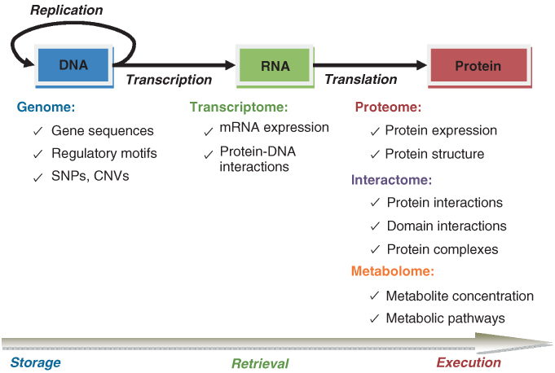
1. Basics of research work
1.1. The character of scientific work in the experimental biology
Experimental biology is now in the age of the accumulation and of large amount of data - correct scientific evaluation of large data sets is the key for the scientific progress
M Koyutϋrk WIREs Syst Biol Med 2010. DOI: 10.1002/wsbm.61
Copyright © 2009 John Wiley & Sons, Inc.
B130P16: Practical basics of scientific work Department of Experimental Plant Biology, FS CU https://lhr.ueb.cas.cz/petrasek/B130P16.htm

Slide 8
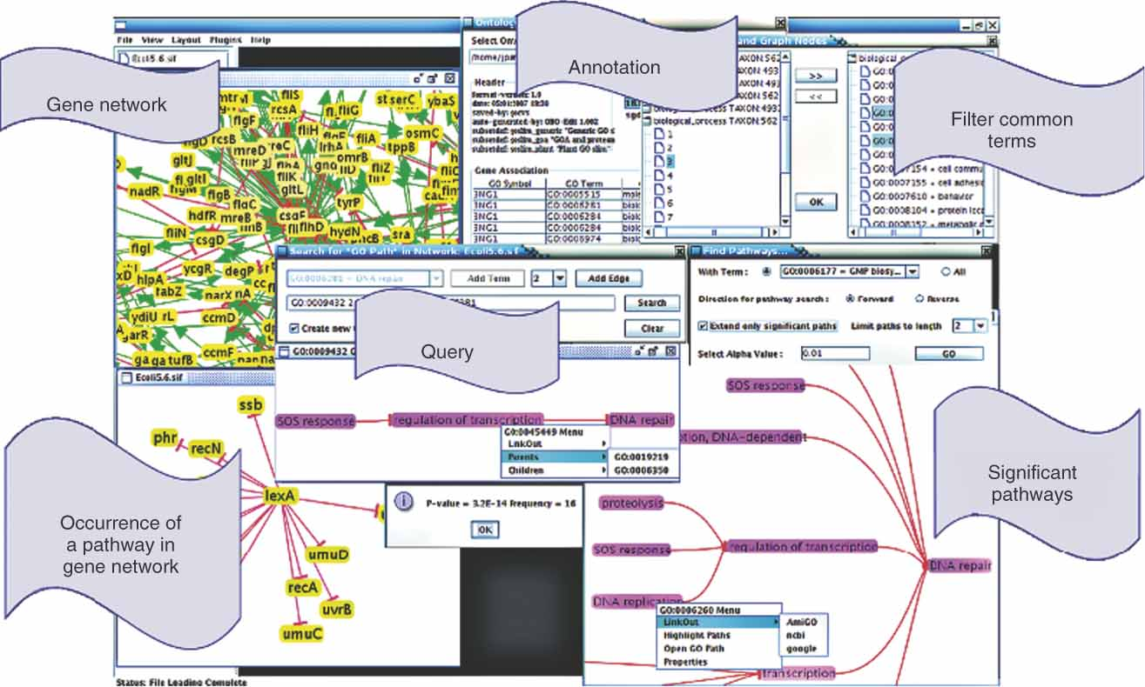
1. Basics of research work
1.1. The character of scientific work in the experimental biology
Experimental biology is now in the age of the accumulation and of large amount of data - correct scientific evaluation of large data sets is the key for the scientific progress
M Koyutϋrk WIREs Syst Biol Med 2010. DOI: 10.1002/wsbm.61 Copyright © 2009 John Wiley & Sons, Inc.
B130P16: Practical basics of scientific work Department of Experimental Plant Biology, FS CU https://lhr.ueb.cas.cz/petrasek/B130P16.htm

Slide 9
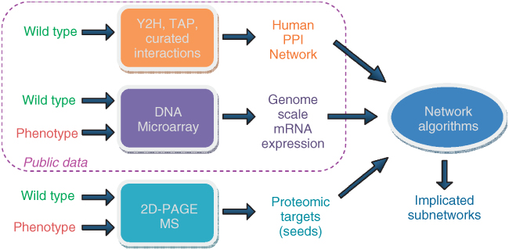
1. Basics of research work
1.1. The character of scientific work in the experimental biology
Experimental biology is now in the age of the accumulation and of large amount of data - correct scientific evaluation of large data sets is the key for the scientific progress
M Koyutϋrk WIREs Syst Biol Med 2010. DOI: 10.1002/wsbm.61 Copyright © 2009 John Wiley & Sons, Inc.
B130P16: Practical basics of scientific work Department of Experimental Plant Biology, FS CU https://lhr.ueb.cas.cz/petrasek/B130P16.htm

Slide 10
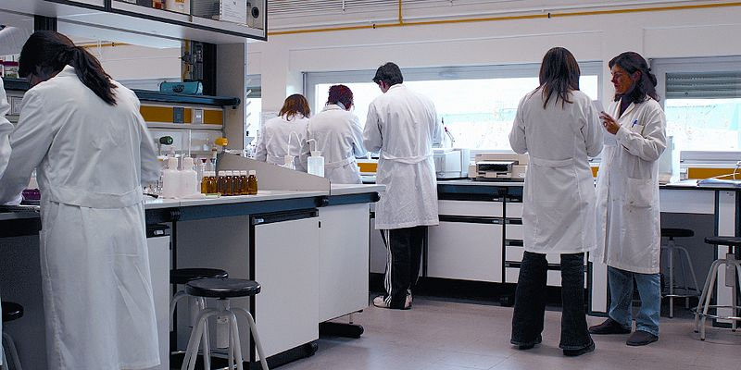
1. Basics of research work
1.1. The character of scientific work in the experimental biology
Biology as the exact science? This is really a challenge…
http://commons.wikimedia.org/wiki/File:InvestigadoresUR.JPG
http://library.miami.edu/uml/chc/tag/behind-the-scenes-at-chc/
B130P16: Practical basics of scientific work Department of Experimental Plant Biology, FS CU https://lhr.ueb.cas.cz/petrasek/B130P16.htm

Slide 11
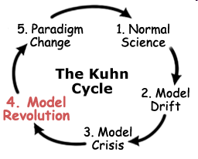
1. Basics of research work
1.1. The character of scientific work in the experimental biology
Scientific work
Testing hypotheses - verification or falsification
1. Question
Verification of models - in the biology, the model represents the result of experimental activities and reductionist approach to the object studied
5. Analysis
2. Hypothesis
4. Experiment
3. Prediction
https://commons.wikimedia.org/wiki/File:Thomas-kuhn-portrait.png
http://www.thwink.org/sustain/glossary/ModelRevolution.htm
B130P16: Practical basics of scientific work Department of Experimental Plant Biology, FS CU https://lhr.ueb.cas.cz/petrasek/B130P16.htm

Slide 12
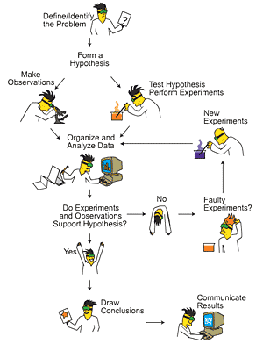
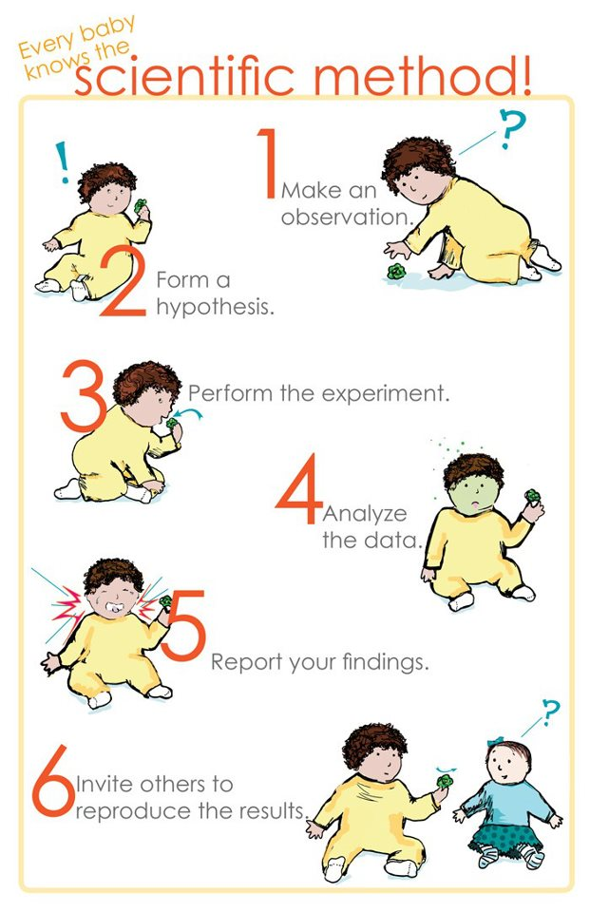
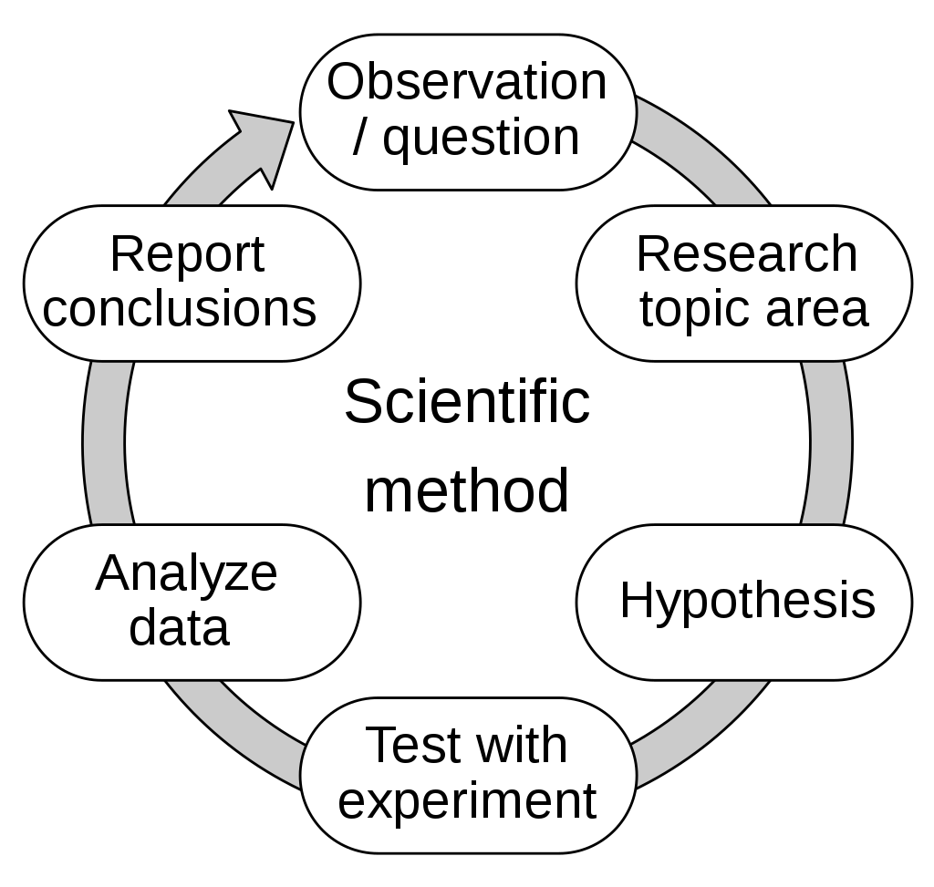
1. Basics of research work
1.1. The character of scientific work in the experimental biology
Scientific method
https://upload.wikimedia.org/wikipedia/commons/8/82/The_Scientific_Method.svg
B130P16: Practical basics of scientific work Department of Experimental Plant Biology, FS CU https://lhr.ueb.cas.cz/petrasek/B130P16.htm

Slide 13
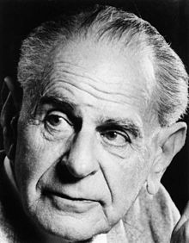
1. Basics of research work
1.1. The character of scientific work in the experimental biology
Asking new questions - the key for the successful scientific research
Scientific discovery is rather continual approach to the final „knowledge“
Karl Raimund Popper - philosopher of Austrian origin, his critical rationalism gives a true picture of the continual approaching to the truth, which is achieved through the elimination of various mistakes and errors
- correct scientific statements must be possible to falsify, this is achieved through systematic experimental activity with subsequent interpretation
- Popper’s razor - the theory that is refutable could be replaced by another theory that resulted from the systematic research activity
B130P16: Practical basics of scientific work Department of Experimental Plant Biology, FS CU https://lhr.ueb.cas.cz/petrasek/B130P16.htm

Slide 14
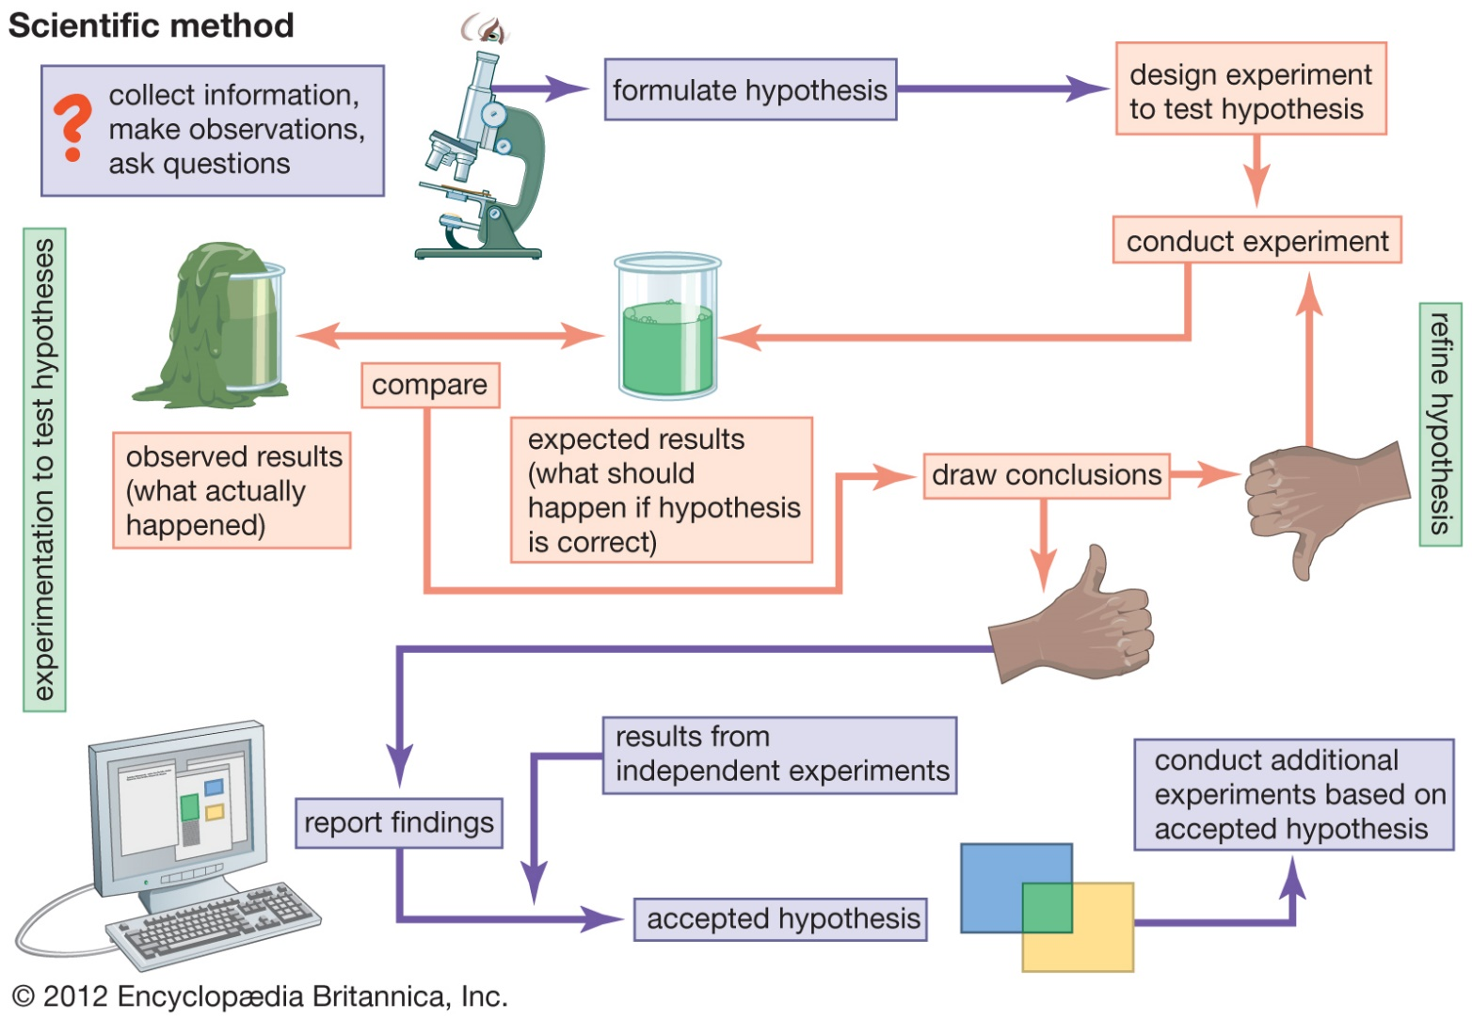
1. Basics of research work
1.1. The character of scientific work in the experimental biology
How to distinguish between scientific and non-scientific activities in biology and other disciplines?
Scientific activities:
systematic gathering of data - experiment and observation
formulation of hypotheses - these must be able to be falsified and tested, e.g. by comparing results with results of other scientists
in general we cannot verify, we can only falsify theories
B130P16: Practical basics of scientific work Department of Experimental Plant Biology, FS CU https://lhr.ueb.cas.cz/petrasek/B130P16.htm
Notes:
Jak se poprat s informacemi aneb krize redukcionismu je výzvou pro budoucnost biologie.
Biologie prožívá poslední dvě dekády opravdu nevšední období. Proč nevšední? Protože se daří úspěšně získávat stále větší a větší množství informací o částech, ze kterých jsou poskládány veškeré živé organismy. Toto poznávání pospíchá rychlostí, která je dech beroucí. Právě ona je také příčinou obrovského množství původních vědeckých studií v biologických vědách. Umíme rychle přečíst genetický kód prakticky jakéhokoliv organismu. Umíme též zjistit kolik genů je ve zcela konkrétní situaci aktivních a tím umožňuje vznik bílkovin, základních stavebních prvků živých organismů. Ba co více, umíme i mikroskopicky sledovat kde jsou všechny tyto bílkoviny lokalizovány, jak spolupracují, jak vznikají a zanikají. Umíme to udělat pro tisíce a tisíce dalších molekul najednou, a pokud budeme mít dostatek peněz i pro každou sekundu života organismu. Jinými slovy, biologové dneška a blízké budoucnosti budou dostávat neuvěřitelně komplexní informaci o fungování konkrétního organismu. Jedním z mohutných hybatelů pokroku v biologických vědách byl a je redukcionistický přístup, který umožňuje konkrétní děj studovat v jakési izolovanosti. Odráží se v něm jistý pragmatický přístup vědců, kteří ani nic lepšího dělat nemohou u vědomí nesmírné komplexity života. Ale nejdůležitější je vždy vědomí souvislostí. A i když není vůbec jisté, jestli někdy budeme schopni pochopit fungování celku takříkajíc odshora, právě získávání nesmírně komplexních souborů dat je jakýmsi prvním krůčkem. Abychom však mohli s těmito soubory dat pracovat účelně, tj. získat z nich odpovědi na otázku jak se celý organismus chová díky vztahům mezi všemi jeho součástmi, je potřeba změna v chápání poznatelnosti celku cestou poznatelnosti částí. Tedy posunout se od redukcionistického pohledu na jeden či pouze pár probíhajících dějů směrem k postupům založených na schopnosti získat ze záplavy informací zcela novou kvalitu. Toto je momentálně dle mého názoru jednoznačně největší výzvou současné biologie. Pokud se s touto výzvou úspěšně popasuje, je i možné s jistou mírou optimismu doufat v jisté dohnání míry exaktnosti, kterou se pyšní obory jako matematika, fyzika či chemie.

Slide 15
1. Basics of research work
1.1. The character of scientific work in the experimental biology
How to distinguish between scientific and non-scientific activities in biology and other disciplines?
CSI - Committee for Skeptical Inquiry The society of scientists and philosophers promoting methods and ideas of new skepticism (in a sense of critical rationalism) towards paranormal and other fringe-science claims.
SISYFOS – Czech sceptical club Czech branch of the international sceptical club, known for every year awarding of unscientific activities that are presented publicly
B130P16: Practical basics of scientific work Department of Experimental Plant Biology, FS CU https://lhr.ueb.cas.cz/petrasek/B130P16.htm

Slide 16
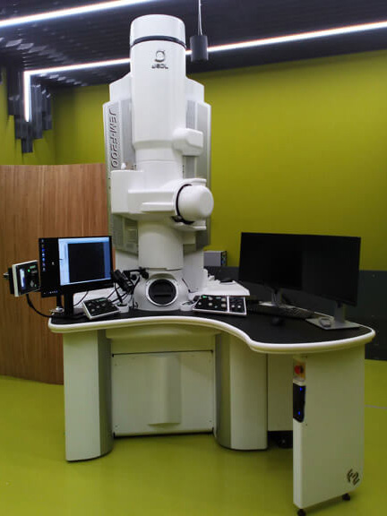
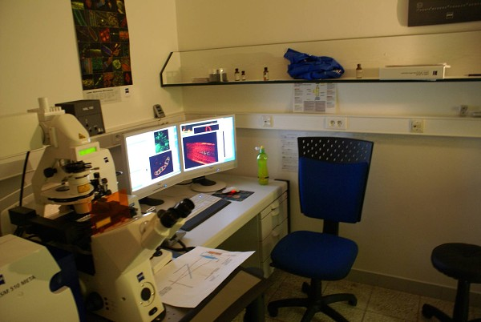
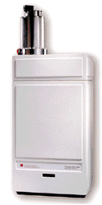
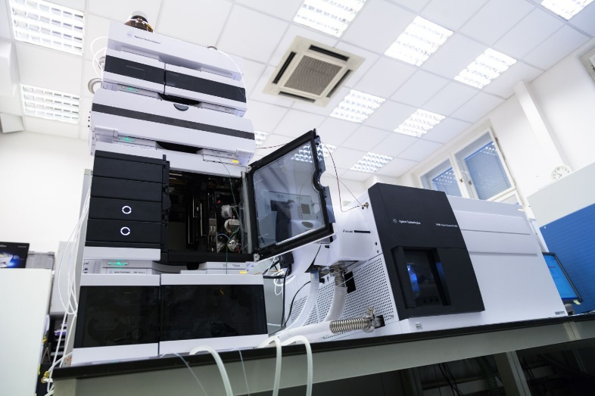
1. Basics of research work
1.1. The character of scientific work in the experimental biology
Categorization of activities of modern experimental biologists:
1) Laboratory expert
B130P16: Practical basics of scientific work Department of Experimental Plant Biology, FS CU https://lhr.ueb.cas.cz/petrasek/B130P16.htm

Slide 17
1. Basics of research work
1.1. The character of scientific work in the experimental biology
Categorization of activities of modern experimental biologists:
2) Writer and teacher
B130P16: Practical basics of scientific work Department of Experimental Plant Biology, FS CU https://lhr.ueb.cas.cz/petrasek/B130P16.htm

Slide 18
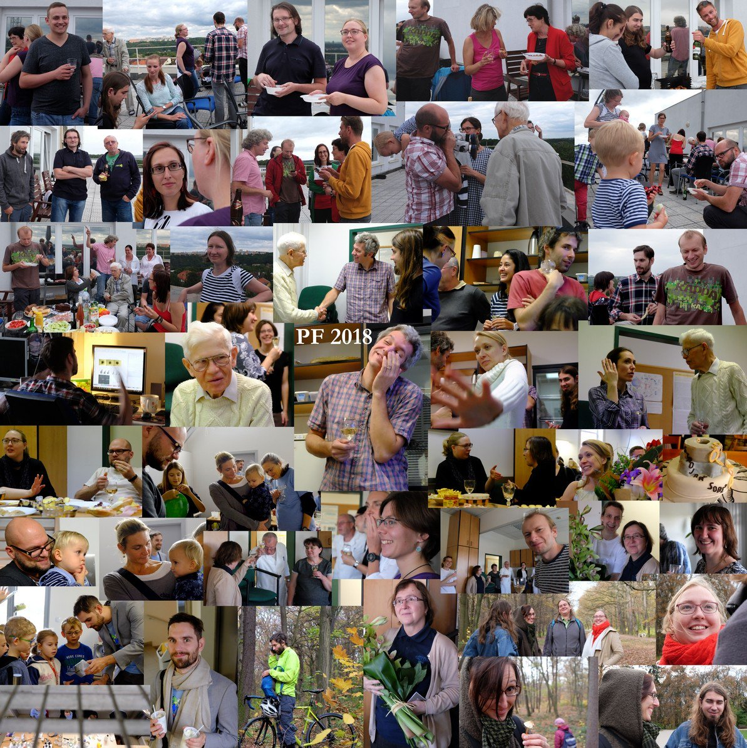
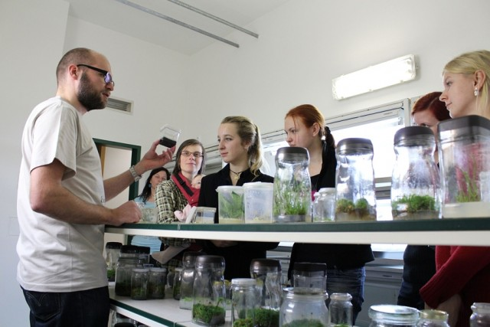
1. Basics of research work
1.1. The character of scientific work in the experimental biology
Categorization of activities of modern experimental biologists:
3) Manager and popularizer
B130P16: Practical basics of scientific work Department of Experimental Plant Biology, FS CU https://lhr.ueb.cas.cz/petrasek/B130P16.htm

Slide 19
1. Basics of research work
1.2. Observation and experiment - two general approaches
Scientific work
Observation - explorative or analytical (analysis)
Experiment - following the effect of well-defined factors
The approach of experiment and observation are mixed and can not be separated from each other
B130P16: Practical basics of scientific work Department of Experimental Plant Biology, FS CU https://lhr.ueb.cas.cz/petrasek/B130P16.htm

Slide 20
1. Basics of research work
1.2. Observation and experiment - two general approaches
How to perform experiments? Experimental design, data acquisition, processing and interpretation
Experimental design:
- is the experiment really necessary?
- stating the null hypothesis that might be rejected based on the results of our experiment
- considering time and financial costs
- choosing appropriate methods including their understanding
- considering the way of presentation of results
B130P16: Practical basics of scientific work Department of Experimental Plant Biology, FS CU https://lhr.ueb.cas.cz/petrasek/B130P16.htm

Slide 21
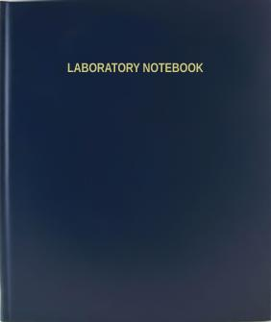
1. Basics of research work
1.2. Observation and experiment - two general approaches
How to perform experiments? Experimental design, data acquisition, processing and interpretation
Data acquisition in the laboratory:
- rules for health and safety policy careful handling with chemicals, radioactive material and genetically modified material, protective coats and glowes are often obligatory
- hand-written laboratory notebook
- electronical version of the experimental protocol
B130P16: Practical basics of scientific work Department of Experimental Plant Biology, FS CU https://lhr.ueb.cas.cz/petrasek/B130P16.htm

Slide 22
1. Basics of research work
1.2. Observation and experiment - two general approaches
Reasons to keep a laboratory notebook
To provide yourself with a complete record of why experiments were initiated and how they were performed. You’ll forget if you don’t. Seriously: even in your youth your brain cells are senescing.
To give yourself a central, physical place to record your data, to note statistical outcomes, and to paste graphs that show results. Researchers who keep these items in separate places are unlikely to be productive scientists.
To encourage sound thinking. Keeping a notebook gives you a forum to talk to yourself — to ask questions, to record important thoughts about the experimental design, and to speculate on how your results might eventually be interpreted.
To provide information to a person who is interested in continuing your research project, even if you deem that possibility hilariously unlikely. And if you’re doing important research and die an early, gruesome death, your colleagues might want to pick it up.
To get rich. Not everyone sets out with the goal of patenting a process or contraption, but you might stumble onto something actually important, and in such an event you must have a notebook that supports your claims.
Colin Purrington, https://colinpurrington.com/tips/lab-notebooks/
B130P16: Practical basics of scientific work Department of Experimental Plant Biology, FS CU https://lhr.ueb.cas.cz/petrasek/B130P16.htm

Slide 23
1. Basics of research work
What to use as a laboratory notebook
Purchase a notebook that possesses a stitched binding. Spiral-bound notebooks are undesirable because it is too tempting to rip out pages in moments of frustration or when you make silly mistake. And glue-bound notebooks are generally bad because glue doesn’t last over time (it ages and becomes brittle, plus cockroaches will eat glue). Ring binders and stacks of loose paper are unacceptable.
Some laboratory notebooks have a “carbon copy” function that allows a duplicated sheet to be created and then removed to a second, safer location. I think these notebooks encourage bad notebook procedures and should be avoided. A proper notebook has a lot of glued-in information (printed graphs, datasheet templates, photographs, product labels, etc.) that simply will not show up on the sheet below, so the “carbon copy” notebooks are only good for archiving written entries. If you really want a backup of your notebook, make a daily date with a Xerox machine. For the truly motivated and/or paranoid, take a photograph of your completed pages each day with your smartphone and store the files in the cloud. Or get a camera equipped with Wifi that sends pics to a designated cloud folder automatically. [If you run a laboratory crawling with undergraduates, you might consider faking a notebook theft just to jar the students into considering these eventualities … it would be a good learning moment, plus good fun to see them all panic.]
Notebooks come in a variety of dimensions. Those larger than a standard page are convenient because you can easily paste in printer output without using scissors. On the other hand, smaller notebooks are much easier to lug around in field conditions, and look cute. There’s a lot to be said for cute. 4. More expensive notebooks have much nicer paper, so if you like a smooth, non-fibrous surface to write on, spend the extra money. Nothing beats smooth, expensive paper to boost creativity and productivity (but that’s just me, and I have a paper and pen fetish).
5. Spend the extra money for a notebook that has pre-numbered pages. You probably can figure out how to number them yourself but it’s boring and life is short.
6. If your parents or mentor are springing for the notebook, you might opt for the really, really expensive variety that lays completely flat when open. It’s a small thing, but it grows on you.
7. If you want to keep a digital notebook, take a look at these reviews at The Chronicle, Nature, and Postdocexperience.
Colin Purrington, https://colinpurrington.com/tips/lab-notebooks/
B130P16: Practical basics of scientific work Department of Experimental Plant Biology, FS CU https://lhr.ueb.cas.cz/petrasek/B130P16.htm

Slide 24
1. Basics of research work
What to put on the outside of your notebook
Put your full name and year of use on the front of notebook. And make it the actual year, not ’19. In 100 years that’s going to be so out of date.
I also suggest adding your last name and date span (e.g., 2013/06 - 2013/12) on the spine so that you can find your research when it’s on a shelf with lots of other notebooks that look exactly alike (e.g., photograph). For writing on the spine I recommend light-colored paint pens.
Put your mailing address, phone number, and e-mail on the inside cover. This information is useful when you foolishly leave your notebook somewhere. Tape a $5 bill to the inside front cover with a note saying, “I’ll give you another if you find this notebook.” If your research is priceless, it’s money well spent. It’s especially good to have wording like this if you do field research with your notebook.
Bling. If the notebook is yours, take some pride in what you do and get crafty with the exterior. Good science is an inherently creative process, so I suspect most researchers have blinging talents even if repressed by years of scorn from colleagues.
Colin Purrington, https://colinpurrington.com/tips/lab-notebooks/
B130P16: Practical basics of scientific work Department of Experimental Plant Biology, FS CU https://lhr.ueb.cas.cz/petrasek/B130P16.htm

Slide 25
1. Basics of research work
General guidelines for maintaining a notebook
Use a pen, never a pencil. As for what kind of pen, use a ball point, gel pen, or Rapidograph — all types of which have ink that can stand up to water and most solvents. If you know what you’re doing, a fountain pen with archival, waterproof ink (e.g., Bulletproof Black ink from Noodler’s) works well, too.
Avoid using Sharpies (or equivalent). These markers were very good at resisting water spills but can be removed by many solvents. More importantly, permanent markers tend to bleed through to the underlying page, which makes for rather sloppy, illegible laboratory notebooks.
Devote pages 1 and 2 to a Table of Contents (which you will fill in as time passes). Have 2 columns, one for the experiment name and one for the page number where an experiment starts, etc. If you come back to your notebook after 20 years, you will be able to quickly find the appropriate section of your notebook. This Table of Contents is also crucial for others who might want to use the notebook to reconstruct your activities.
Never remove a page. This directive is to prevent unscrupulous researchers from “losing” data that might not have been favorable to their research objectives. If you rip out some pages you thought were unnecessary, others might reasonably view the gaps as suspicious.
If you make a mistake, draw a thin line through the word or number rather than obliterating the entry with a blob of ink. You might decide, upon reflection, that your original entry was actually the correct one, and you will be glad that you can still read it.
For the same reason, never use correction fluids (e.g., White Out) or strips of white laboratory tape.
Write legibly. Your notebook does not have to be a work of art but it should be easily readable by another person of average intelligence.
Provide the full date whenever you make an entry. Use the international standard format if possible: YYYY/MM/DD (e.g., 2019/01/11). Note: only the month gets a leading zero when just a single digit.
There’s a fad in some fields to “recopy” notes into a different notebook at the end of the day. I think doing that is insane. Sure, you might have fresh insight when you’re recopying data and such, but you’ll invariably introduce copying errors (yes, even you). If you really think recopying is going to help your science, I suggest you record your “field” notes on one side of the notebook and then recopy and add insights onto the facing page. However, if you do fieldwork were it is likely that you’ll lose your notebook or it will be stolen by bands of thugs with machetes, recopying into a secondary notebook might make good sense (so don’t travel with both copies, just in case). Again, if you have a smartphone or wifi-enabled camera, just take daily photos of your pages and send them to the cloud.
Colin Purrington, https://colinpurrington.com/tips/lab-notebooks/
B130P16: Practical basics of scientific work Department of Experimental Plant Biology, FS CU https://lhr.ueb.cas.cz/petrasek/B130P16.htm

Slide 26
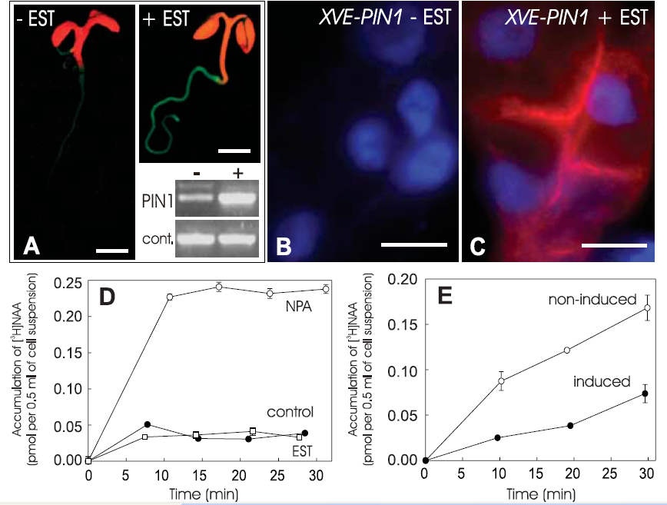
1. Basics of research work
1.2. Observation and experiment - two general approaches
How to perform experiments? Experimental design, data acquisition, processing and interpretation
Negative and positive controls
A negative control is a kind of control that is not expected to produce results.
A positive control is a kind of control that produce known results
Controls need to be involved to test methods, chemicals, organisms, etc.
B130P16: Practical basics of scientific work Department of Experimental Plant Biology, FS CU https://lhr.ueb.cas.cz/petrasek/B130P16.htm

Slide 27
1. Basics of research work
1.2. Observation and experiment - two general approaches
How to perform experiments? Experimental design, data acquisition, processing and interpretation
The evaluation and interpretation of the experiment:
- both original form of data (numbers, images) and processed data in a form of electronic protocol must be stored
- collecting processed data together with preliminary conclusions in a form of presentation is very useful
- statistical evaluation - depending on the experimental design, when needed it must be consulted with experts
B130P16: Practical basics of scientific work Department of Experimental Plant Biology, FS CU https://lhr.ueb.cas.cz/petrasek/B130P16.htm

