Slide 1
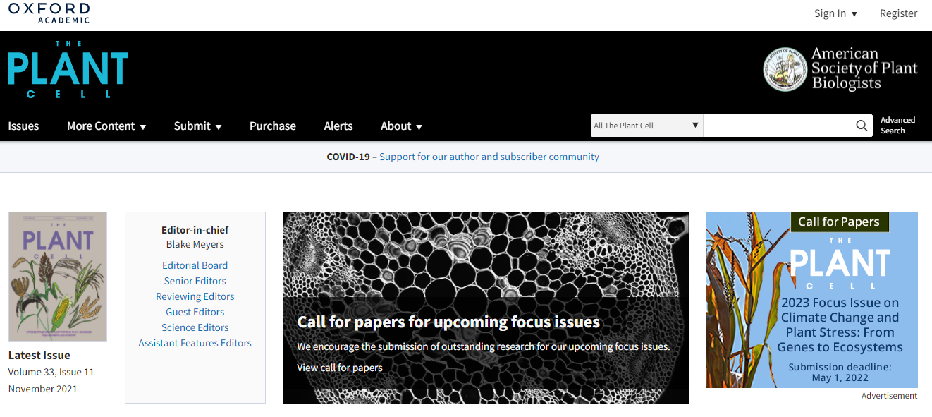
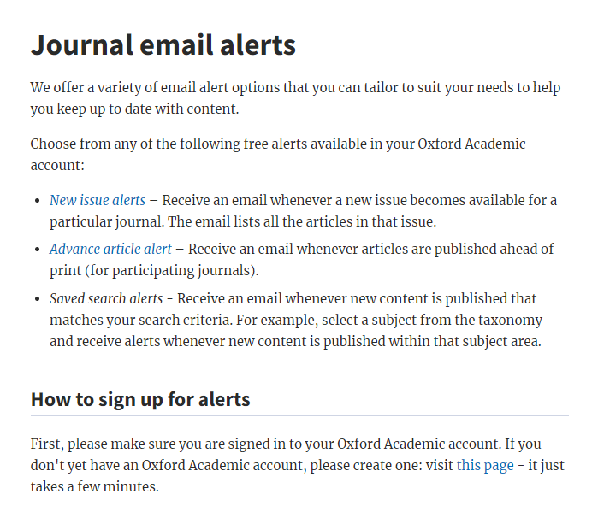





3. Scientific literature, Internet online resources
3.3 How to search bibliographic records and full text articles?
Browsing through every individual volume of the journal
It is necessary to select journals that are relevant to the field
One could be smashed by an enormous amount of articles
Searching is not so straightforward and comprehensive
E-mail alerts
B130P16E: Practical basics of scientific work Department of Experimental Plant Biology, FS CU https://lhr.ueb.cas.cz/petrasek/B130P16E.htm

Slide 2
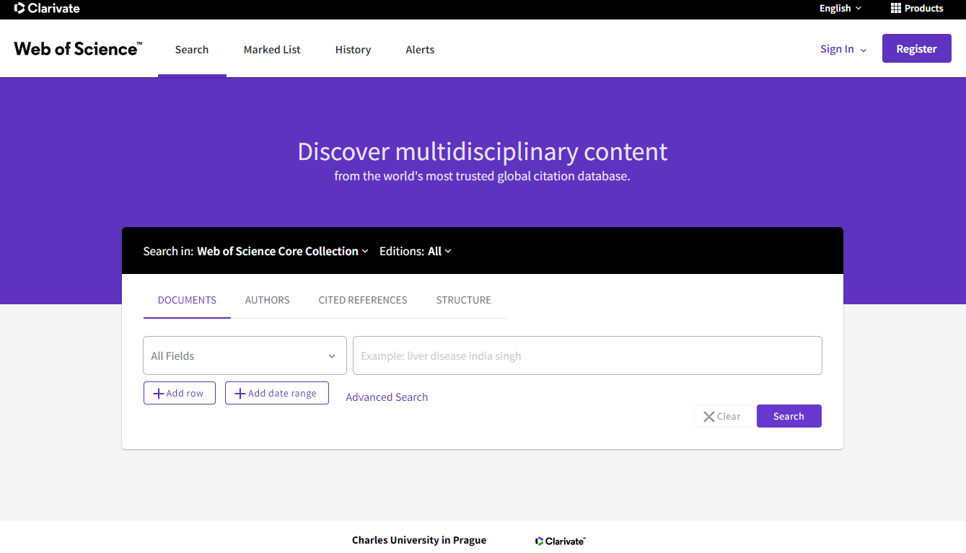
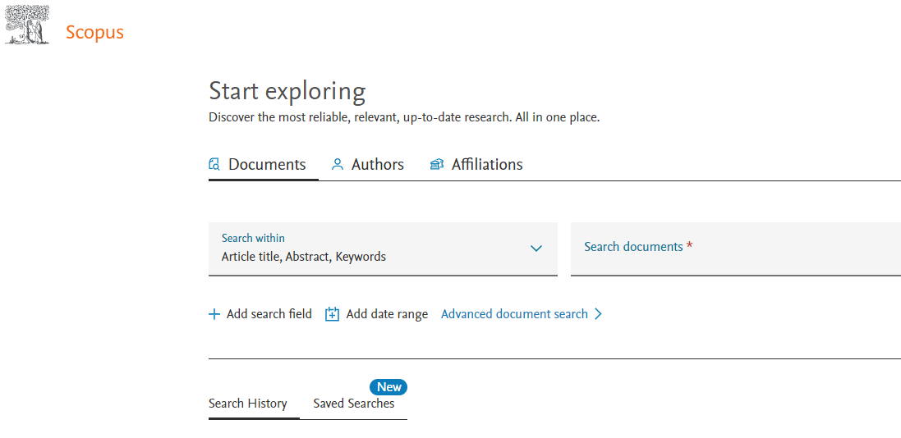
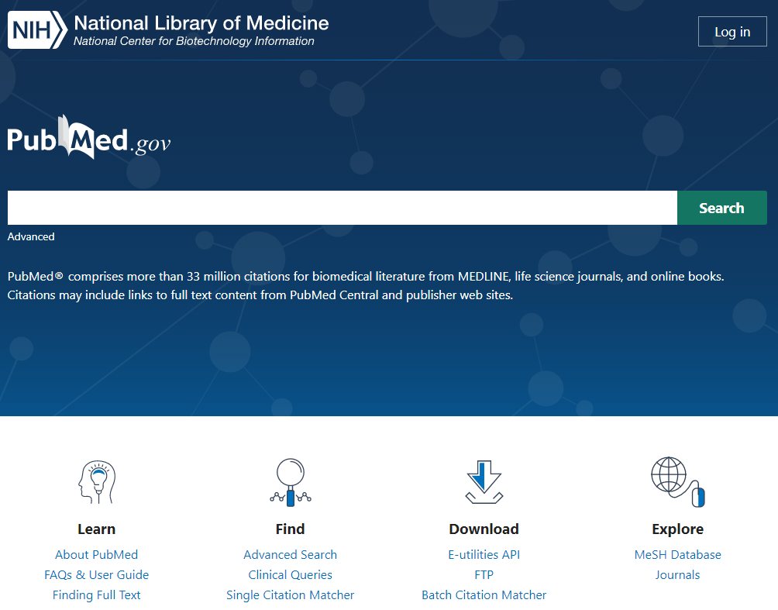
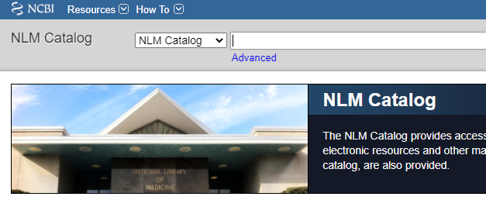
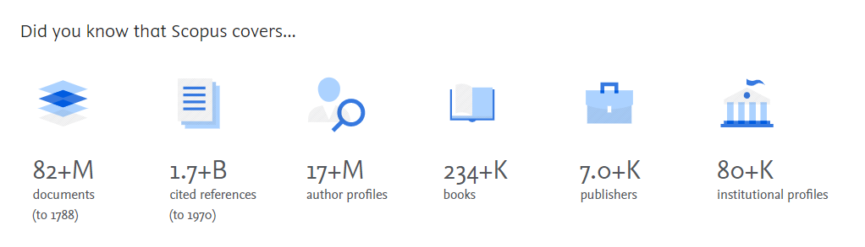

3. Scientific literature, Internet online resources
3.3 How to search bibliographic records and full text articles?
Literature searching using the bibliographic database
Complete information
One could be smashed by an enormous amount of records
Searching is very easy and comprehensive
The database must be searched regularly using clever combinations of key words
ISI Web of Knowledge
Scopus
Pubmed
B130P16E: Practical basics of scientific work Department of Experimental Plant Biology, FS CU https://lhr.ueb.cas.cz/petrasek/B130P16E.htm

Slide 3
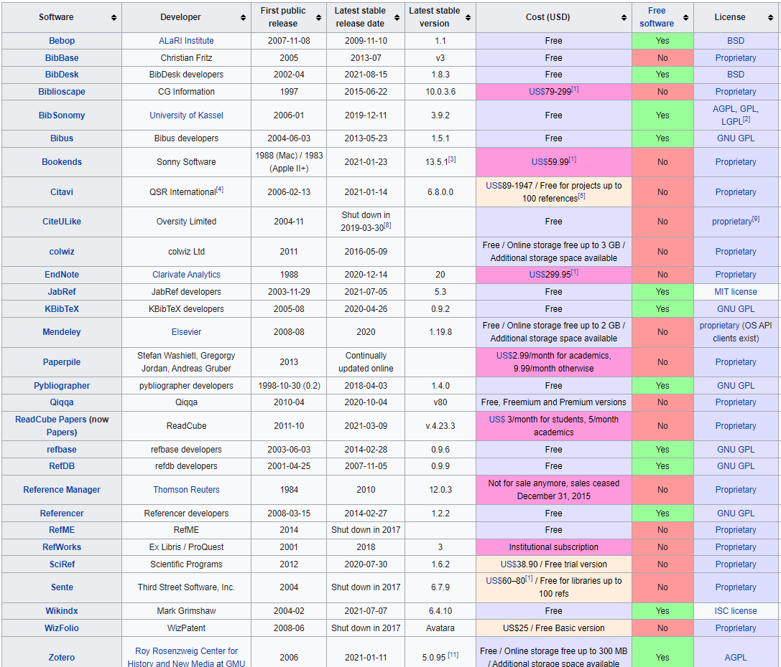
3. Scientific literature, Internet online resources
3.3 How to search bibliographic records and full text articles?
Creating a personal database of references
Reference management software
- both freeware and commercial reference management software exist
- import and export filters are shared
- citation styles and reference list file formats could be modified and saved
- integration into word processor
- communication with databases
https://en.wikipedia.org/wiki/Comparison_of_reference_management_software
B130P16E: Practical basics of scientific work Department of Experimental Plant Biology, FS CU https://lhr.ueb.cas.cz/petrasek/B130P16E.htm

Slide 4
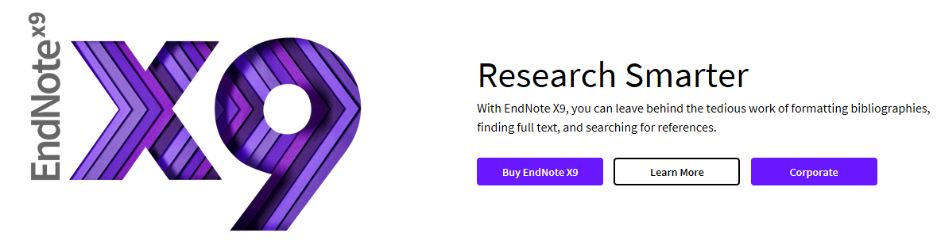
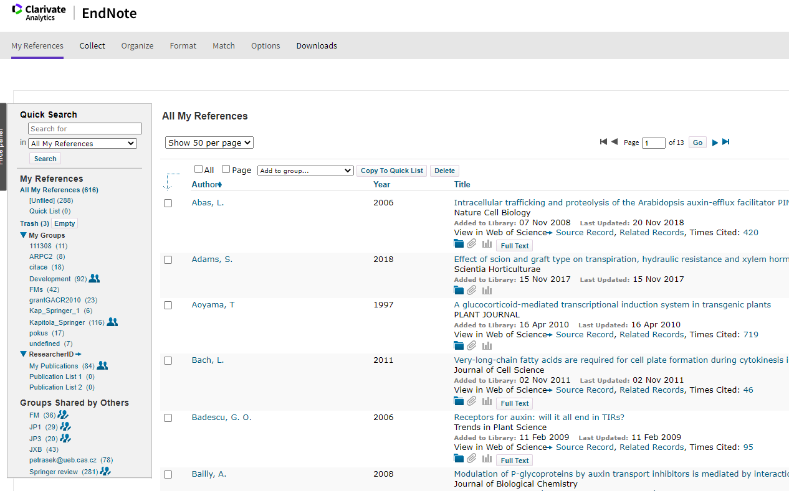
3. Scientific literature, Internet online resources
3.3 How to search bibliographic records and full text articles?
Creating a personal database of references
Reference management software
EndNote
- provided by Clarivate
- Commercial
MyEndNoteWeb
- provided by Clarivate
- freeware
B130P16E: Practical basics of scientific work Department of Experimental Plant Biology, FS CU https://lhr.ueb.cas.cz/petrasek/B130P16E.htm

Slide 5

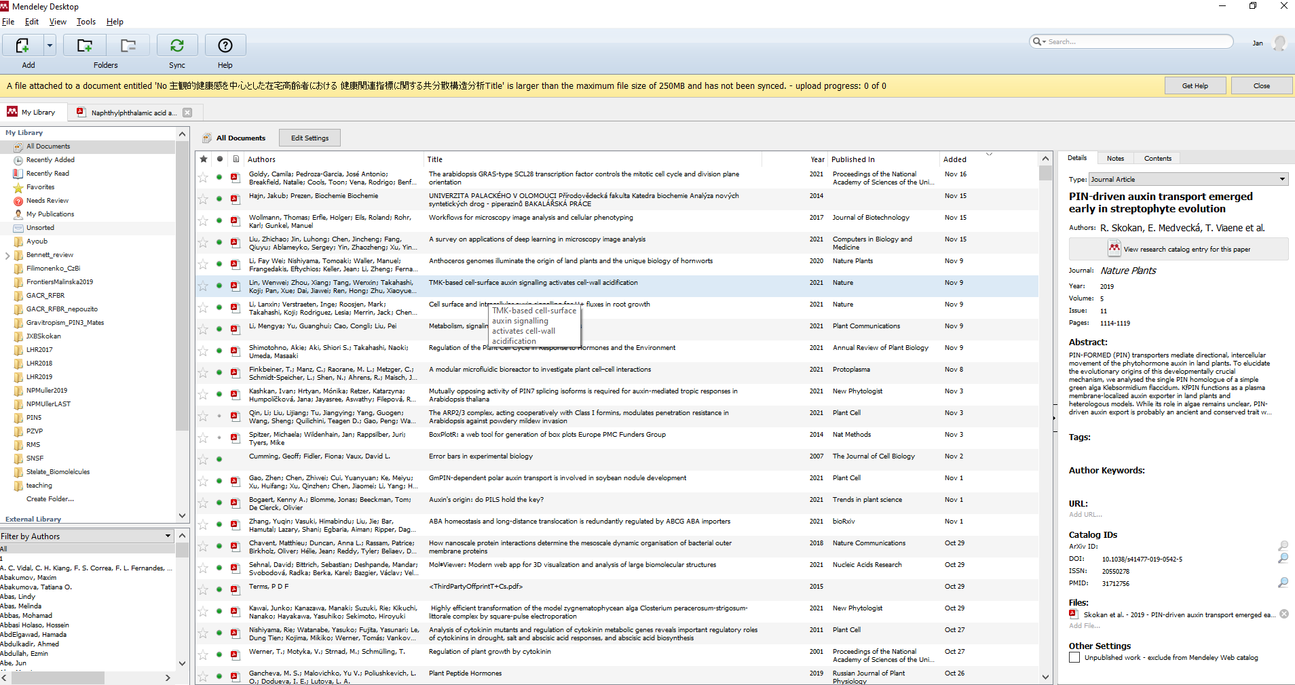

3. Scientific literature, Internet online resources
3.3 How to search bibliographic records and full text articles?
Creating a personal database of references
Mendeley
- perfect combination of full text and bibliography searching in one database
- 2 GB of cloud space for free
7 ways to add documents to Mendeley
B130P16E: Practical basics of scientific work Department of Experimental Plant Biology, FS CU https://lhr.ueb.cas.cz/petrasek/B130P16E.htm

Slide 6

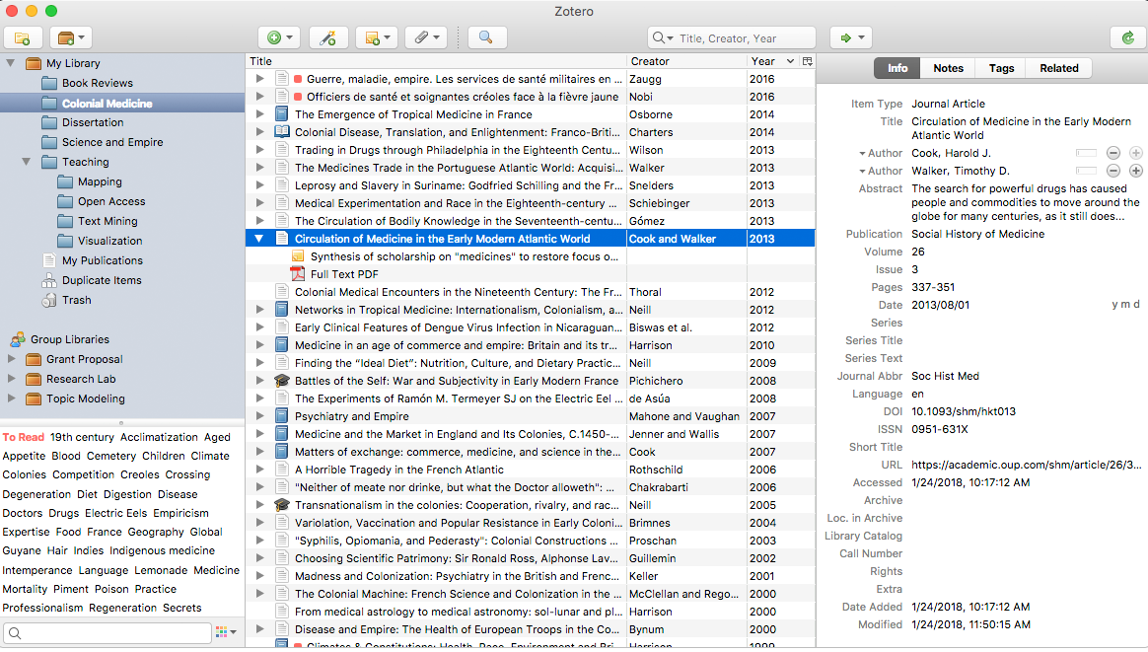
3. Scientific literature, Internet online resources
3.3 How to search bibliographic records and full text articles?
Creating a personal database of references
Zotero
- Very similar to Mendeley
- originally as a Firefox plugin, now as a stand alone application
- combination of full text and bibliographic approach
B130P16E: Practical basics of scientific work Department of Experimental Plant Biology, FS CU https://lhr.ueb.cas.cz/petrasek/B130P16E.htm

Slide 7
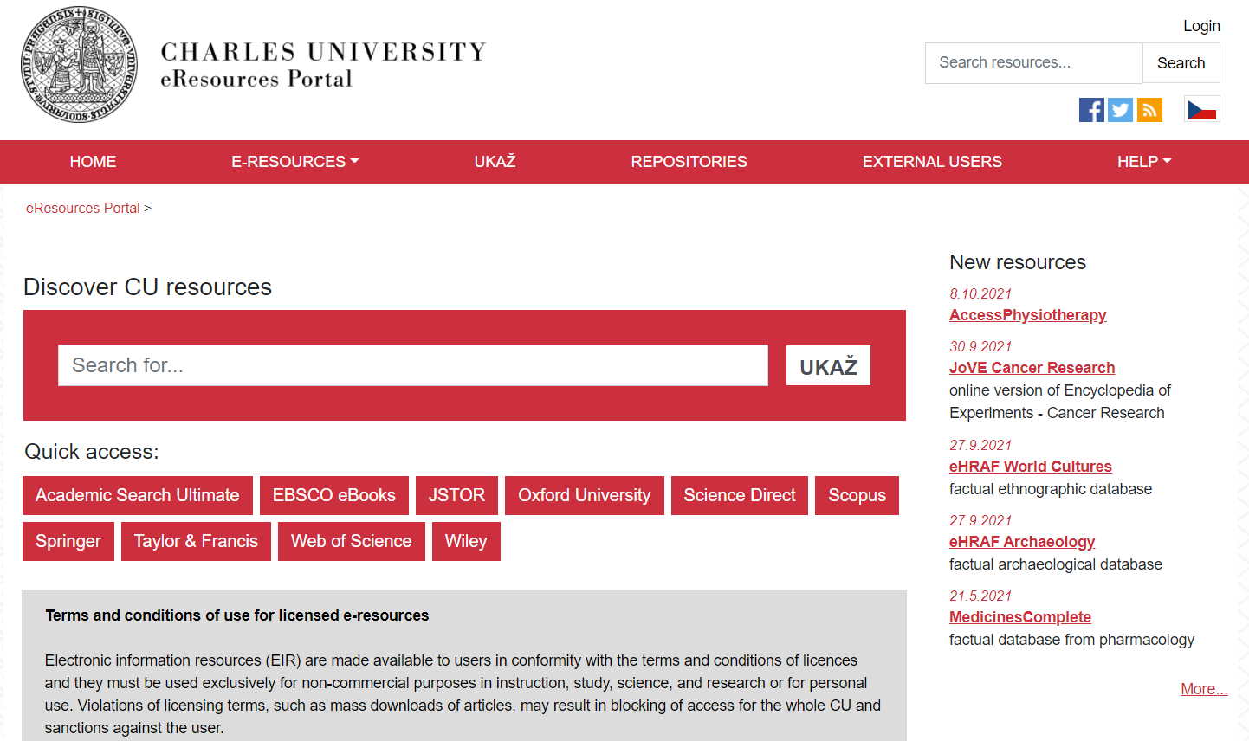
3. Scientific literature, Internet online resources
3.3 How to search bibliographic records and full text articles?
Finding full text of articles from journals or books
B130P16E: Practical basics of scientific work Department of Experimental Plant Biology, FS CU https://lhr.ueb.cas.cz/petrasek/B130P16E.htm

Slide 8

3. Scientific literature, Internet online resources
3.3 How to search bibliographic records and full text articles?
Finding full text of articles from journals or books
Some bibliographic databases integrate available full text resources „at one click“, like EndNote Click from Clarivate
B130P16E: Practical basics of scientific work Department of Experimental Plant Biology, FS CU https://lhr.ueb.cas.cz/petrasek/B130P16E.htm

Slide 9
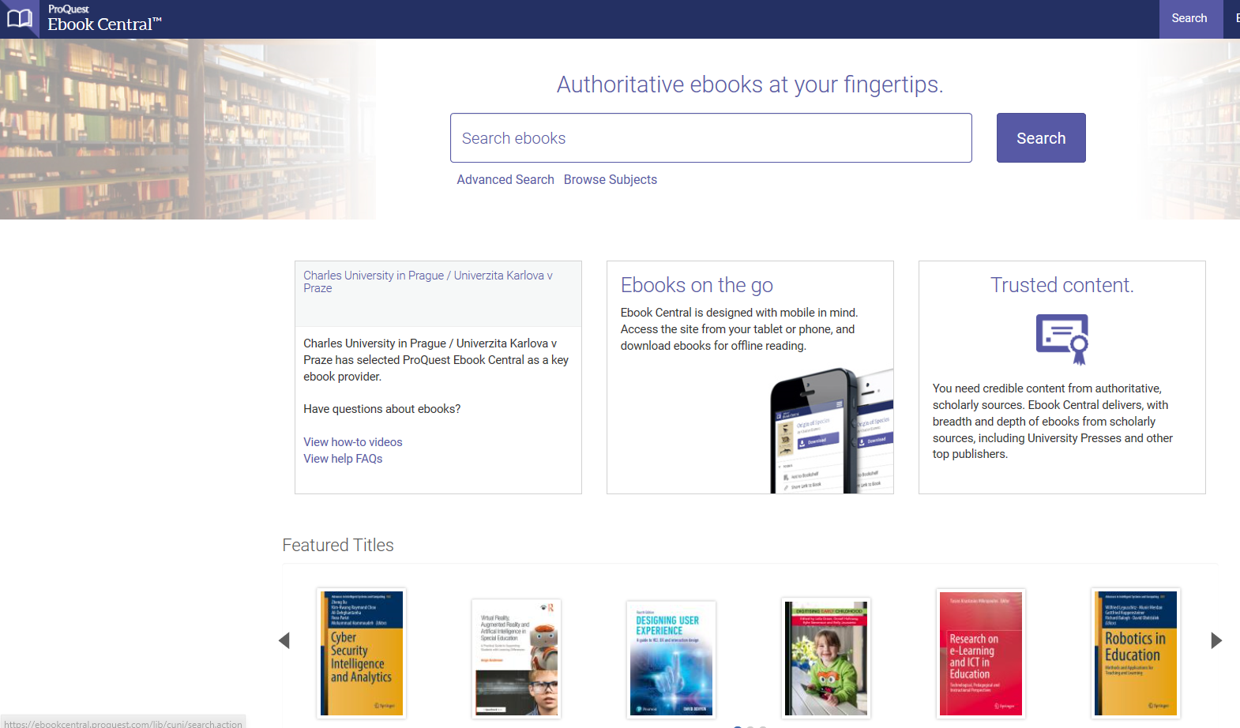
3. Scientific literature, Internet online resources
3.3 How to search bibliographic records and full text articles?
Finding full text of articles from journals or books
ProQuest Ebook Central https://ebookcentral.proquest.com/lib/cuni/home.action?ebraryDocId=null
B130P16E: Practical basics of scientific work Department of Experimental Plant Biology, FS CU https://lhr.ueb.cas.cz/petrasek/B130P16E.htm

Slide 10

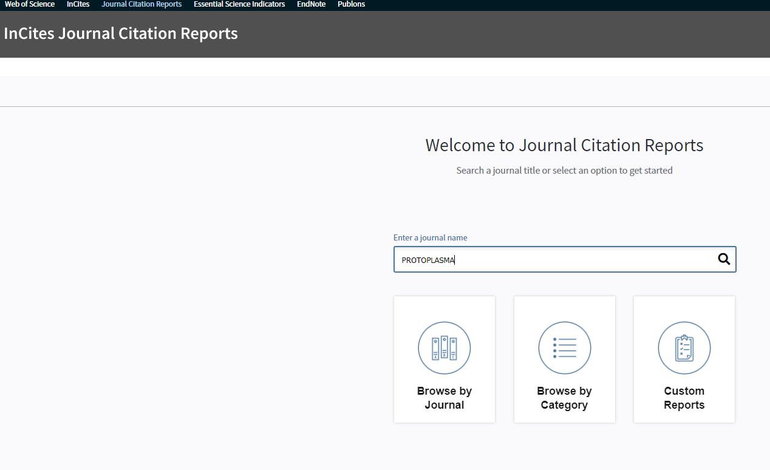
3. Scientific literature, Internet online resources
3.4 Scientometry as the a tool to evaluate the quality of scientific work
Journal Citation Reports - one of the database of Web of Knowledge of the Institute for Scientific Information (ISI). Journals from all scientific fields are included and evaluated. http://isiknowledge.com/
The comparison is largely mainly based on the impact factor (IF), i.e. the average number of citations per article within past two years. Higher impact factor usually reflects better quality and higher impact in the scientific community.
B130P16E: Practical basics of scientific work Department of Experimental Plant Biology, FS CU https://lhr.ueb.cas.cz/petrasek/B130P16E.htm

Slide 11
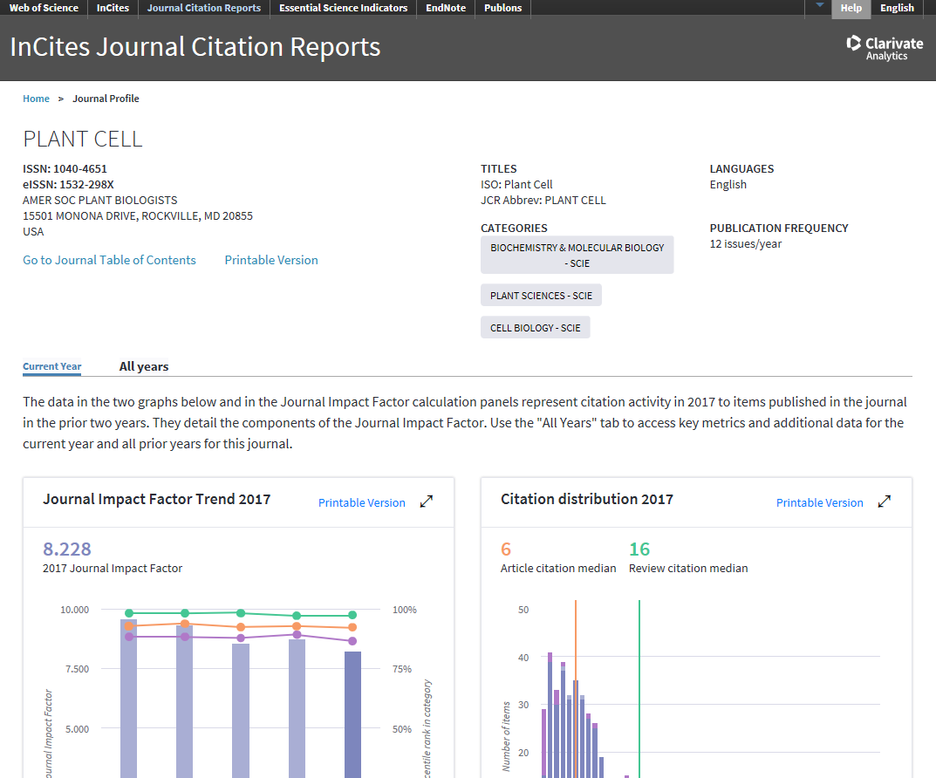
3. Scientific literature, Internet online resources
3.4 Scientometry as the a tool to evaluate the quality of scientific work
There are also several other factors with kind of improved validity for comparison between research fields, like Eigenfactor calculated from 5-year impact factor and considering also the scope of journals, where the citations appear.
Very often, journals are evaluated based on their ranking in individual quartiles of IF or Eigenfactor.
Good researchers are pushed to publish only in the best quartile or even decile.
B130P16E: Practical basics of scientific work Department of Experimental Plant Biology, FS CU https://lhr.ueb.cas.cz/petrasek/B130P16E.htm

Slide 12
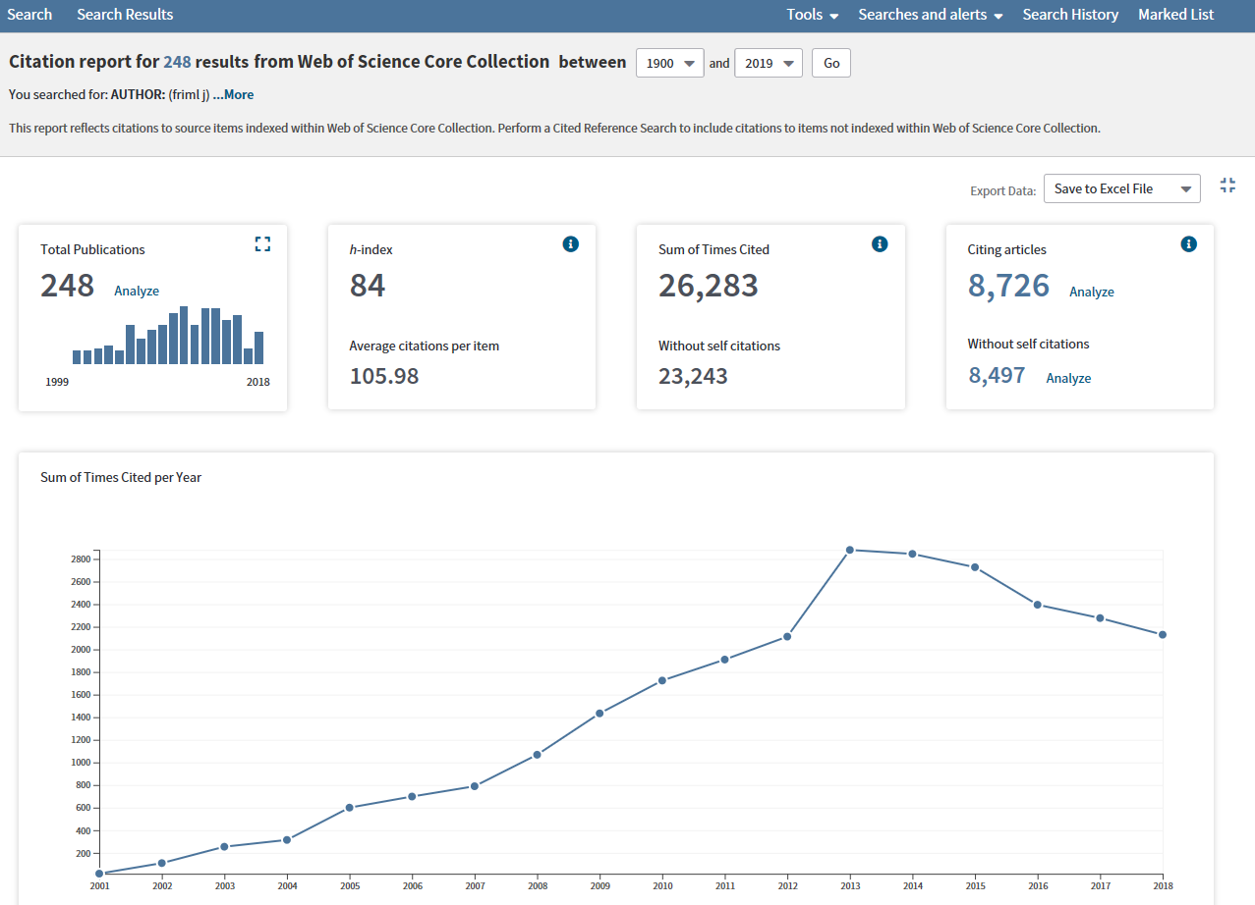
3. Scientific literature, Internet online resources
3.4 Scientometry as the a tool to evaluate the quality of scientific work
Scientometry is also used for the evaluation of the quality of individual researchers.
Hirsch index (h), introduced by J. Hirsch in 2005 is often used. A researcher has an h-index, if he/she has at least h publications for which he/she has received at least h citations.
h index could be found in WOS and Scopus.
B130P16E: Practical basics of scientific work Department of Experimental Plant Biology, FS CU https://lhr.ueb.cas.cz/petrasek/B130P16E.htm

Slide 13
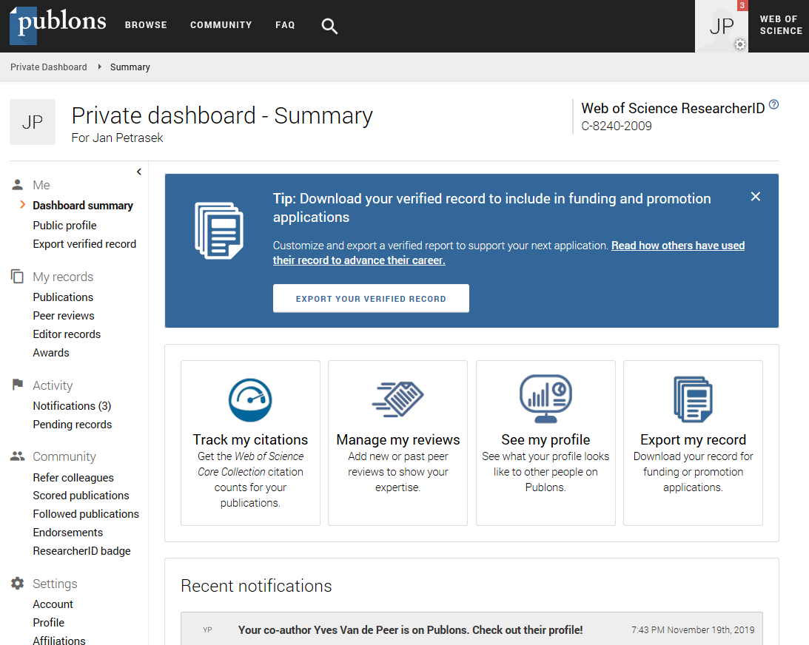

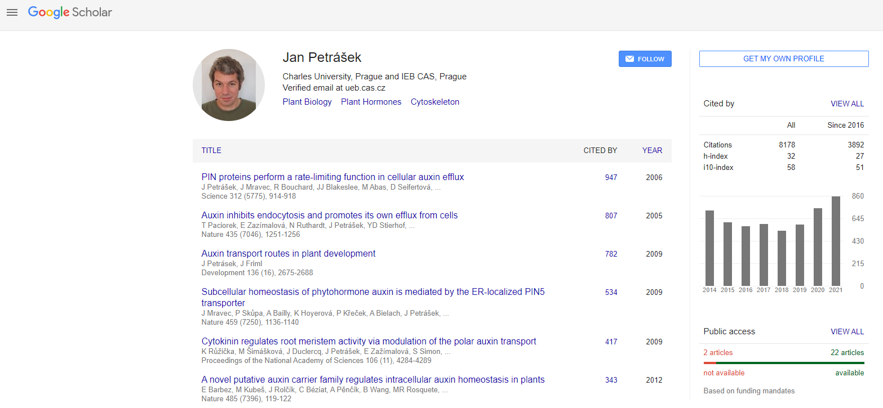
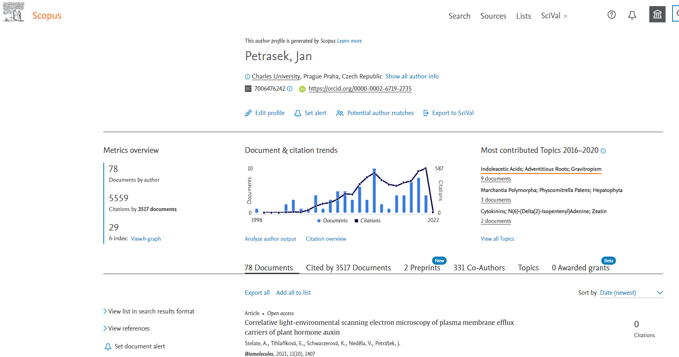
3. Scientific literature, Internet online resources
3.4 Scientometry as the a tool to evaluate the quality of scientific work
Citation profile for individual scientists could be found using author search using ISI WOS, Scopus or Google Scholar
Individual researcher are responsible for keeping their publication record up to date using following services:
1) Publons (formerly researcher ID, ISI WOS)
2) ORCID (Open Researcher and Contributor Identifier)
3) Google Scholar (User Profiles)
4) Scopus (Citation overview)
B130P16E: Practical basics of scientific work Department of Experimental Plant Biology, FS CU https://lhr.ueb.cas.cz/petrasek/B130P16E.htm

