Slide 1
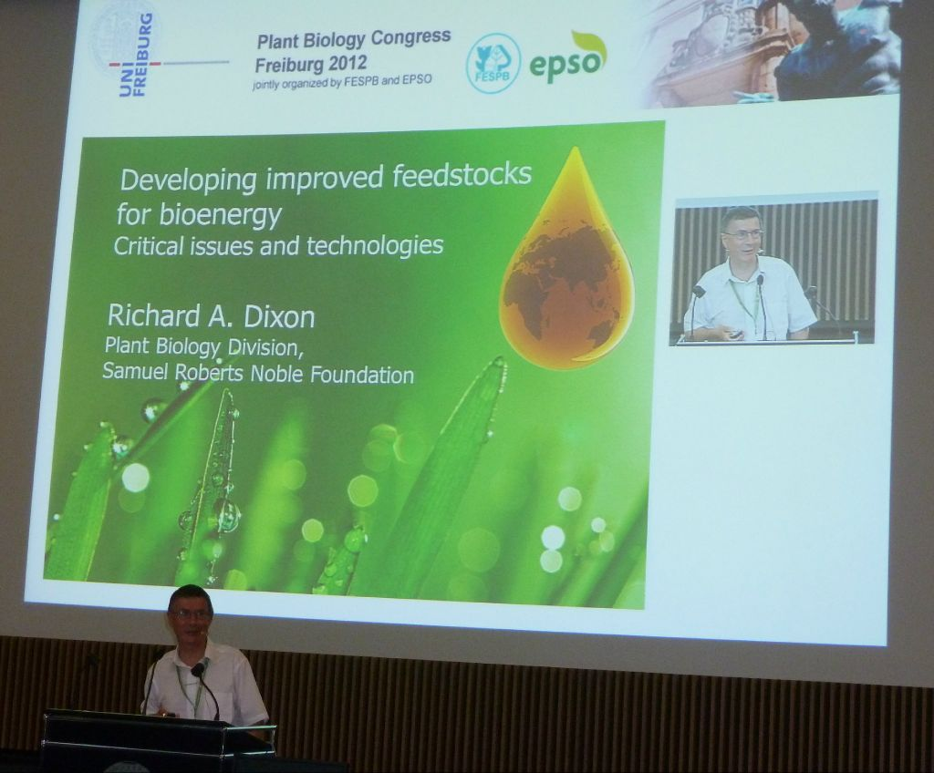



3. Scientific literature, Internet online resources
3.1. Types of scientific reports and their purpose
Two general forms
oral form - it is not obligatory, could be very formal and it can not be used for the justification of scientific priority
http://storify.com/rbastow/epso-fespb-plant-congres-2012
B130P16E: Practical basics of scientific work Department Experimental Plant Biology FSCU http:/lhr.ueb.cas.cz/petrasek

Slide 2
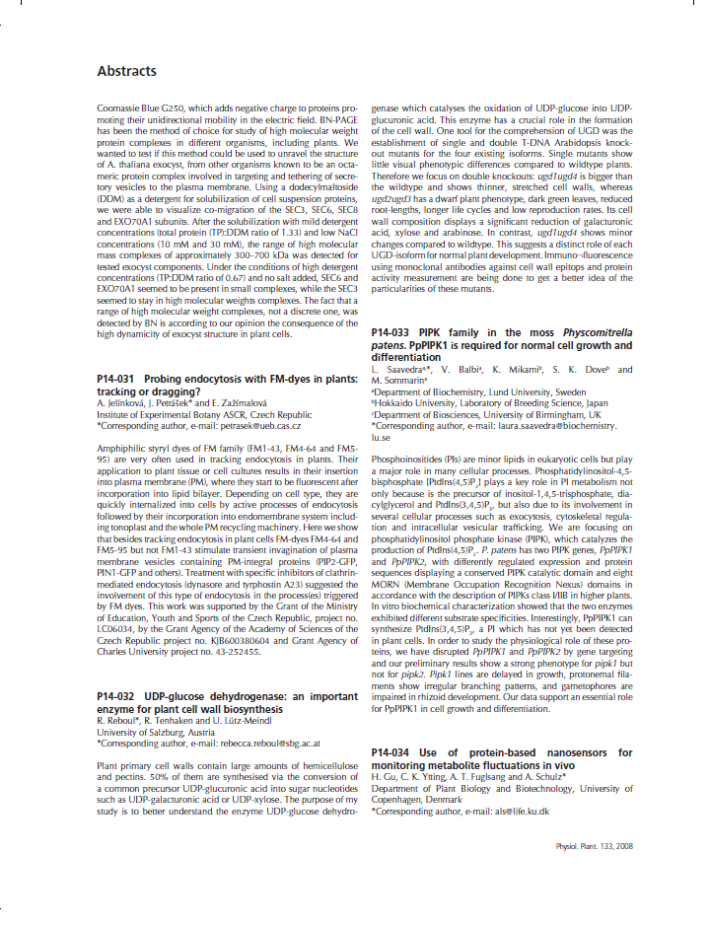

3. Scientific literature, Internet online resources
3.1. Types of scientific reports and their purpose
Two forms
oral form - it is not obligatory, could be both very formal and informal, it can not be used for the justification of scientific priority
written form - obligatory form of contribution, the scientific quality and relevancy of the article reflect both the quality of scientist and reviewer
Types of written contributions:
- abstract of oral or poster contribution - published in the book of abstracts, they are not reviewed
B130P16E: Practical basics of scientific work Department Experimental Plant Biology FSCU http:/lhr.ueb.cas.cz/petrasek

Slide 3
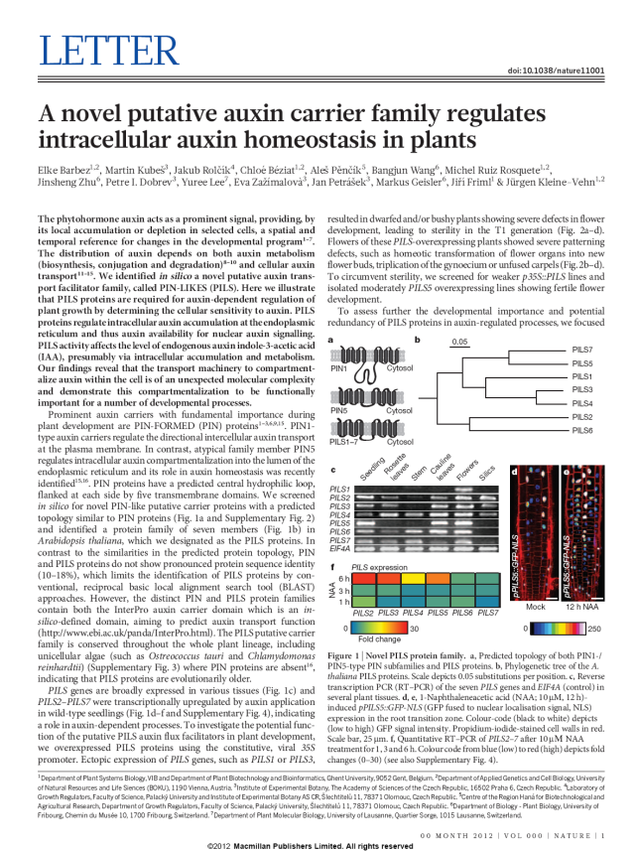
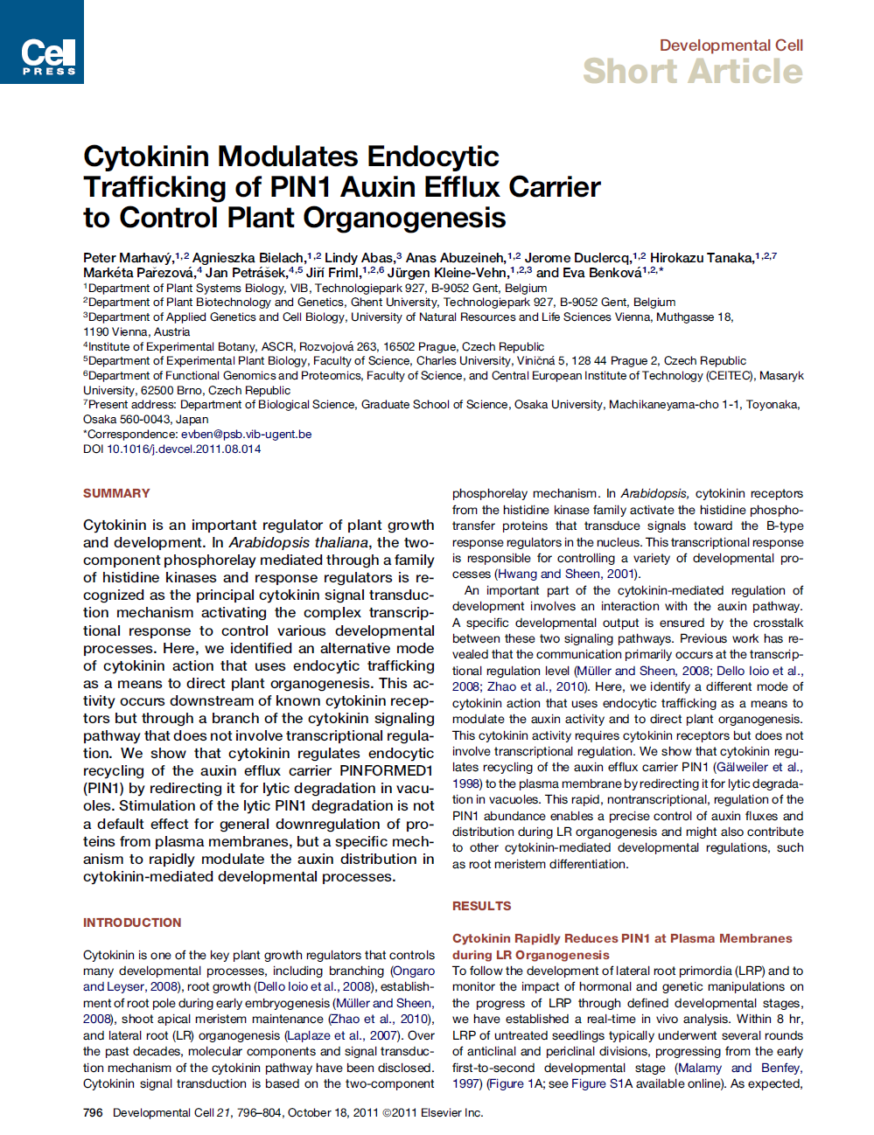
3. Scientific literature, Internet online resources
3.1. Types of scientific reports and their purpose
Two forms
oral form - it is not obligatory, could be very formal and it can not be used for the justification of scientific priority
written form - obligatory form of contribution, the scientific quality and relevancy of the article reflect both the quality of scientist and reviewer
Types of written contributions:
- original contribution (the article) - universal communication tool, it exists in several forms, the style of writing should be standardized
B130P16E: Practical basics of scientific work Department Experimental Plant Biology FSCU http:/lhr.ueb.cas.cz/petrasek

Slide 4
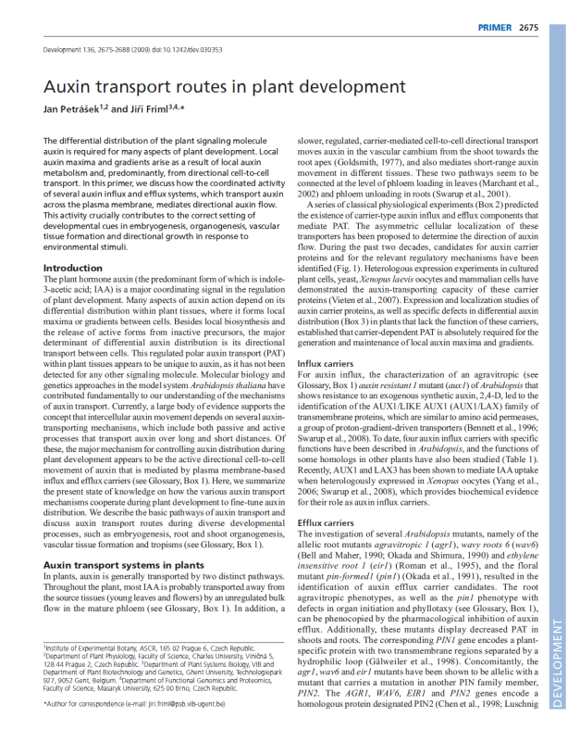
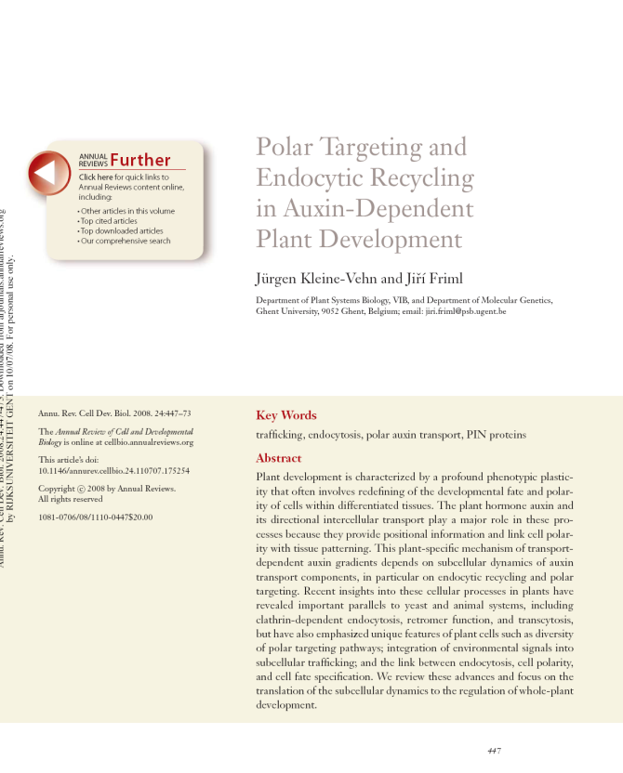
3. Scientific literature, Internet online resources
3.1. Types of scientific reports and their purpose
Two forms
oral form - it is not obligatory, could be very formal and it can not be used for the justification of scientific priority
written form - obligatory form of contribution, the scientific quality and relevancy of the article reflect both the quality of scientist and reviewer
Types of written contributions:
- review - summary of already published results with new interpretations, critical approach is highly needed here
B130P16E: Practical basics of scientific work Department Experimental Plant Biology FSCU http:/lhr.ueb.cas.cz/petrasek

Slide 5
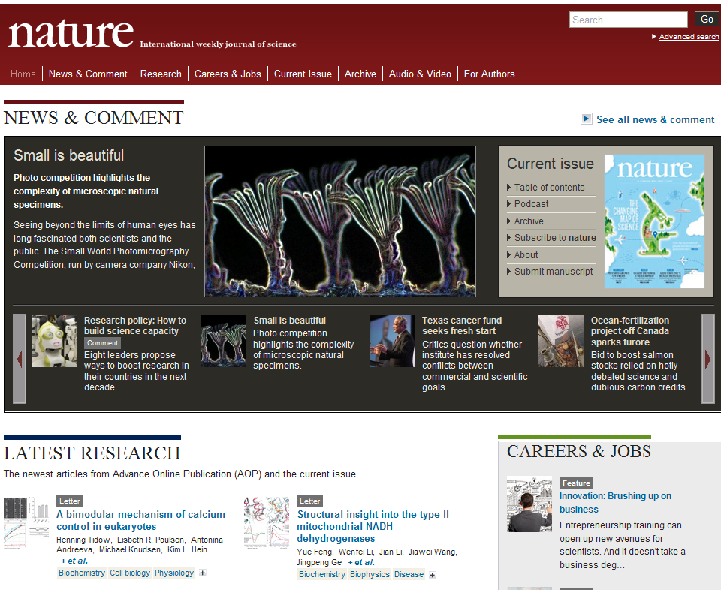
3. Scientific literature, Internet online resources
3.1. Types of scientific reports and their purpose
Main multidisciplinary scientific journals:
Nature
B130P16E: Practical basics of scientific work Department Experimental Plant Biology FSCU http:/lhr.ueb.cas.cz/petrasek

Slide 6
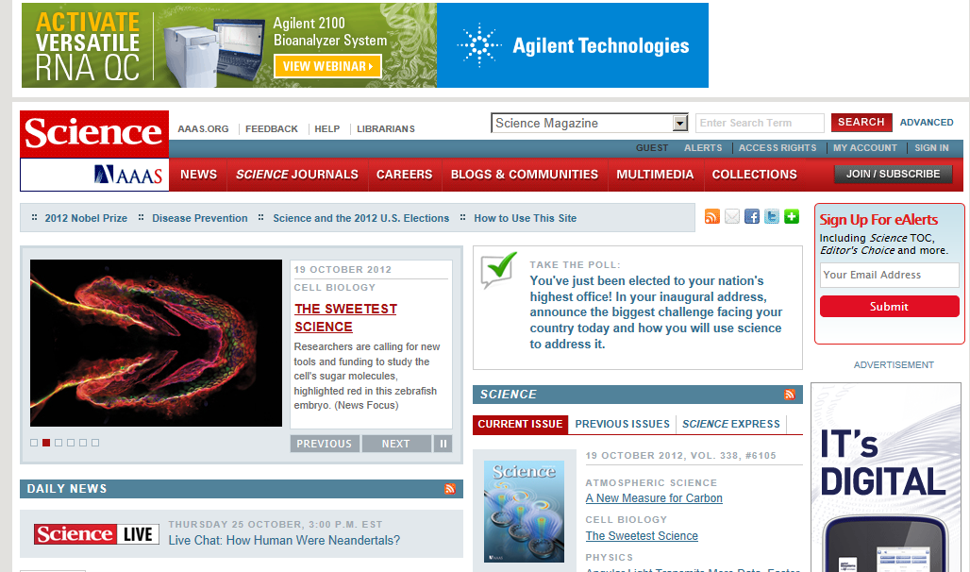
3. Scientific literature, Internet online resources
3.1. Types of scientific reports and their purpose
Main multidisciplinary scientific journals:
Science
B130P16E: Practical basics of scientific work Department Experimental Plant Biology FSCU http:/lhr.ueb.cas.cz/petrasek

Slide 7
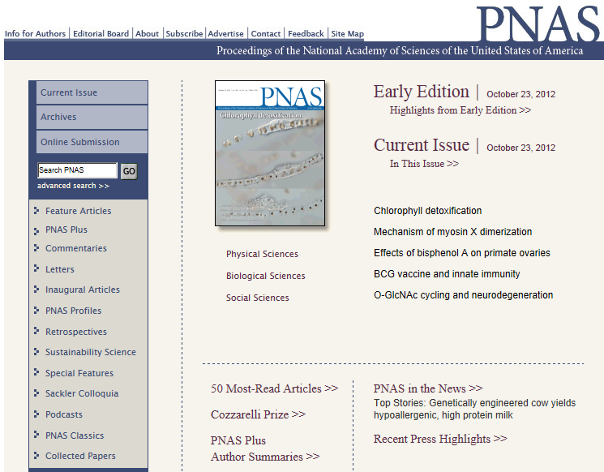
3. Scientific literature, Internet online resources
3.1. Types of scientific reports and their purpose
Main multidisciplinary scientific journals:
PNAS - Proceedings of the National Academy of Sciences of the United States of America
B130P16E: Practical basics of scientific work Department Experimental Plant Biology FSCU http:/lhr.ueb.cas.cz/petrasek

Slide 8
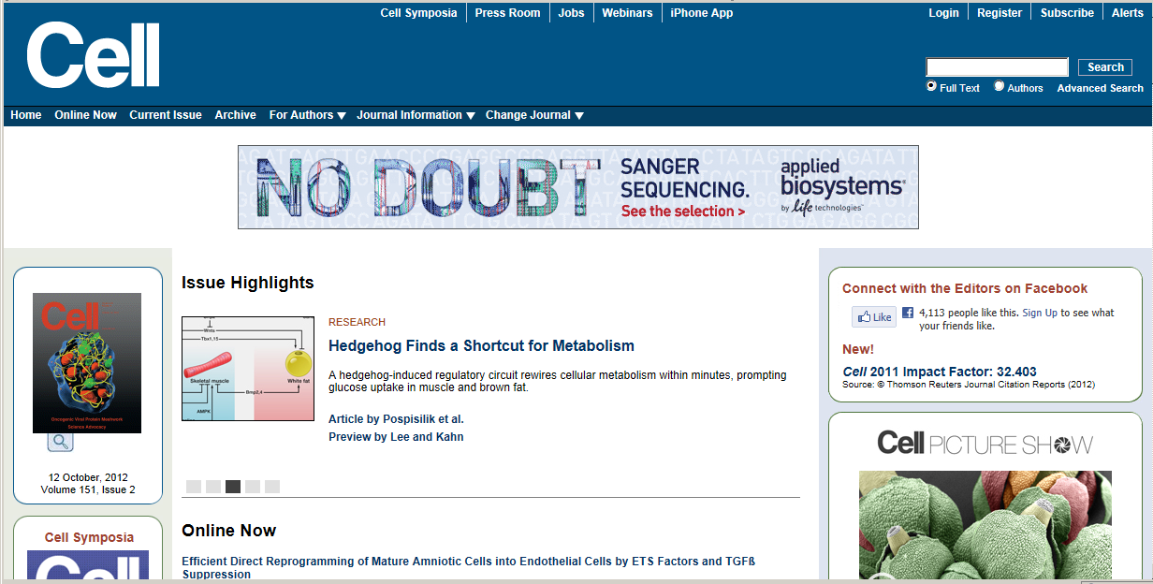
3. Scientific literature, Internet online resources
3.1. Types of scientific reports and their purpose
Main experimental biology journals
Cell
B130P16E: Practical basics of scientific work Department Experimental Plant Biology FSCU http:/lhr.ueb.cas.cz/petrasek

Slide 9
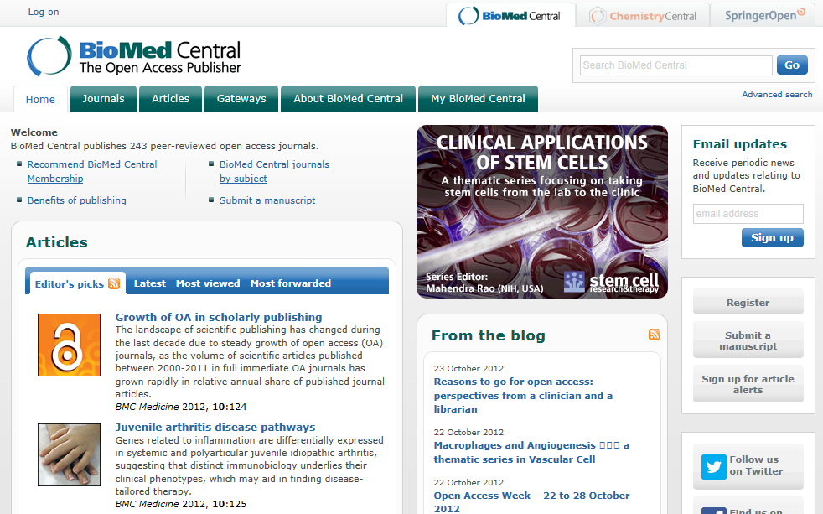
3. Scientific literature, Internet online resources
3.1. Types of scientific reports and their purpose
Electronical journal - open access publishers
BioMed Central
B130P16E: Practical basics of scientific work Department Experimental Plant Biology FSCU http:/lhr.ueb.cas.cz/petrasek

Slide 10

3. Scientific literature, Internet online resources
3.1. Types of scientific reports and their purpose
Electronical journal - open access publishers
Frontiers
B130P16E: Practical basics of scientific work Department Experimental Plant Biology FSCU http:/lhr.ueb.cas.cz/petrasek

Slide 11

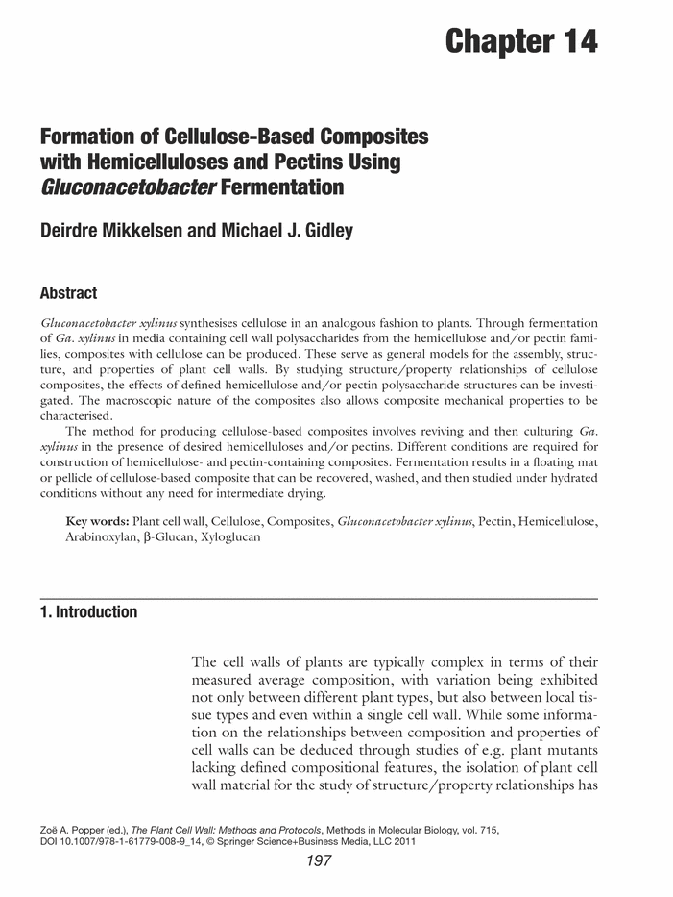
3. Scientific literature, Internet online resources
3.1. Types of scientific reports and their purpose
Monographs, books - collections of already published data, discussed in a way that resulting book will have long-term validity
B130P16E: Practical basics of scientific work Department Experimental Plant Biology FSCU http:/lhr.ueb.cas.cz/petrasek

Slide 12
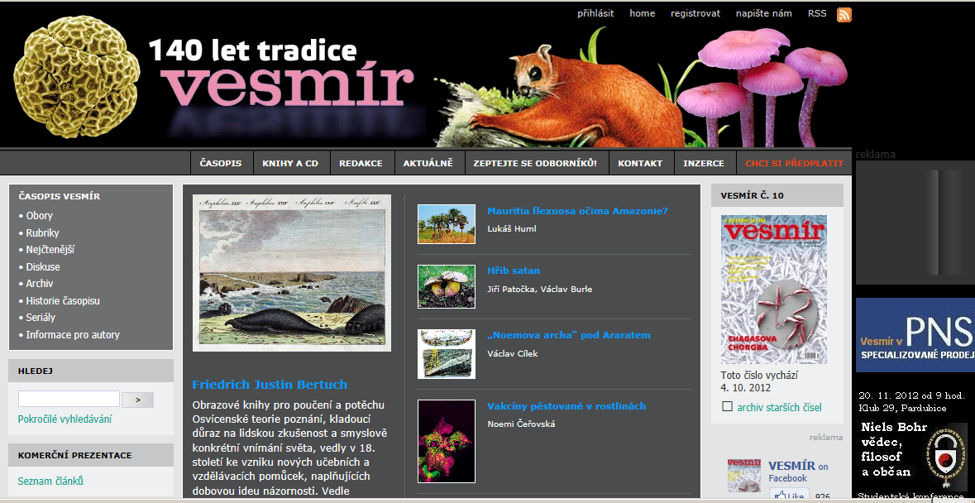
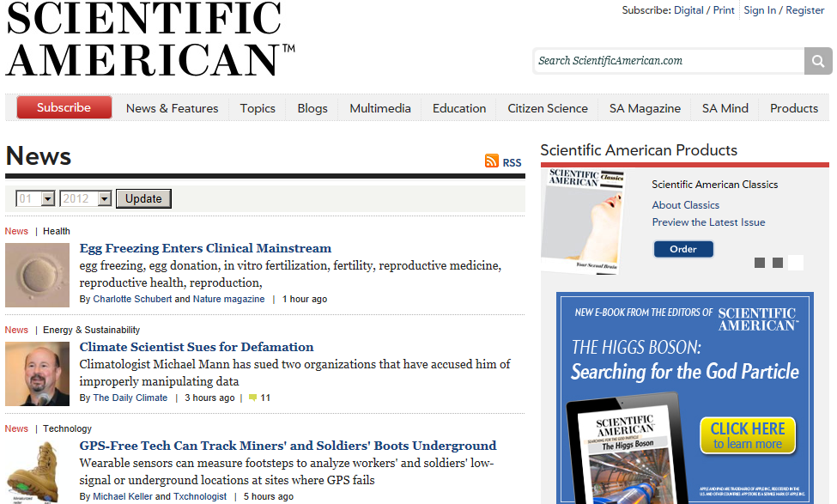
3. Scientific literature, Internet online resources
3.1. Types of scientific reports and their purpose
Science popularization article or a book - must be accessible to broad reading community (public), in the USA Scientific American, in the Czech Republic Vesmír
B130P16E: Practical basics of scientific work Department Experimental Plant Biology FSCU http:/lhr.ueb.cas.cz/petrasek

Slide 13
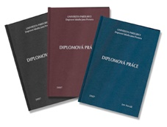
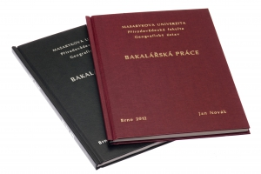
3. Scientific literature, Internet online resources
3.1. Types of scientific reports and their purpose
Bachelor, diploma, dissertation and habilitation thesis
- they are subject of rigorous review process, do not have to be necessarily original contributions, because findings can be published in a form of the scientific paper
E-thesis - electronical form of Ph.D. theses
B130P16E: Practical basics of scientific work Department Experimental Plant Biology FSCU http:/lhr.ueb.cas.cz/petrasek

Slide 14
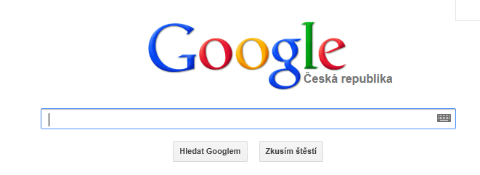
3. Scientific literature, Internet online resources
3.2. Internet information resources
Web browsers
B130P16E: Practical basics of scientific work Department Experimental Plant Biology FSCU http:/lhr.ueb.cas.cz/petrasek

Slide 15
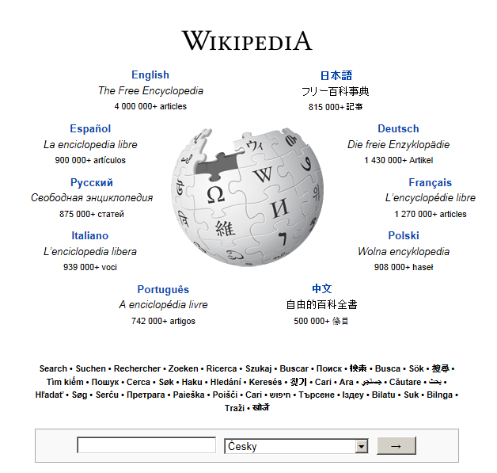
3. Scientific literature, Internet online resources
3.2. Internet information resources
Wikipedia
B130P16E: Practical basics of scientific work Department Experimental Plant Biology FSCU http:/lhr.ueb.cas.cz/petrasek

Slide 16
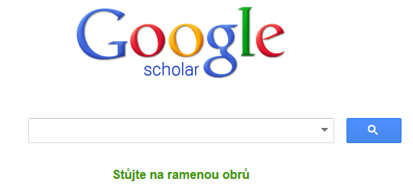
3. Scientific literature, Internet online resources
3.2. Internet information resources
Specialized web browsers - provides a search of scholarly literature across many disciplines and sources, including theses, books, abstracts and articles
B130P16E: Practical basics of scientific work Department Experimental Plant Biology FSCU http:/lhr.ueb.cas.cz/petrasek

Slide 17
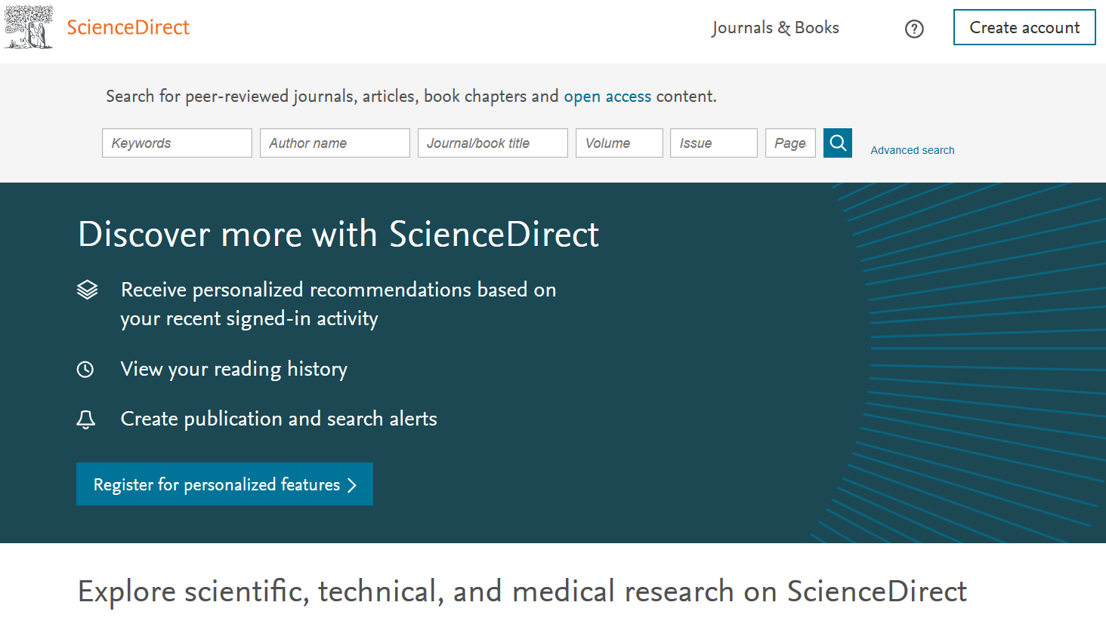
3. Scientific literature, Internet online resources
3.2. Internet information resources
Specialized browsers of some publishers
B130P16E: Practical basics of scientific work Department Experimental Plant Biology FSCU http:/lhr.ueb.cas.cz/petrasek

Slide 18
3. Scientific literature, Internet online resources
3.3. How to search for bibliographic records and full text articles
What types of databases do we have?
- bibliographic - there are only records about articles or books
- fulltext - contains full length articles in addition to bibliographic record
- personal - created by user with the help of specialized software
B130P16E: Practical basics of scientific work Department Experimental Plant Biology FSCU http:/lhr.ueb.cas.cz/petrasek

Slide 19
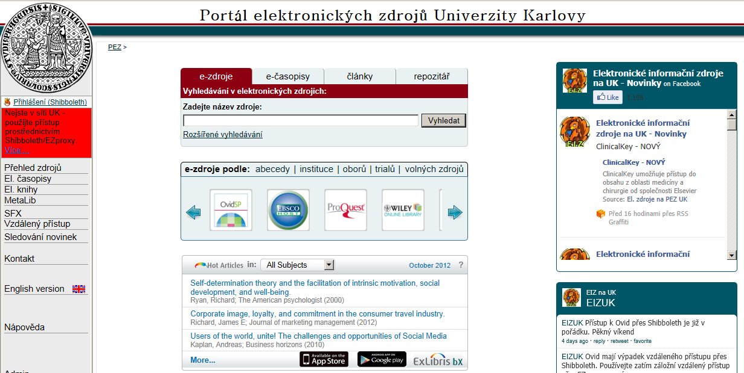
3. Scientific literature, Internet online resources
3.3. How to search for bibliographic records and full text articles
Electronic Information Resources at Charles University
B130P16E: Practical basics of scientific work Department Experimental Plant Biology FSCU http:/lhr.ueb.cas.cz/petrasek

Slide 20
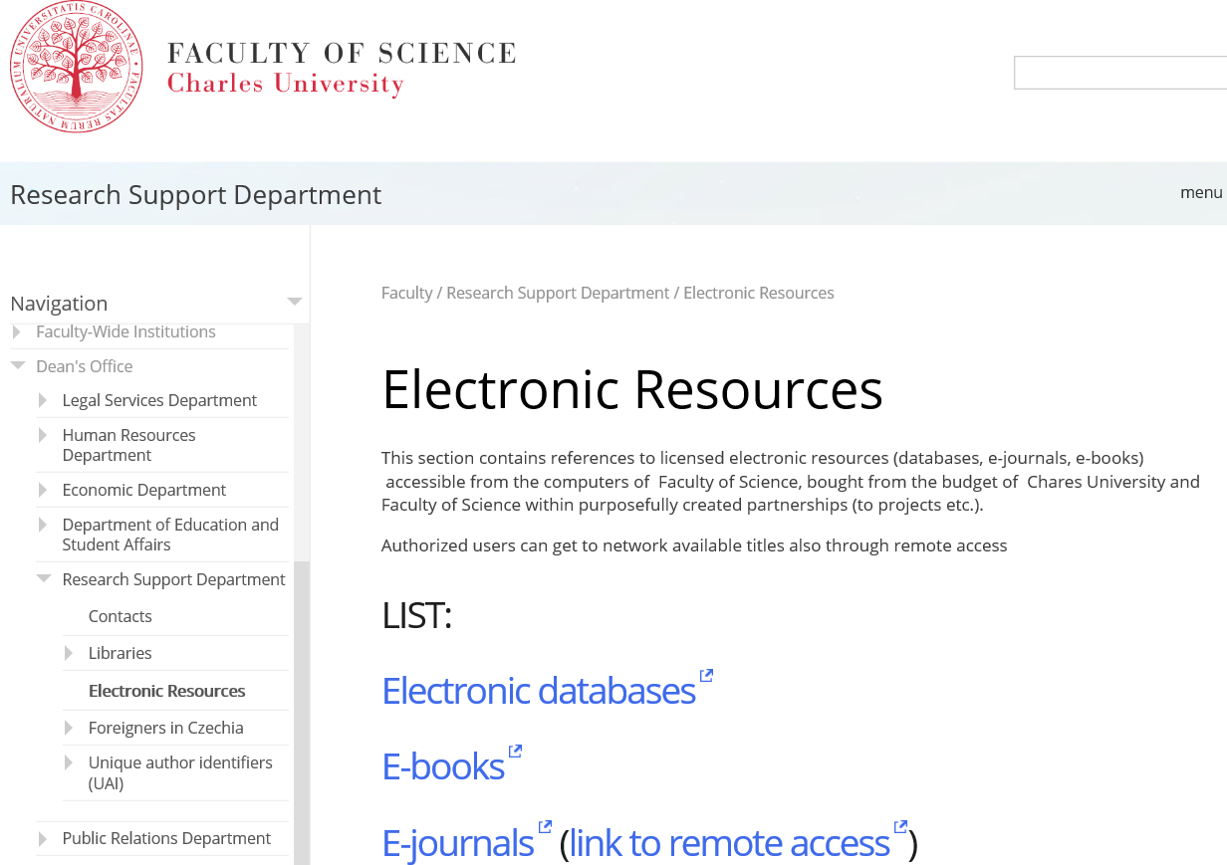
3. Scientific literature, Internet online resources
3.3. How to search for bibliographic records and full text articles
Scientific information department at our Faculty
B130P16E: Practical basics of scientific work Department Experimental Plant Biology FSCU http:/lhr.ueb.cas.cz/petrasek

Slide 21
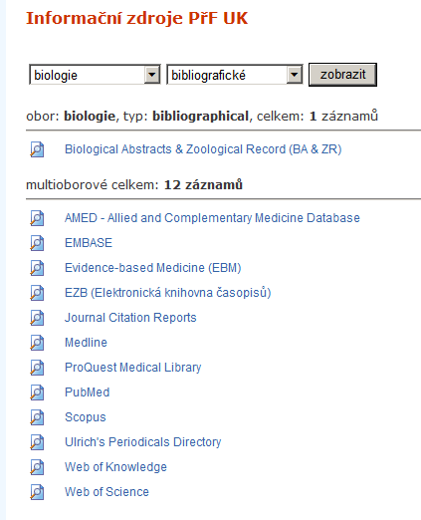
3. Scientific literature, Internet online resources
3.3. How to search for bibliographic records and full text articles
3.3.1. Bibliographic databases accessible at our faculty
B130P16E: Practical basics of scientific work Department Experimental Plant Biology FSCU http:/lhr.ueb.cas.cz/petrasek

Slide 22
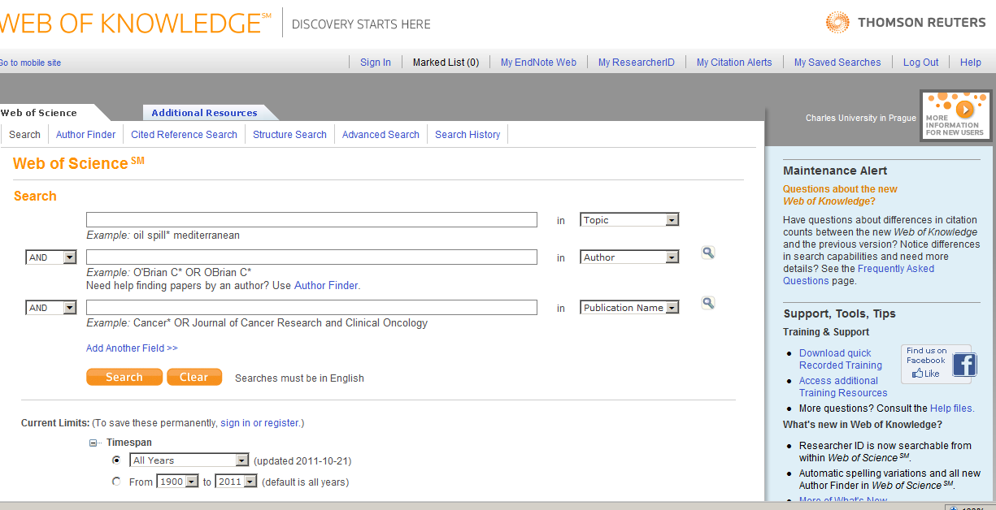
3. Scientific literature, Internet online resources
3.3. How to search for bibliographic records and full text articles
3.3.1. Bibliographic databases accessible at our faculty
ISI Web of Knowledge - commercial, citation and journal database. For academic users, requires authentication and login
B130P16E: Practical basics of scientific work Department Experimental Plant Biology FSCU http:/lhr.ueb.cas.cz/petrasek

Slide 23
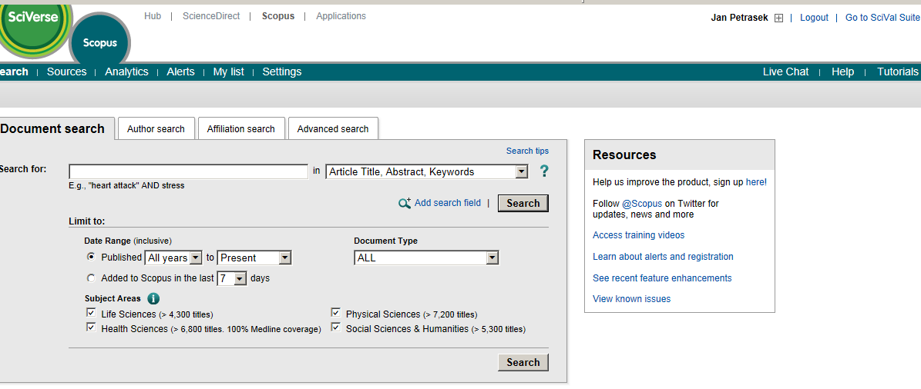
3. Scientific literature, Internet online resources
3.3. How to search for bibliographic records and full text articles
3.3.1. Bibliographic databases accessible at our faculty
Scopus - commercial, large abstract and citation database of research literature with links to full texts, requires authentication and login, same as used at Elsevier (ScienceDirect)
B130P16E: Practical basics of scientific work Department Experimental Plant Biology FSCU http:/lhr.ueb.cas.cz/petrasek

Slide 24
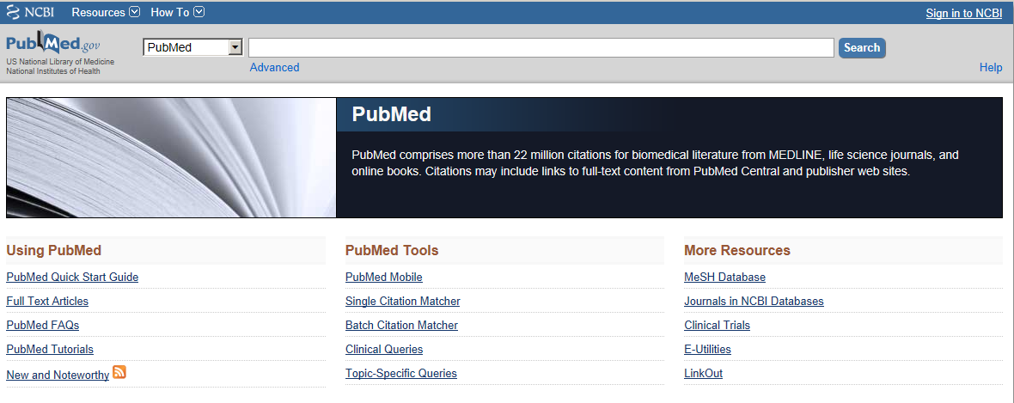
3. Scientific literature, Internet online resources
3.3. How to search for bibliographic records and full text articles
3.3.1. Bibliographic databases accessible at our faculty
NCBI Pubmed - free access, good coverage, online early and pre-print articles could be found here
B130P16E: Practical basics of scientific work Department Experimental Plant Biology FSCU http:/lhr.ueb.cas.cz/petrasek

Slide 25
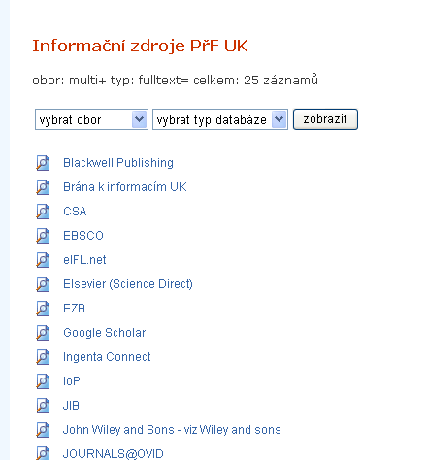
3. Scientific literature, Internet online resources
3.3. How to search for bibliographic records and full text articles
3.3.1. Full text databases accessible at our faculty
Např. Blackwell, Elsevier, JSTOR, Kluwer, Springer, Wiley, atd..
B130P16E: Practical basics of scientific work Department Experimental Plant Biology FSCU http:/lhr.ueb.cas.cz/petrasek

Slide 26
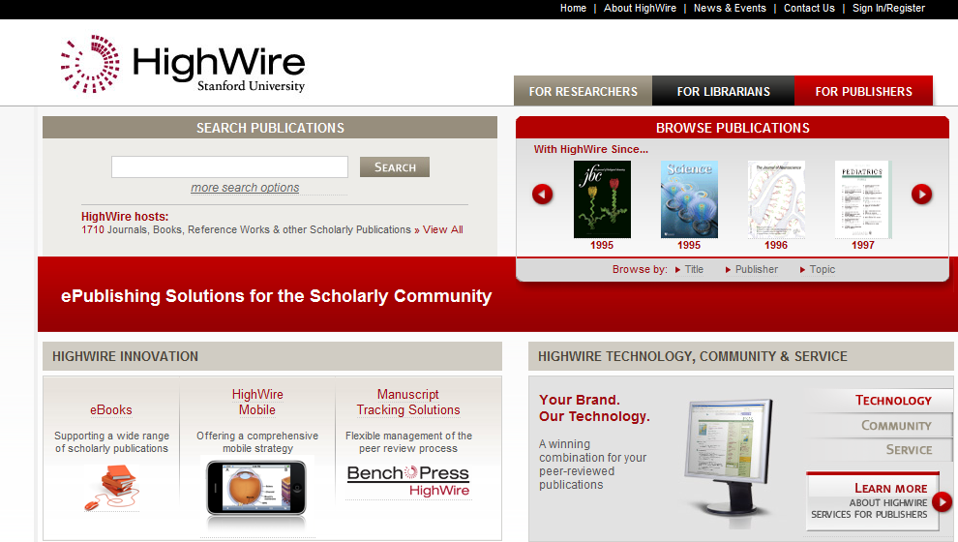
3. Scientific literature, Internet online resources
3.3. How to search for bibliographic records and full text articles
3.3.1. Full text databases accessible at our faculty
HighWire press - freely accessible database at Stanford Universit, the largest depository of full texts
B130P16E: Practical basics of scientific work Department Experimental Plant Biology FSCU http:/lhr.ueb.cas.cz/petrasek

