Slide 1



2. Helpful hints in the processing of experimental data
2.1. Organization of work, type of data
Continual processing and evaluation of experimental data is needed
- Avoid the approach: „ I am experimenting this year and during the next one, I am going to evaluate what I got“
- Miscellaneous software is in every day use
Types od data:
- Numerical data - raw data or data converted to the numerical form, may be obtained with simple tools (ruler etc.) or more complex instrumentation (spectrophotometer etc.)
- Graphical data - very frequent type of data, their quantification is extremely important
- Structural data - analytical data, outcomes from sequencing machines, etc.
B130P16E: Practical basics of scientific work Department Experimental Plant Biology FSCU http:/lhr.ueb.cas.cz/petrasek

Slide 2
2. Helpful hints in the processing of experimental data
2.1. Organization of work, type of data
Software used in modern laboratory:
- Software controlling machines - very often quite complex, the most important is the form of the output (table, text)
- General, „office“-type software - text and spreadsheet editors, graphical software, presentation software, mainly products of Microsoft at the Charles University
- Specialized software - very important in the field of image analysis and processing of sequence data
- Open source software - very good tools, often problems with the compatibility
- Online software - mainly in bioinformatics, but there is also other software available (e.g. graphical editors)
B130P16E: Practical basics of scientific work Department Experimental Plant Biology FSCU http:/lhr.ueb.cas.cz/petrasek

Slide 3
2. Helpful hints in the processing of experimental data
2.1. Organization of work, type of data
Windows Explorer or similar software (Windows Commander)
Individual folders should be named according to date.
Format ideally as YYMMDD (171030). The date must correspond well to the one in the laboratory book.
Never modify folder with raw data - copying to the folder with other files accompanying the experiment.
Back up data - external HDD or DVD, online cloud repositories.
Do not postpone backuping!!!
Experiment must be always finished with complete documentation, do not start the new one without finishing the previous.
B130P16E: Practical basics of scientific work Department Experimental Plant Biology FSCU http:/lhr.ueb.cas.cz/petrasek

Slide 4
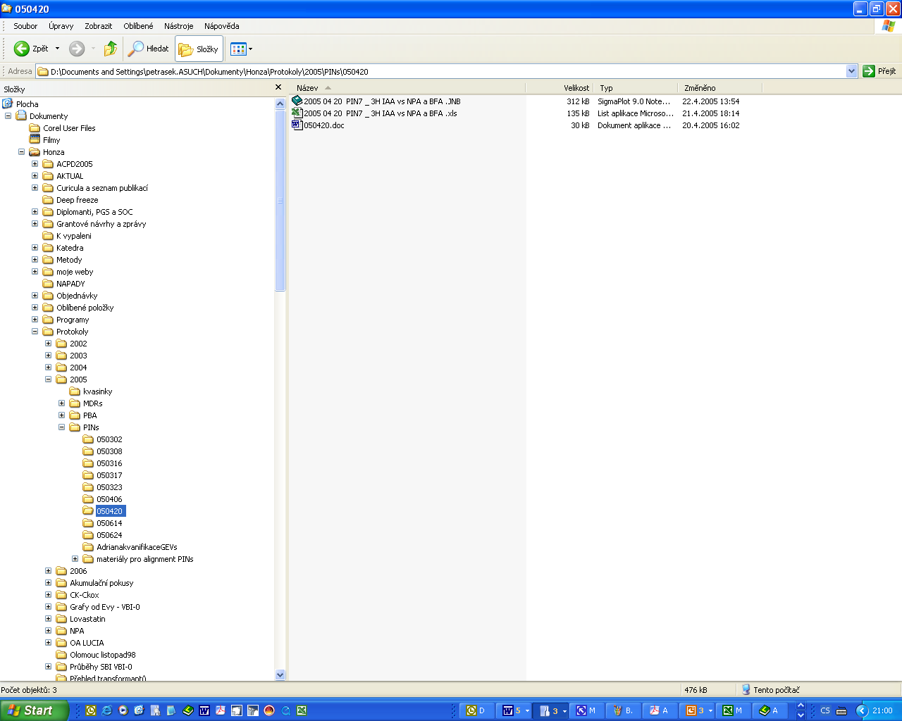
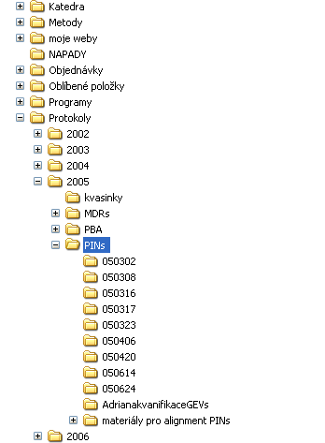
2. Helpful hints in the processing of experimental data
2.2. Data explorers, correct data handling and saving
Windows Explorer
B130P16E: Practical basics of scientific work Department Experimental Plant Biology FSCU http:/lhr.ueb.cas.cz/petrasek

Slide 5
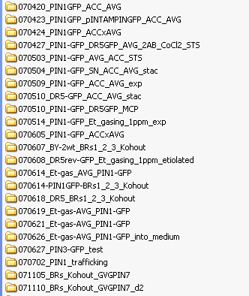
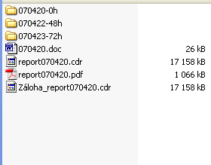
2. Helpful hints in the processing of experimental data
2.2. Data explorers, correct data handling and saving
B130P16E: Practical basics of scientific work Department Experimental Plant Biology FSCU http:/lhr.ueb.cas.cz/petrasek

Slide 6
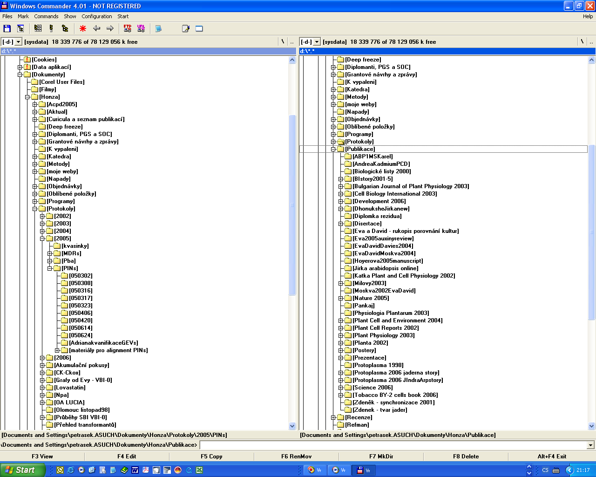

2. Helpful hints in the processing of experimental data
2.2. Data explorers, correct data handling and saving
Total Commander
B130P16E: Practical basics of scientific work Department Experimental Plant Biology FSCU http:/lhr.ueb.cas.cz/petrasek

Slide 7





2. Helpful hints in the processing of experimental data
2.3. Spreadsheets, statistical software, graph editors
Bulk data processing, their editing and graphical output
Microsoft Excel - suitable for all basic operations including statistics
Specialised mathematical or statistical software - Statgraphics, NCSS, Matlab, or the open source alternative R
B130P16E: Practical basics of scientific work Department Experimental Plant Biology FSCU http:/lhr.ueb.cas.cz/petrasek

Slide 8
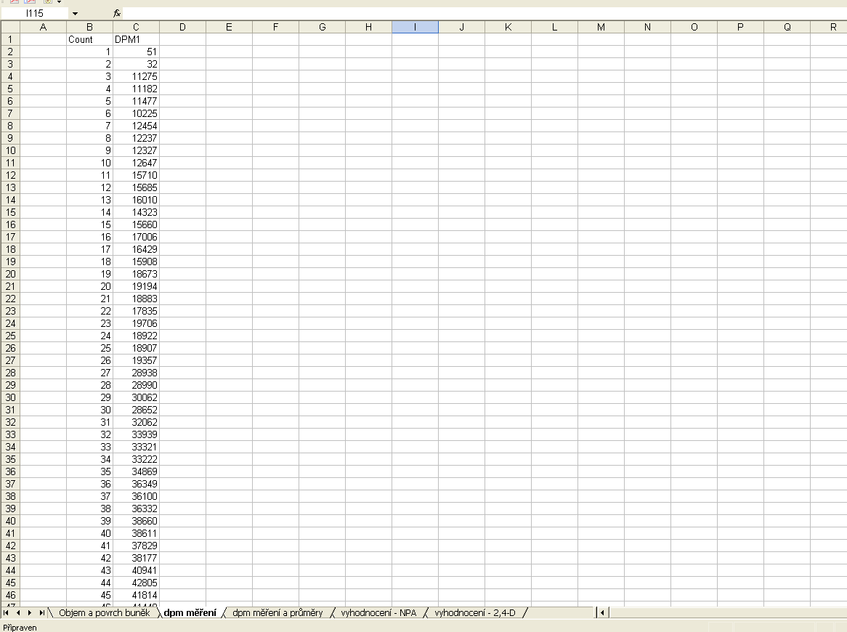
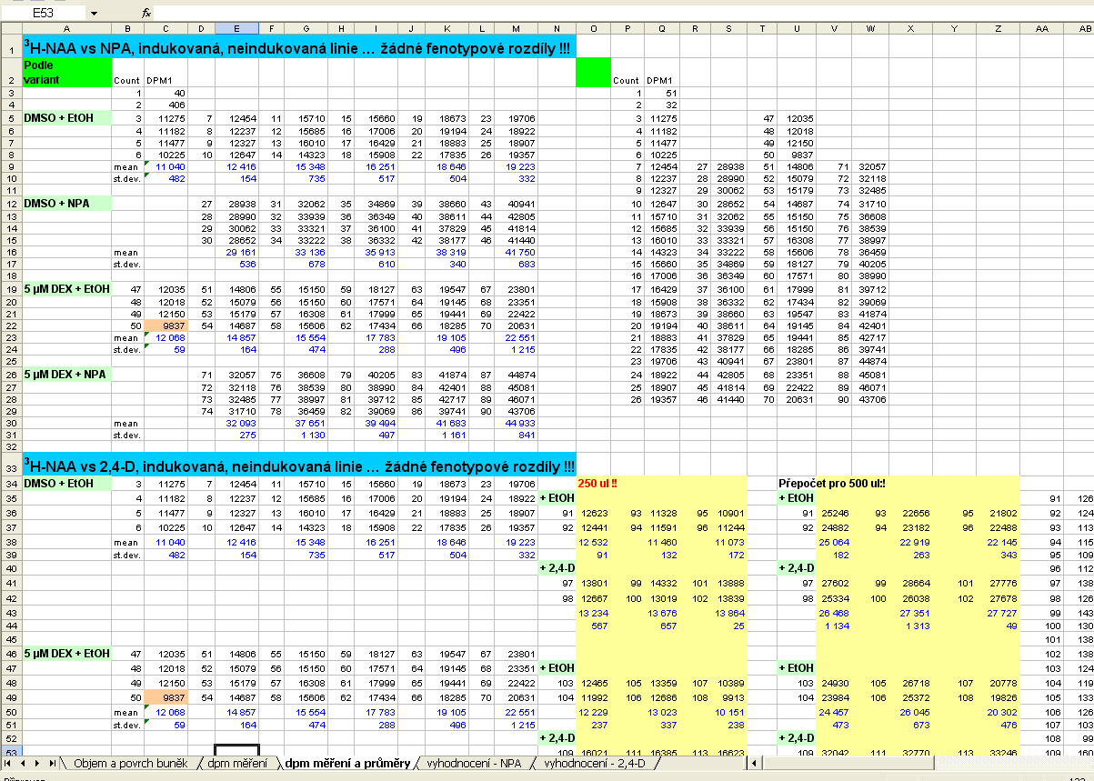
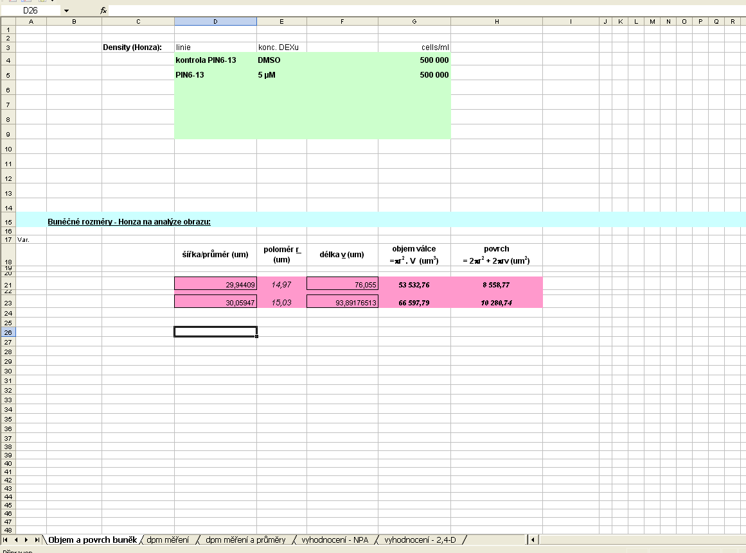
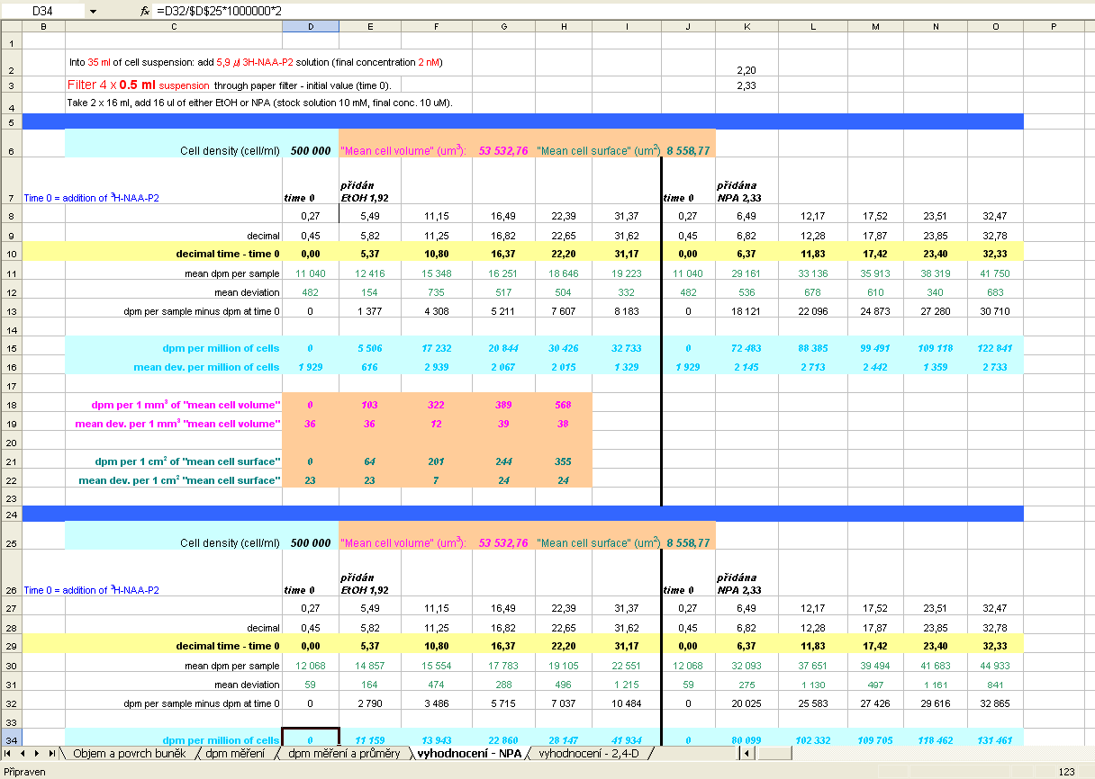
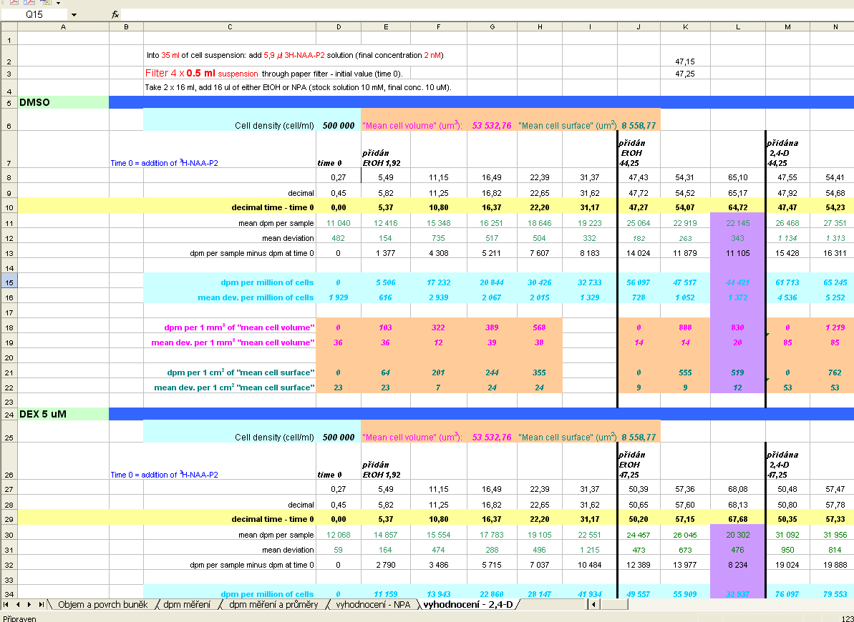
2. Helpful hints in the processing of experimental data
2.3. Spreadsheets, statistical software, graph editors
Microsoft Excel – whole protocol management, automation of numerical operations
B130P16E: Practical basics of scientific work Department Experimental Plant Biology FSCU http:/lhr.ueb.cas.cz/petrasek

Slide 9

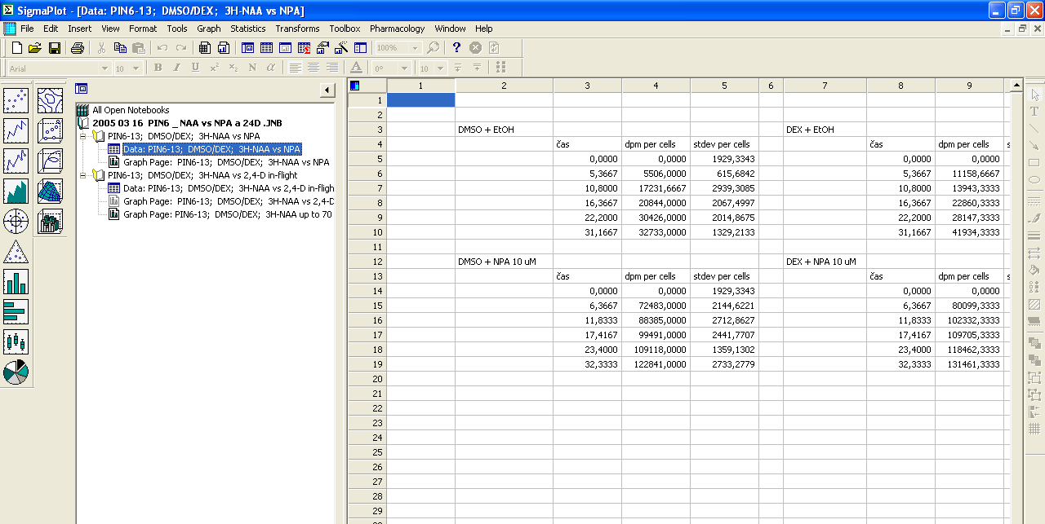
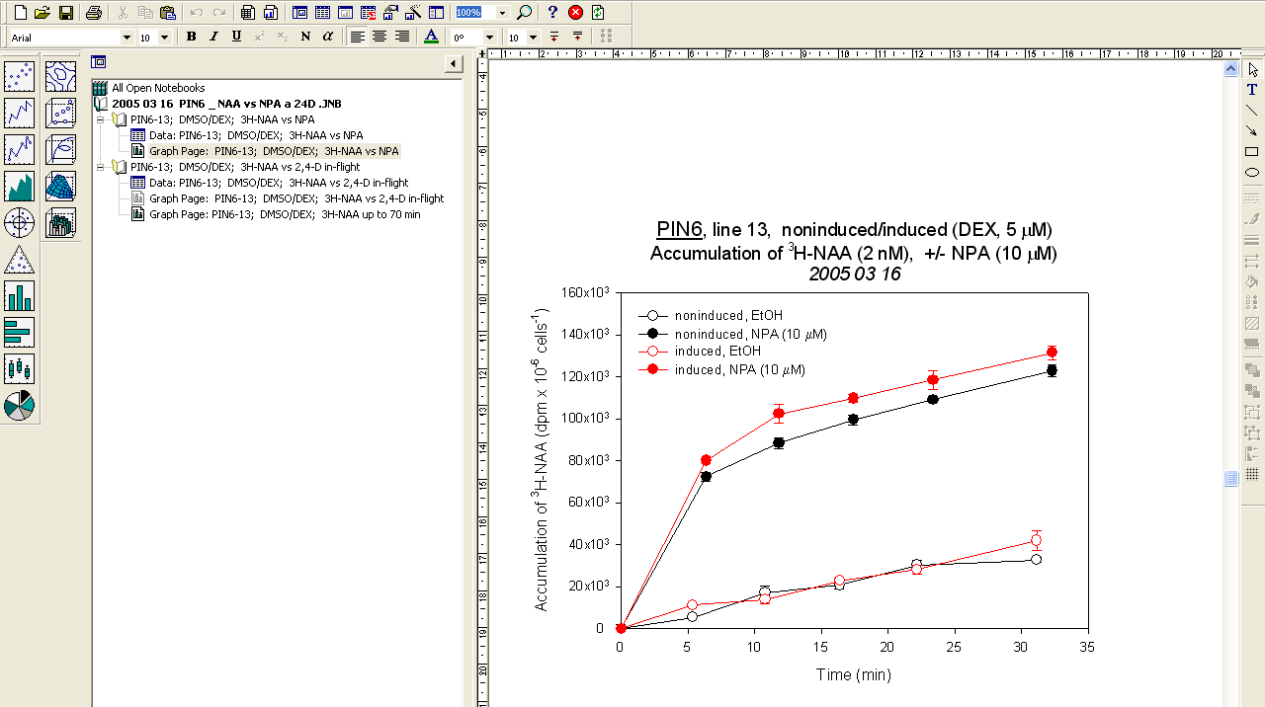
2. Helpful hints in the processing of experimental data
2.3. Spreadsheets, statistical software, graph editors
Sigma Plot - line/scatter plots, bar charts, histograms
B130P16E: Practical basics of scientific work Department Experimental Plant Biology FSCU http:/lhr.ueb.cas.cz/petrasek

Slide 10
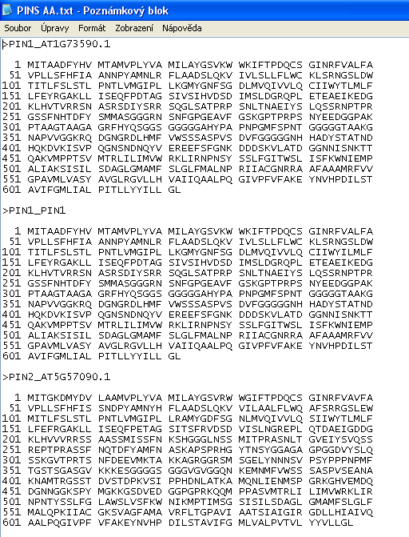
2. Helpful hints in the processing of experimental data
2.3. Processing of structural and sequence data
Notepad
Avoids excessive formatting
- Plenty of online and stand alone applications for the processing of sequences
B130P16E: Practical basics of scientific work Department Experimental Plant Biology FSCU http:/lhr.ueb.cas.cz/petrasek

Slide 11
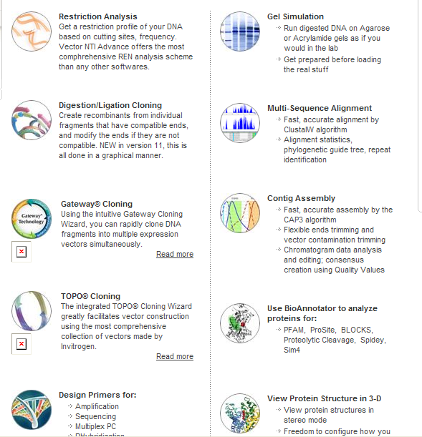


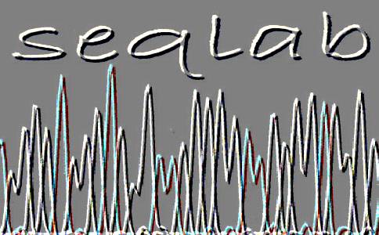
2. Helpful hints in the processing of experimental data
2.3. Processing of structural and sequence data
Vector NTI (Invitrogen)
Geneious
B130P16E: Practical basics of scientific work Department Experimental Plant Biology FSCU http:/lhr.ueb.cas.cz/petrasek

Slide 12

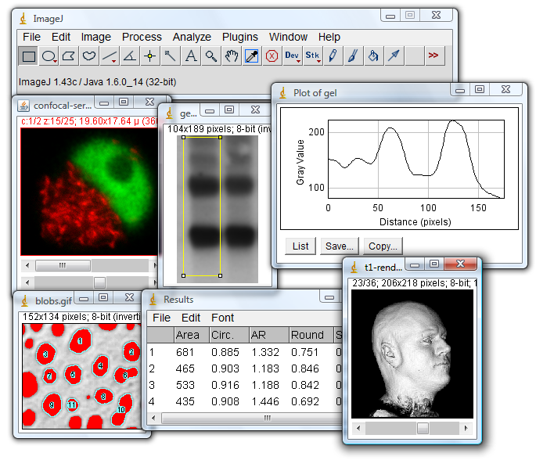

2. Helpful hints in the processing of experimental data
2.4 Image analysis, graphical software, presentation software
ImageJ (NIH)
Fiji
http://rsb.info.nih.gov/ij/docs/concepts.html
B130P16E: Practical basics of scientific work Department Experimental Plant Biology FSCU http:/lhr.ueb.cas.cz/petrasek

Slide 13
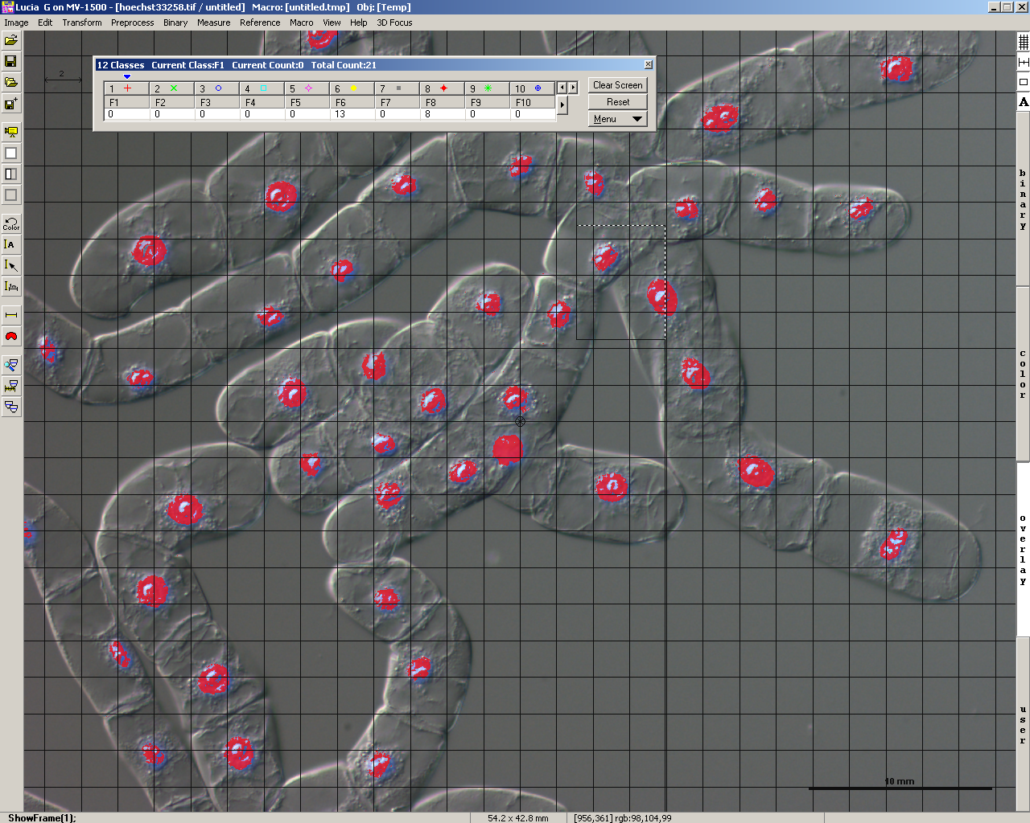
2. Helpful hints in the processing of experimental data
2.4 Image analysis, graphical software, presentation software
NIS elements
B130P16E: Practical basics of scientific work Department Experimental Plant Biology FSCU http:/lhr.ueb.cas.cz/petrasek

Slide 14
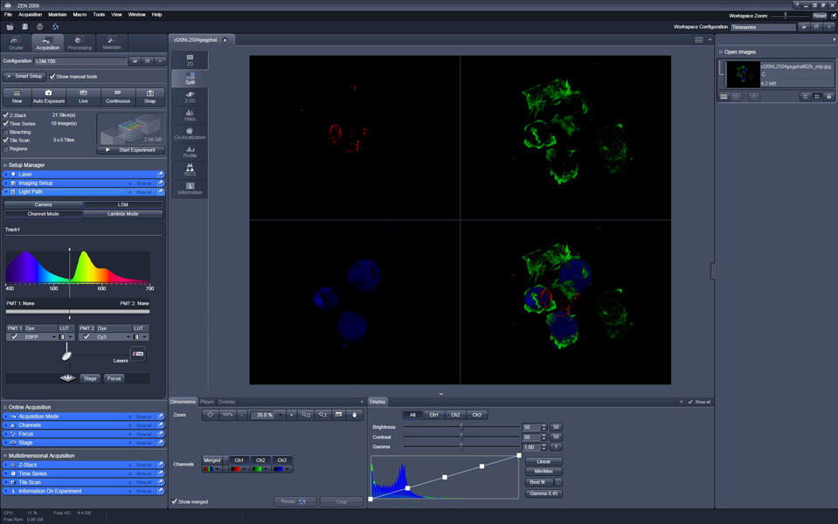




2. Helpful hints in the processing of experimental data
2.4 Image analysis, graphical software, presentation software
Graphical software for grabbing and processing of micro- and macro-scopical images
Leica
Zeiss
Nikon
Olympus
B130P16E: Practical basics of scientific work Department Experimental Plant Biology FSCU http:/lhr.ueb.cas.cz/petrasek

Slide 15
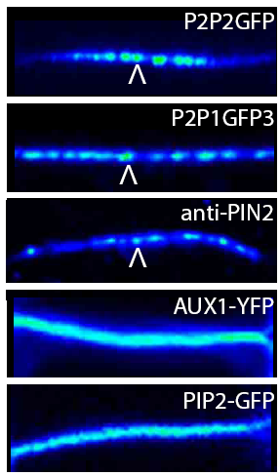

2. Helpful hints in the processing of experimental data
Color depth in microscopy
8 bit - 256 levels of grey (2⁸)
12 bit - 4096 levels of grey (2¹²)
16 bit - 65536 levels of grey (2¹⁶)
24 bit - 16 777 216 levels of grey (2²⁴)
Kleine-Vehn, Mol Syst Biol 7:540, 2011
B130P16E: Practical basics of scientific work Department Experimental Plant Biology FSCU http:/lhr.ueb.cas.cz/petrasek

Slide 16
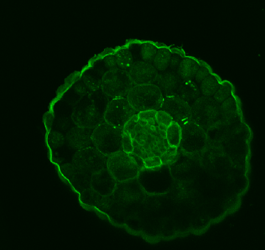
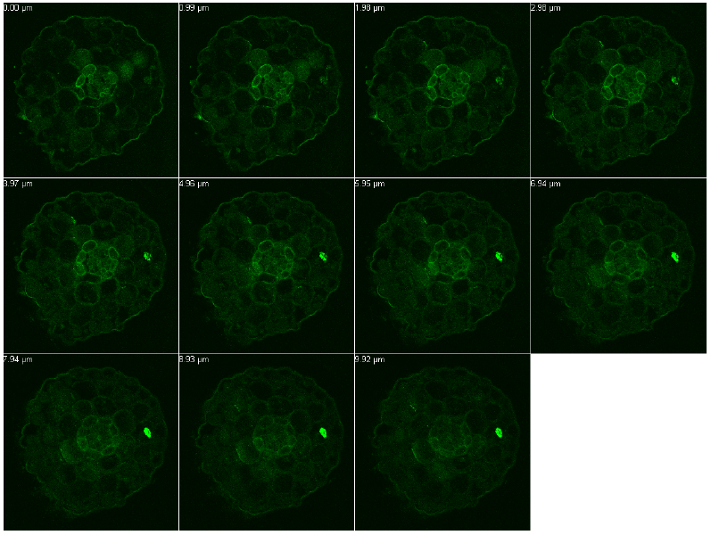
2. Helpful hints in the processing of experimental data
From image sequence to the image projection
PIN3::PIN3:YFP
Maximální projekce
Žádníková et al., Development 137, 607-617, 2009
B130P16E: Practical basics of scientific work Department Experimental Plant Biology FSCU http:/lhr.ueb.cas.cz/petrasek

Slide 17
2. Helpful hints in the processing of experimental data
Analysis of colocalization
Jelínková et al., Plant Journal 61, 883-891, 2009
B130P16E: Practical basics of scientific work Department Experimental Plant Biology FSCU http:/lhr.ueb.cas.cz/petrasek

Slide 18
2. Helpful hints in the processing of experimental data
Analysis of colocalization
Jelínková et al., Plant Journal 61, 883-891, 2009
B130P16E: Practical basics of scientific work Department Experimental Plant Biology FSCU http:/lhr.ueb.cas.cz/petrasek

Slide 19
2. Helpful hints in the processing of experimental data
Analysis of intracellular protein dynamics
Prebleach
Postbleach
FRAP 30 min
FRAP in tobacco BY-2 cells expressing AtPIN1-GFP
B130P16: Praktické základy vědecké práce Katedra experimentální biologie rostlin PřF UK http:/lhr.ueb.cas.cz/petrasek

Slide 20
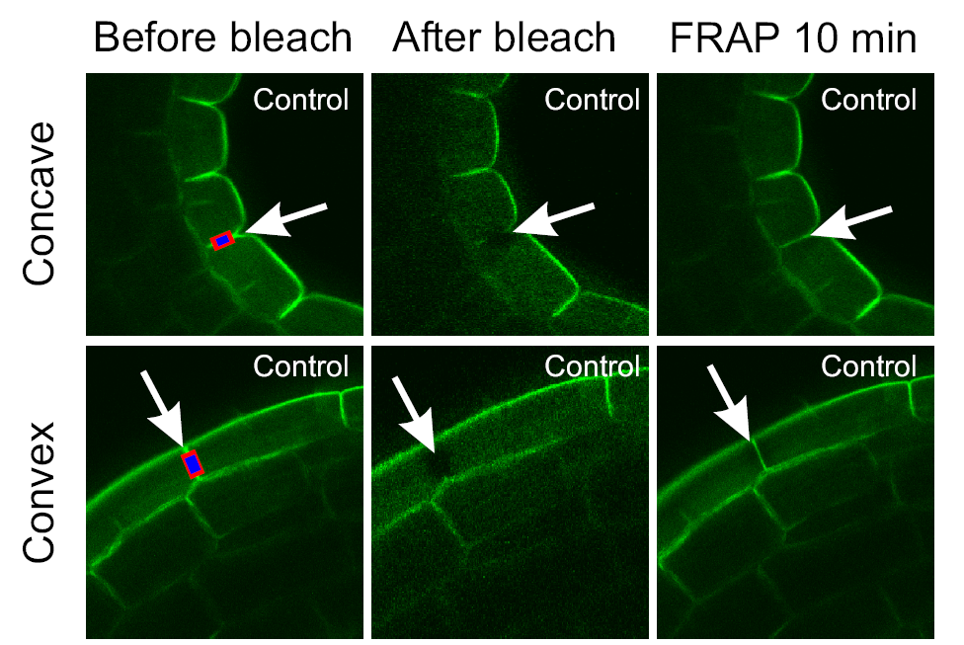
2. Helpful hints in the processing of experimental data
Analysis of intracellular protein dynamics
Vandenbussche et al., 2009, Development 137, 597-606
B130P16E: Practical basics of scientific work Department Experimental Plant Biology FSCU http:/lhr.ueb.cas.cz/petrasek

Slide 21
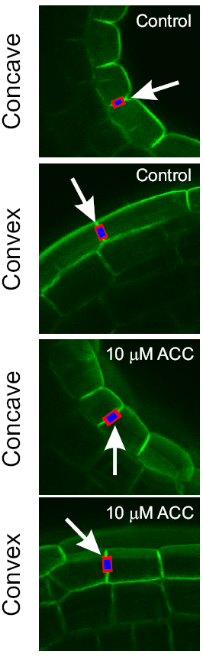
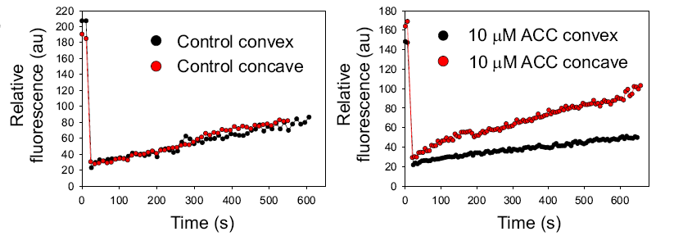
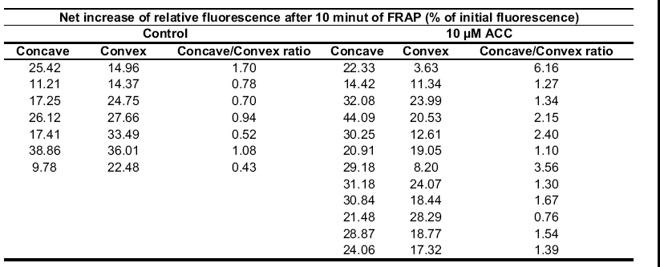
Analysis of intracellular protein dynamics
Vandenbussche et al., 2009, Development 137, 597-606
B130P16E: Practical basics of scientific work Department Experimental Plant Biology FSCU http:/lhr.ueb.cas.cz/petrasek

Slide 22
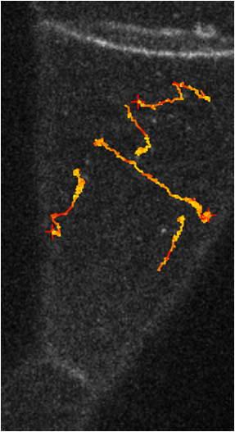
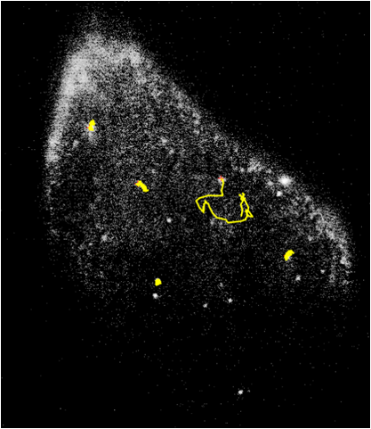
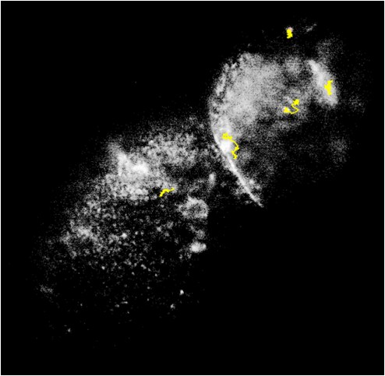
2. Helpful hints in the processing of experimental data
Analysis of intracellular protein dynamics
> 1 µm/s
0.4 - 1 µm/s
< 0.4 µm/s
PIN1-GFP
PIN1-GFP, 30 min 20 µM Oryzalin
PIN1-GFP, 30 min 0.5 µM LatB
Laňková et al., in preparation
B130P16E: Practical basics of scientific work Department Experimental Plant Biology FSCU http:/lhr.ueb.cas.cz/petrasek
Notes:
After treatments with cytoskeletal drugs both PIN1-GFP and AUX1-YFP endosomes rapidly decreased their dynamics.

Slide 23
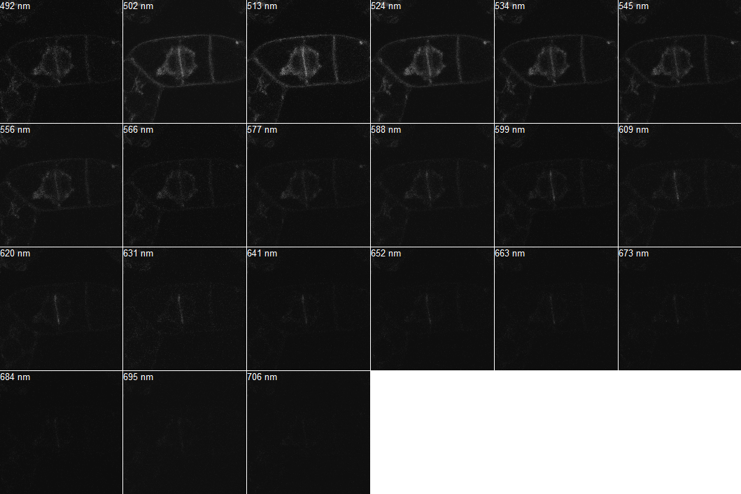
2. Helpful hints in the processing of experimental data
Interaction between two proteins - FRET analysis in vivo (PIN1-ADL1)
GFP peak
RFP peak
Spectral detection using ZEISS META 510 detector, laser 477 nm
B130P16E: Practical basics of scientific work Department Experimental Plant Biology FSCU http:/lhr.ueb.cas.cz/petrasek

Slide 24
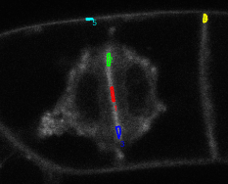
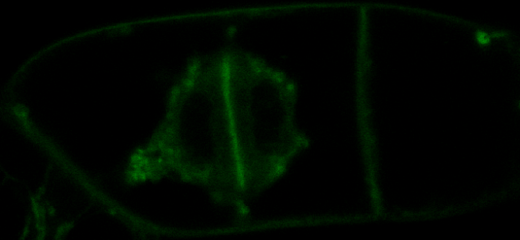

Interaction between two proteins - FRET analysis in vivo (PIN1-ADL1)
5
Average fluorescence intensity measured over the emission spectrum in the following region of interests:
ROI1 - middle cell plate
ROI2, ROI3 - growing ends of the cell plate
ROI4, ROI5 - transversal and longitudinal plasma membranes
4
2
1
3
500-520 nm unmixed
ROI1
- low FRET
ROI2, ROI3
- high FRET
ROI4, ROI5 - no FRET
600-620 nm unmixed
B130P16E: Practical basics of scientific work Department Experimental Plant Biology FSCU http:/lhr.ueb.cas.cz/petrasek

Slide 25
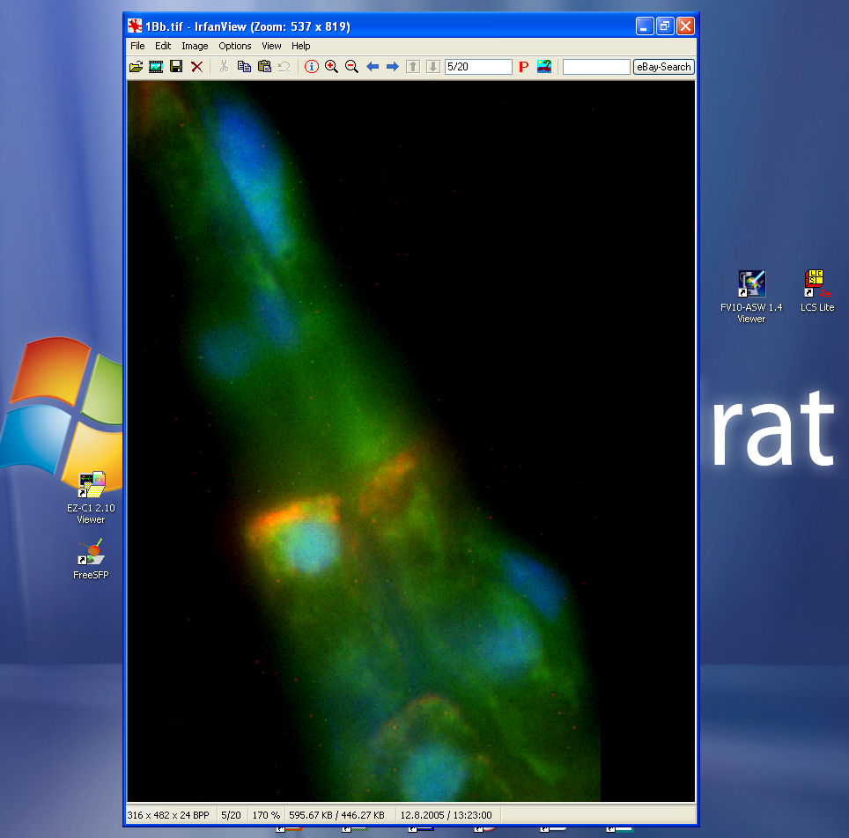

2. Helpful hints in the processing of experimental data
2.4 Image analysis, graphical software, presentation software
Irfan View - good choice for every day browsing through image documentation
B130P16E: Practical basics of scientific work Department Experimental Plant Biology FSCU http:/lhr.ueb.cas.cz/petrasek

Slide 26
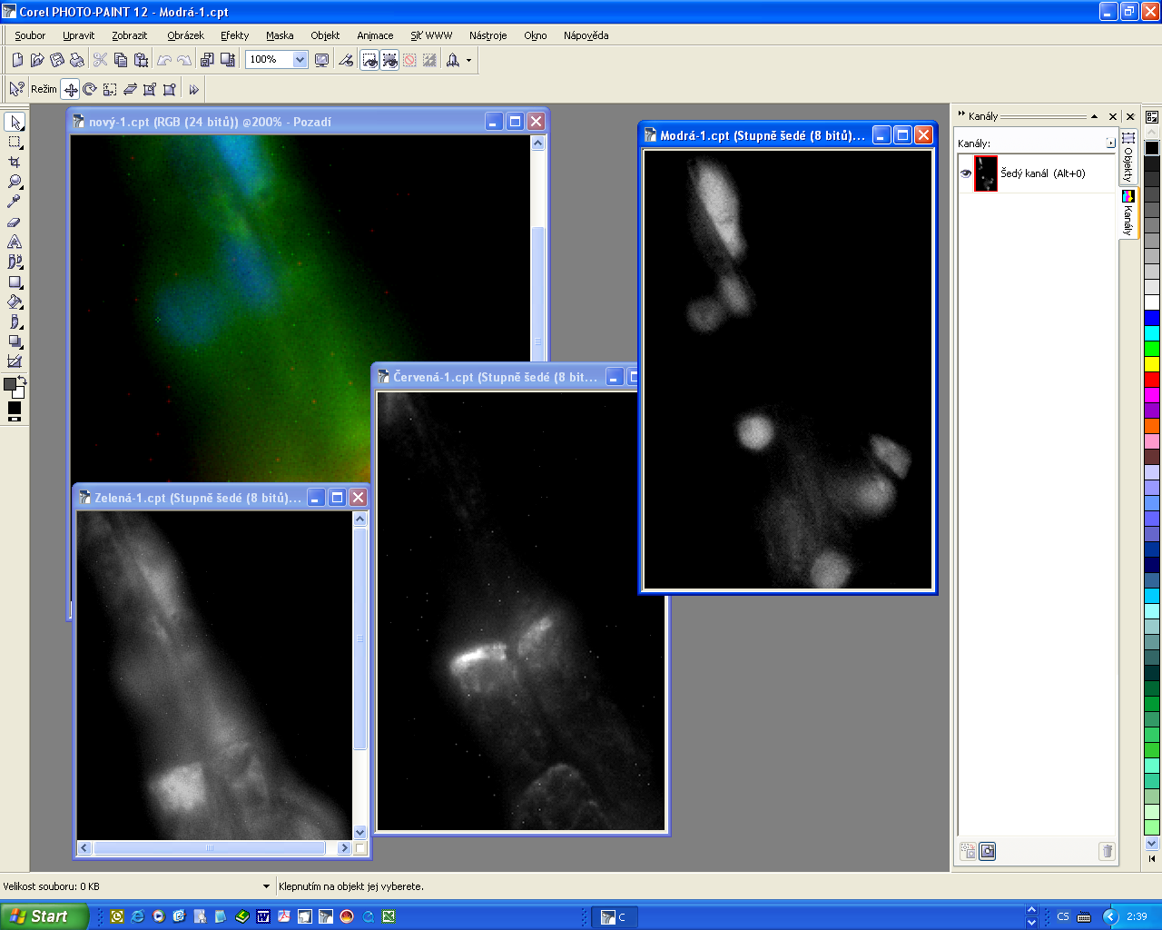


2. Helpful hints in the processing of experimental data
2.4 Image analysis, graphical software, presentation software
Corel Photo Paint
Adobe Photoshop
B130P16E: Practical basics of scientific work Department Experimental Plant Biology FSCU http:/lhr.ueb.cas.cz/petrasek

Slide 27
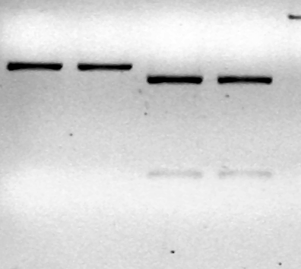
2. Helpful hints in the processing of experimental data
2.4 Image analysis, graphical software, presentation software
Corel Photo Paint či Adobe Photoshop - avoid excessive image adjustment!!
B130P16E: Practical basics of scientific work Department Experimental Plant Biology FSCU http:/lhr.ueb.cas.cz/petrasek

Slide 28
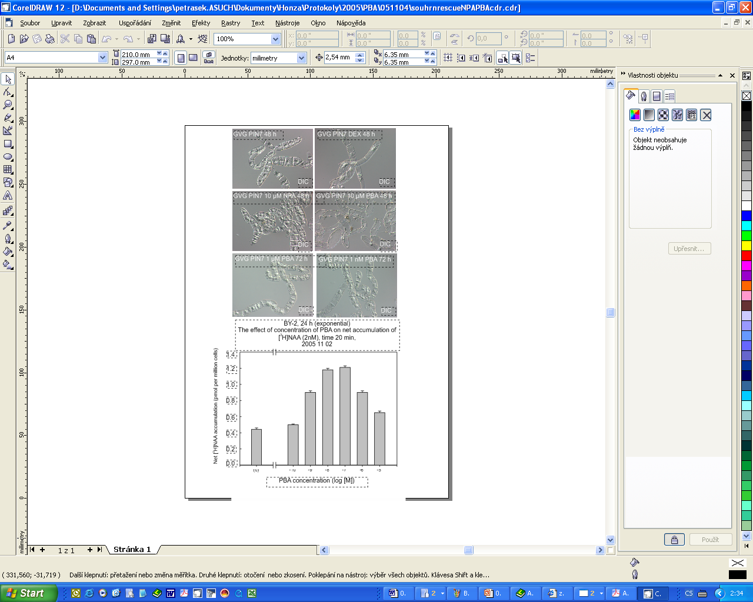


2. Helpful hints in the processing of experimental data
2.4 Image analysis, graphical software, presentation software
Corel Draw
Adobe Illustrator
B130P16E: Practical basics of scientific work Department Experimental Plant Biology FSCU http:/lhr.ueb.cas.cz/petrasek

Slide 29
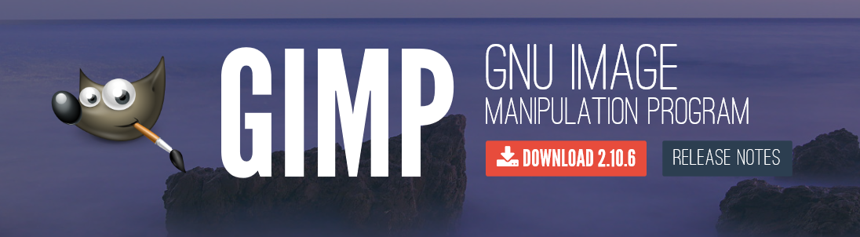
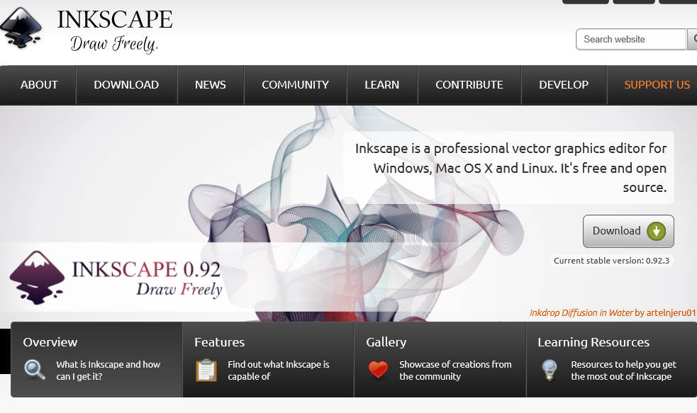
2. Praktické postupy zpracování experimentálních dat
2.4 Open source graphical software
GIMP
Inkscape
B130P16E: Practical basics of scientific work Department Experimental Plant Biology FSCU http:/lhr.ueb.cas.cz/petrasek

