Slide 1
3. Scientific literature, Internet online resources
How to search for bibliographic records effectively?
3) Creating your own bibliography database
Comparison of reference management software
http://en.wikipedia.org/wiki/Comparison_of_reference_management_software
Commercial software:
- EndNote Provided by Thomson Reuters (ISI WOS).
B130P16E: Practical basics of scientific work Department Experimental Plant Biology FSCU http:/lhr.ueb.cas.cz/petrasek

Slide 2
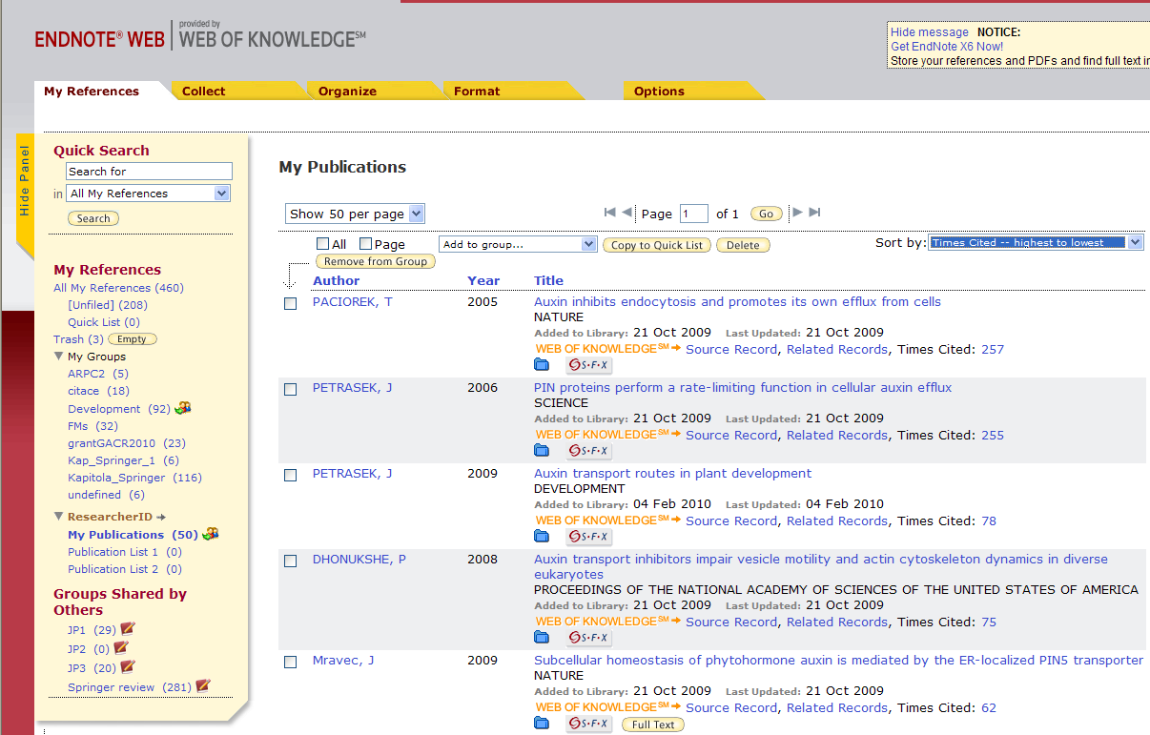
3. Scientific literature, Internet online resources
How to search for bibliographic records effectively?
3) Creating your own bibliography database
Freeware:
EndNote Basic - online version of EndNote, supported by ISI Web of Knowledge - https://www.myendnoteweb.com/
B130P16E: Practical basics of scientific work Department Experimental Plant Biology FSCU http:/lhr.ueb.cas.cz/petrasek

Slide 3
3. Scientific literature, Internet online resources
How to search for bibliographic records effectively?
3) Creating your own bibliography database
Freeware: Mendeley - combining full text and bibliography searching in one database - http://www.mendeley.com/features/
http://blog.mendeley.com/tipstricks/7-ways-to-add-documents-to-mendeley/
B130P16E: Practical basics of scientific work Department Experimental Plant Biology FSCU http:/lhr.ueb.cas.cz/petrasek

Slide 4
3. Scientific literature, Internet online resources
How to search for bibliographic records effectively?
3) Creating your own bibliography database
Freeware:
Zotero - originally as a Firefoxu plugin, now as a stand alone application, combination of full text and bibliographic approach - http://www.zotero.org/
B130P16E: Practical basics of scientific work Department Experimental Plant Biology FSCU http:/lhr.ueb.cas.cz/petrasek

Slide 5
3. Scientific literature, Internet online resources
How to search for bibliographic records effectively?
4) Searching using full text browsers - full text searching and browsing using Wikigenes - http://www.wikigenes.org/
B130P16E: Practical basics of scientific work Department Experimental Plant Biology FSCU http:/lhr.ueb.cas.cz/petrasek

Slide 6
3. Scientific literature, Internet online resources
5) Finding full text of articles from journals or books
eResources Portal of Charles University - http://pez.cuni.cz/, both journals and books
B130P16E: Practical basics of scientific work Department Experimental Plant Biology FSCU http:/lhr.ueb.cas.cz/petrasek

Slide 7
3. Scientific literature, Internet online resources
5) Finding full text of articles from journals or books
Some bibliographic databases integrate available full text resources „at one click“, like Kopernio from ISI WOS.
B130P16E: Practical basics of scientific work Department Experimental Plant Biology FSCU http:/lhr.ueb.cas.cz/petrasek

Slide 8
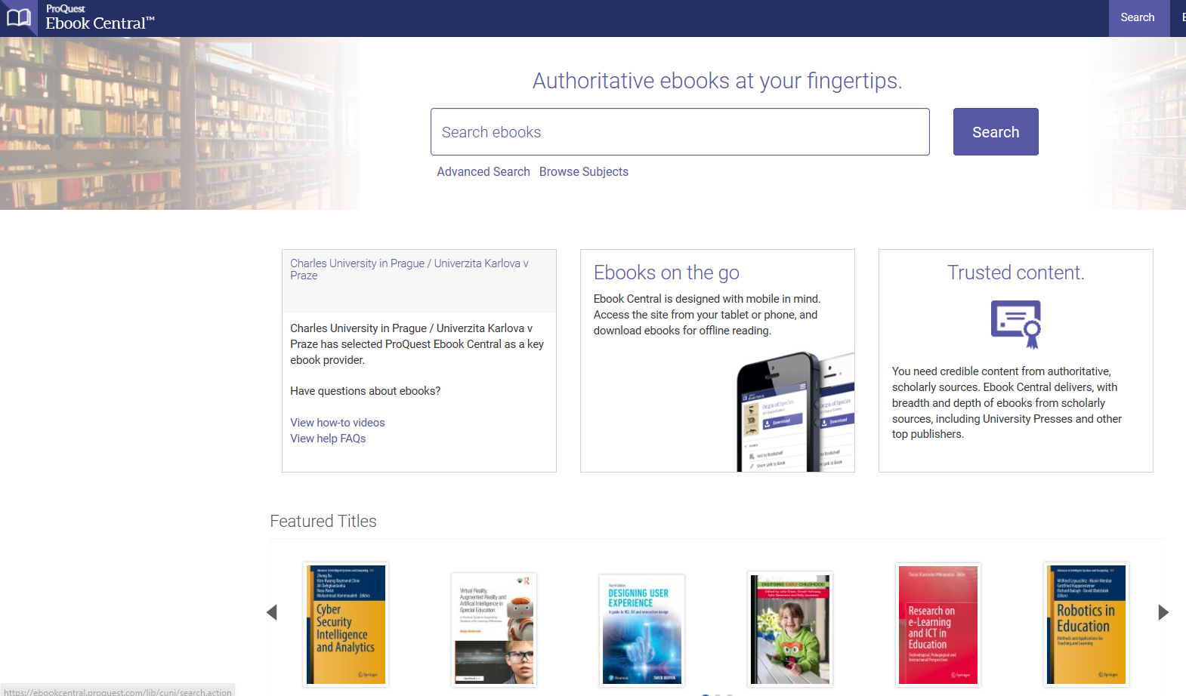
3. Scientific literature, Internet online resources
5) Finding full text of articles from journals or books
ProQuest Ebook Central https://ebookcentral.proquest.com/lib/cuni/home.action?ebraryDocId=null
B130P16E: Practical basics of scientific work Department Experimental Plant Biology FSCU http:/lhr.ueb.cas.cz/petrasek

Slide 9
3. Scientific literature, Internet online resources
3.4. Scientometry as the a tool to evaluate the quality of scientific work
Journal Citation Reports - one of the database of Web of Knowledge of the Institute for Scientific Information (ISI). Journals from all scientific fields are included and evaluated. http://isiknowledge.com/
The comparison is largely mainly based on the impact factor (IF), i.e. the average number of citations per article within past two years. Higher impact usually reflects better quality and higher impact in the scientific community.
B130P16E: Practical basics of scientific work Department Experimental Plant Biology FSCU http:/lhr.ueb.cas.cz/petrasek

Slide 10
3. Scientific literature, Internet online resources
3.4. Scientometry as the a tool to evaluate the quality of scientific work
There are also several other factors with kind of improved validity for comparison between research fields, like Eigenfactor considering 5 year impact factor and journals, where the citations appear.
Very often, journals are evaluated based on their ranking in individual quartiles of IF or Eigenfactor. Researchers are pushed to publish only in the best quartile or even decile.
B130P16E: Practical basics of scientific work Department Experimental Plant Biology FSCU http:/lhr.ueb.cas.cz/petrasek

Slide 11
3. Scientific literature, Internet online resources
3.4. Scientometry as the a tool to evaluate the quality of scientific work
Scientometry is also used for the evaluation of the quality of individual researchers.
Here, Hirsch index (h), introduced by J. Hirsch in 2005 is often used. A researcher has an h-index, if he/she has at least h publications for which he/she has received at least h citations.
h index might be found in WOS and Scopus.
B130P16E: Practical basics of scientific work Department Experimental Plant Biology FSCU http:/lhr.ueb.cas.cz/petrasek

Slide 12
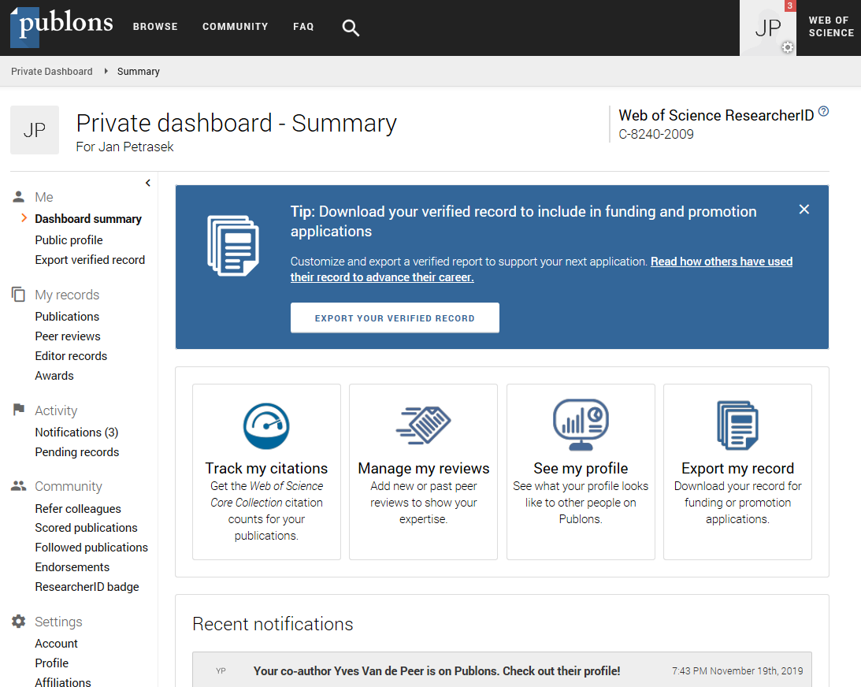
3. Scientific literature, Internet online resources
3.4. Scientometry as the a tool to evaluate the quality of scientific work
Citation profile for individual scientists could be found using author search using ISI WOS, Scopus or Google Scholar
Individual researcher are responsible for keeping their publication record up to date using services like
Publons (formerly researcher ID, ISI WOS),
ORCID (Open Researcher and Contributor Identifier),
Google Scholar (User Profiles), or Scopus (Citation overview).
B130P16E: Practical basics of scientific work Department Experimental Plant Biology FSCU http:/lhr.ueb.cas.cz/petrasek

Slide 13
3. Scientific literature, Internet online resources
3.4. Scientometry as the a tool to evaluate the quality of scientific work
Evaluating the quality of articles after their publication:
Faculty of 1000 - http://f1000.com/
B130P16E: Practical basics of scientific work Department Experimental Plant Biology FSCU http:/lhr.ueb.cas.cz/petrasek

