Slide 1
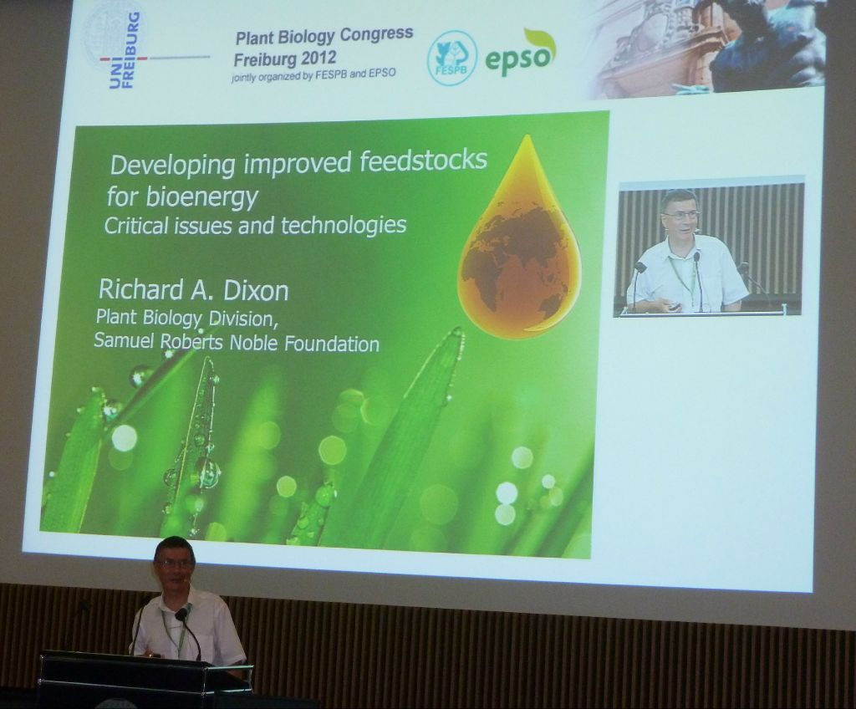
3. Scientific literature, Internet online resources
3.1 Types of scientific reports and their purpose
Two main types
oral form - it is not mandatory, it can be both very formal and informal, it can not be taken as a justification of scientific priority
http://storify.com/rbastow/epso-fespb-plant-congres-2012
https://pbs.twimg.com/media/Dh0XPRrWsAEm6UN?format=jpg&name=large
B130P16E: Practical basics of scientific work Department of Experimental Plant Biology, FS CU https://lhr.ueb.cas.cz/petrasek/B130P16E.htm

Slide 2
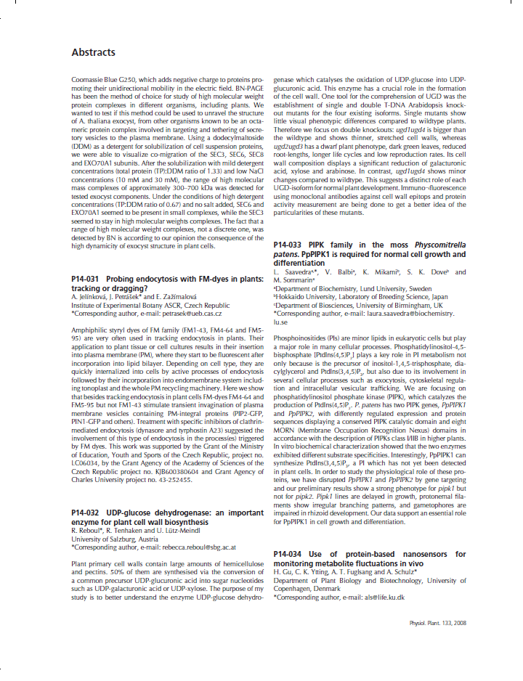
3. Scientific literature, Internet online resources
3.1 Types of scientific reports and their purpose
Two main types
oral form - it is not mandatory, it can be both very formal and informal, it can not be taken as a justification of scientific priority
written form - a mandatory form of contribution, the scientific quality and relevancy of the article reflect both the quality of scientist and reviewers
Types of written contributions:
1) Abstract of oral or poster contribution
- published in the book of abstracts
- it is usually not peer-reviewed
B130P16E: Practical basics of scientific work Department of Experimental Plant Biology, FS CU https://lhr.ueb.cas.cz/petrasek/B130P16E.htm

Slide 3
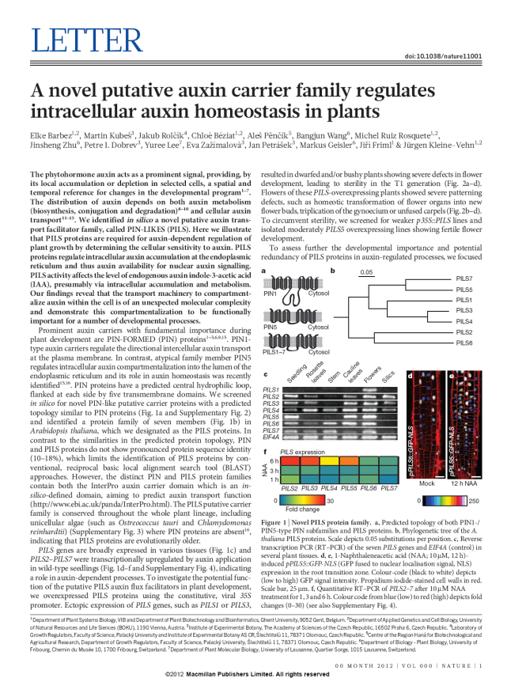
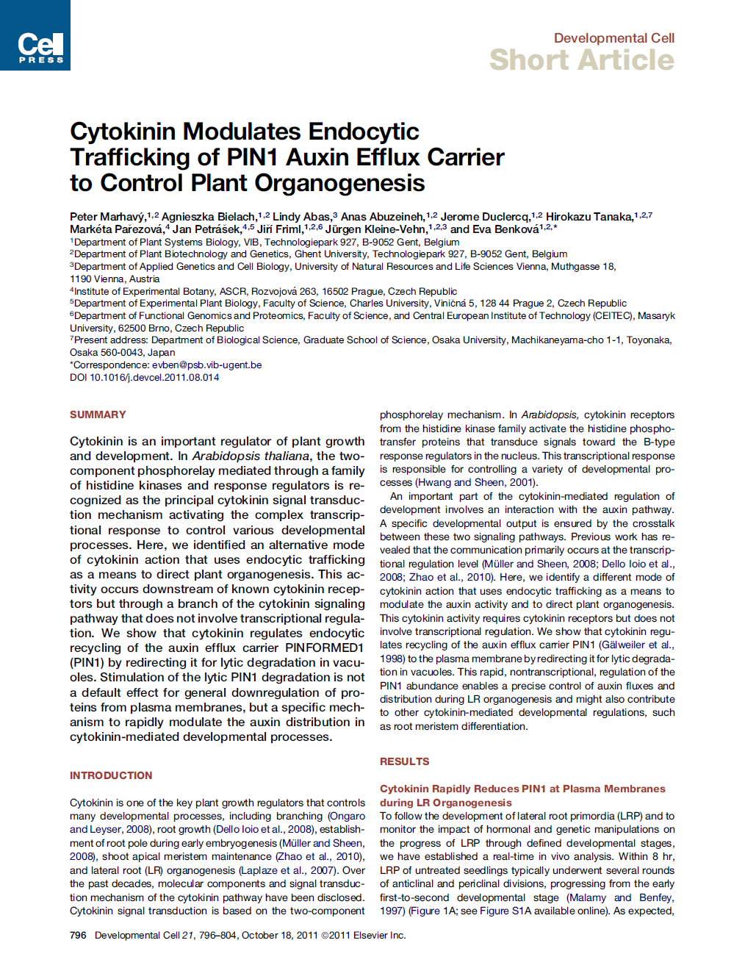
3. Scientific literature, Internet online resources
3.1 Types of scientific reports and their purpose
Two main types
oral form - it is not mandatory, it can be both very formal and informal, it can not be taken as a justification of scientific priority
written form - a mandatory form of contribution, the scientific quality and relevancy of the article reflect both the quality of scientist and reviewers
Types of written contributions:
2) Original contribution (the article)
- universal communication tool
- it exists in several forms
- writing style should be standardised
- it is always peer-reviewed
- it justifies a scientific priority
B130P16E: Practical basics of scientific work Department of Experimental Plant Biology, FS CU https://lhr.ueb.cas.cz/petrasek/B130P16E.htm

Slide 4
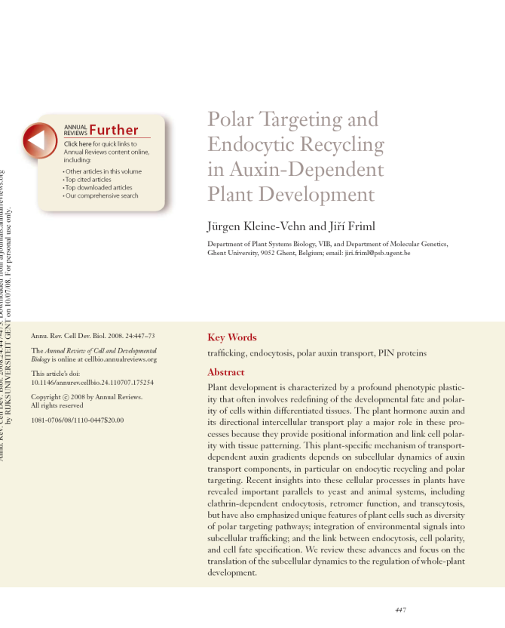
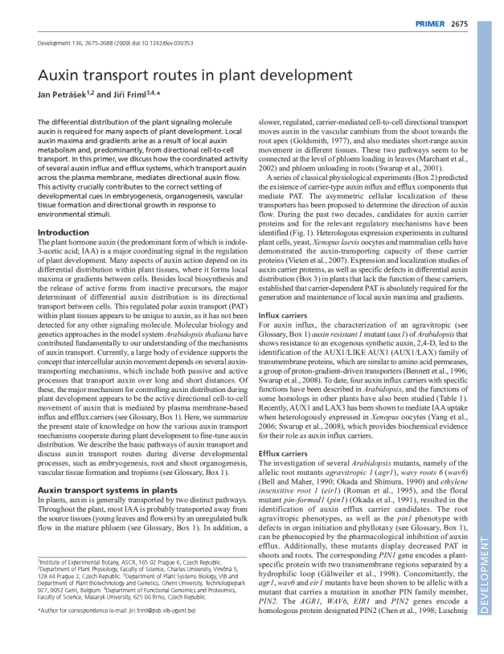
3. Scientific literature, Internet online resources
3.1 Types of scientific reports and their purpose
Two main types
oral form - it is not mandatory, it can be both very formal and informal, it can not be taken as a justification of scientific priority
written form - a mandatory form of contribution, the scientific quality and relevancy of the article reflect both the quality of scientist and reviewers
Types of written contributions:
3) Review article
- summary of already published results
- it exists in several forms
- brings new interpretations
- critical thinking is highly needed
- it is always peer-reviewed
B130P16E: Practical basics of scientific work Department of Experimental Plant Biology, FS CU https://lhr.ueb.cas.cz/petrasek/B130P16E.htm

Slide 5
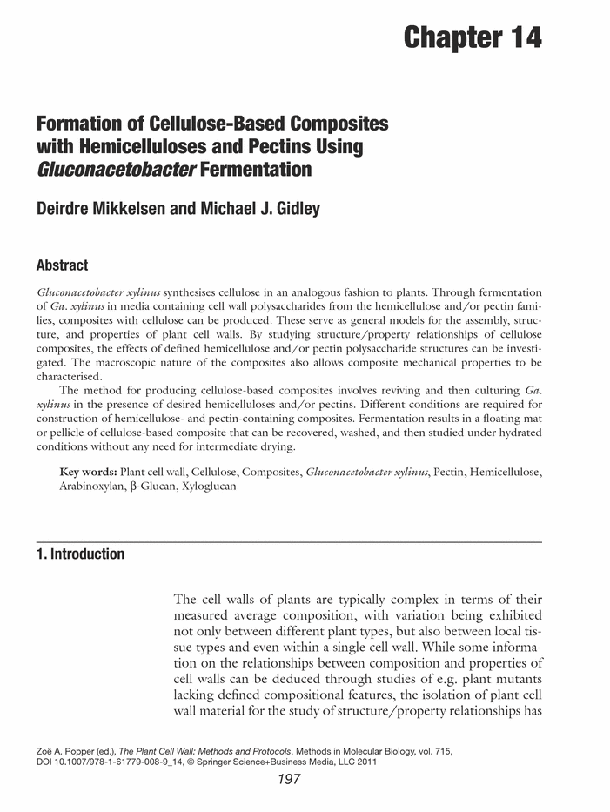
3. Scientific literature, Internet online resources
3.1 Types of scientific reports and their purpose
Two main types
oral form - it is not mandatory, it can be both very formal and informal, it can not be taken as a justification of scientific priority
written form - a mandatory form of contribution, the scientific quality and relevancy of the article reflect both the quality of scientist and reviewers
Types of written contributions:
4) Monographs, books
- collections of already published data
- the book has long-term validity
- it is always peer-reviewed
- it usually does not justify scientific priority
B130P16E: Practical basics of scientific work Department of Experimental Plant Biology, FS CU https://lhr.ueb.cas.cz/petrasek/B130P16E.htm

Slide 6
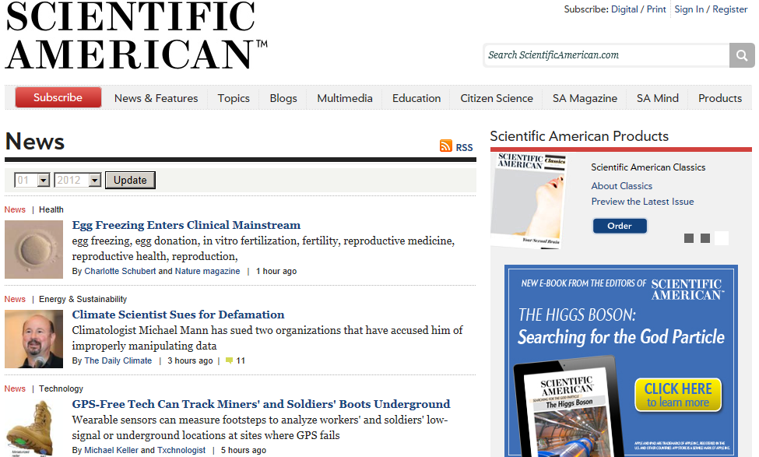
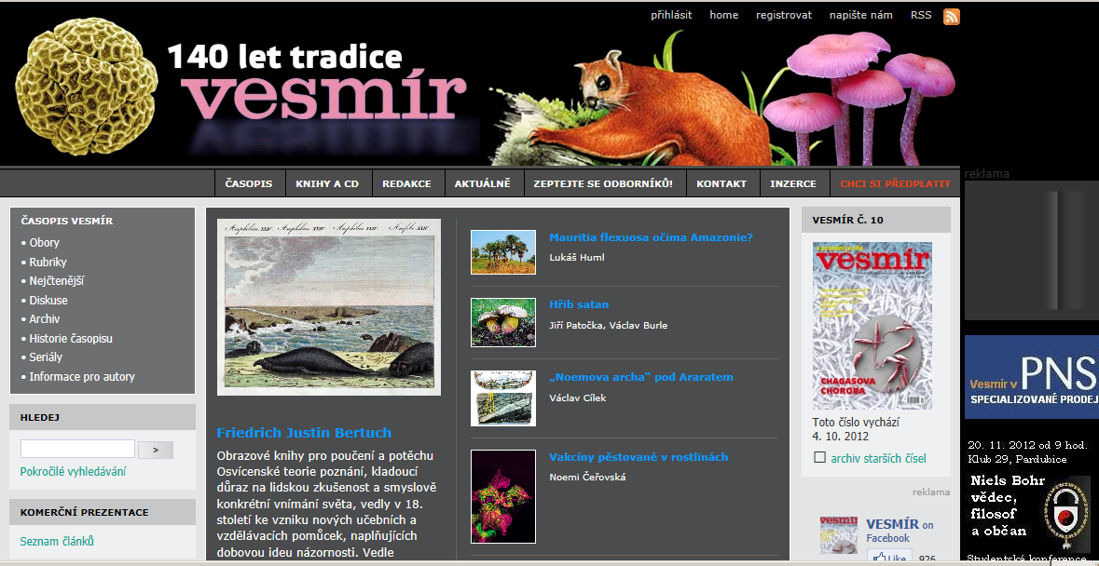
3. Scientific literature, Internet online resources
3.1 Types of scientific reports and their purpose
Two main types
oral form - it is not mandatory, it can be both very formal and informal, it can not be taken as a justification of scientific priority
written form - a mandatory form of contribution, the scientific quality and relevancy of the article reflect both the quality of scientist and reviewers
Types of written contributions:
5) Popularization article or book
- must be accessible to broad reading community (public)
- it should be ideally peer-reviewed
- Scientific American, in the Czech Republic Vesmír - from 1871
B130P16E: Practical basics of scientific work Department of Experimental Plant Biology, FS CU https://lhr.ueb.cas.cz/petrasek/B130P16E.htm

Slide 7
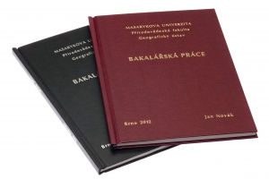
3. Scientific literature, Internet online resources
3.1 Types of scientific reports and their purpose
Two main types
oral form - it is not mandatory, it can be both very formal and informal, it can not be taken as a justification of scientific priority
written form - a mandatory form of contribution, the scientific quality and relevancy of the article reflect both the quality of scientist and reviewers
Types of written contributions:
6) Bachelor, diploma, dissertation and habilitation thesis - it is rigorously peer-reviewed
- it could contain findings that can be published in a form of parallel scientific paper
- it justifies a scientific priority
- E-thesis - electronic form of Ph.D. theses
B130P16E: Practical basics of scientific work Department of Experimental Plant Biology, FS CU https://lhr.ueb.cas.cz/petrasek/B130P16E.htm

Slide 8
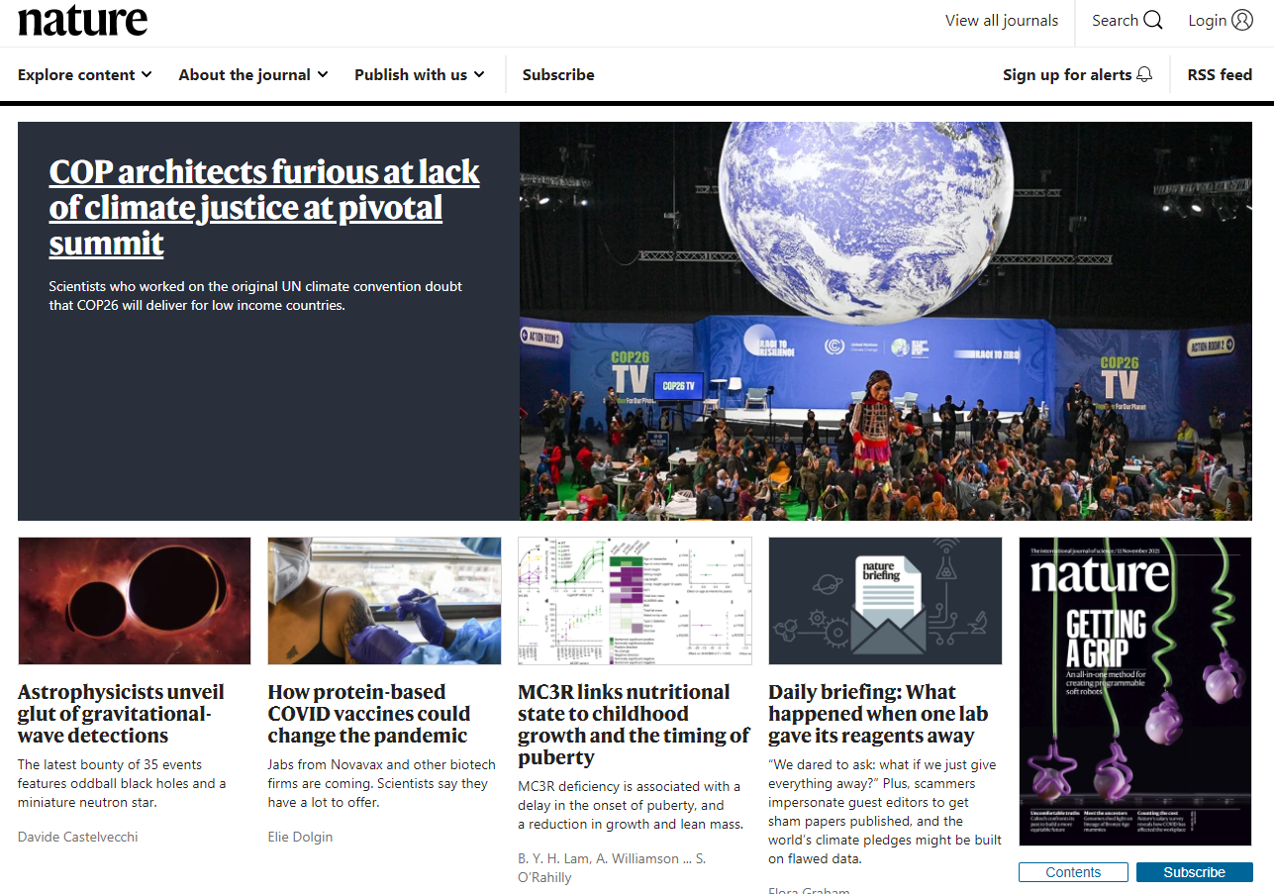
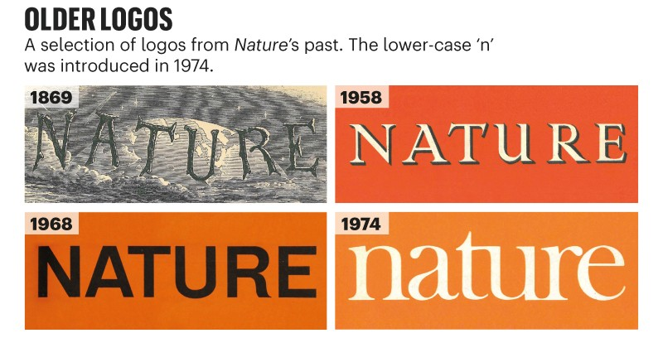
3. Scientific literature, Internet online resources
3.1 Types of scientific reports and their purpose
Nature, from 1869
Main multidisciplinary scientific journals
B130P16E: Practical basics of scientific work Department of Experimental Plant Biology, FS CU https://lhr.ueb.cas.cz/petrasek/B130P16E.htm

Slide 9
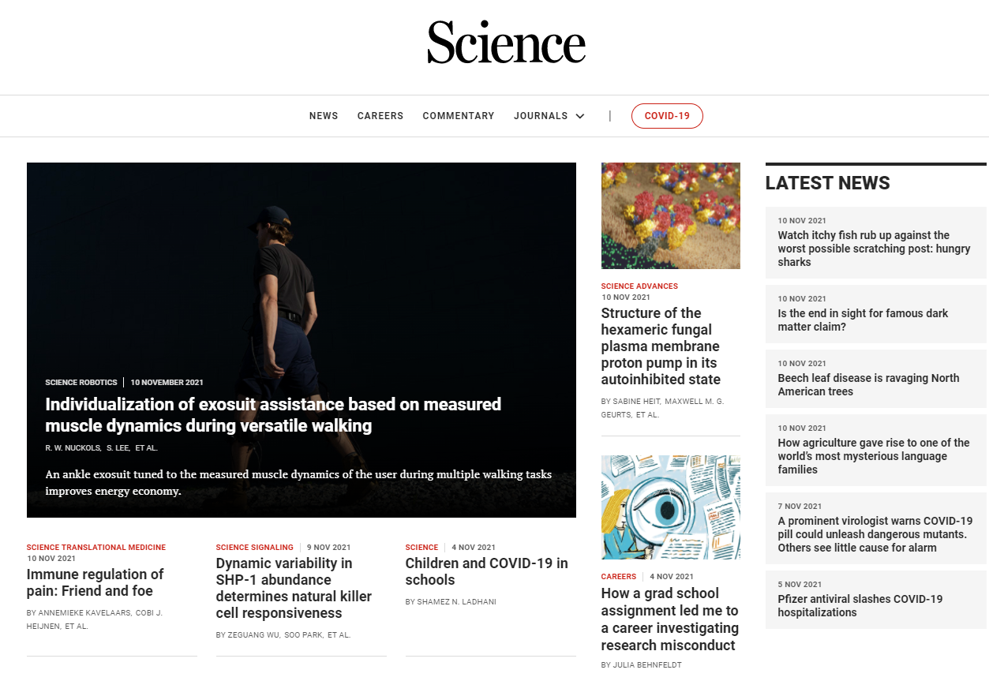
3. Scientific literature, Internet online resources
3.1 Types of scientific reports and their purpose
Science, from 1880
Main multidisciplinary scientific journals
American Association for the Advancement of Science
B130P16E: Practical basics of scientific work Department of Experimental Plant Biology, FS CU https://lhr.ueb.cas.cz/petrasek/B130P16E.htm

Slide 10
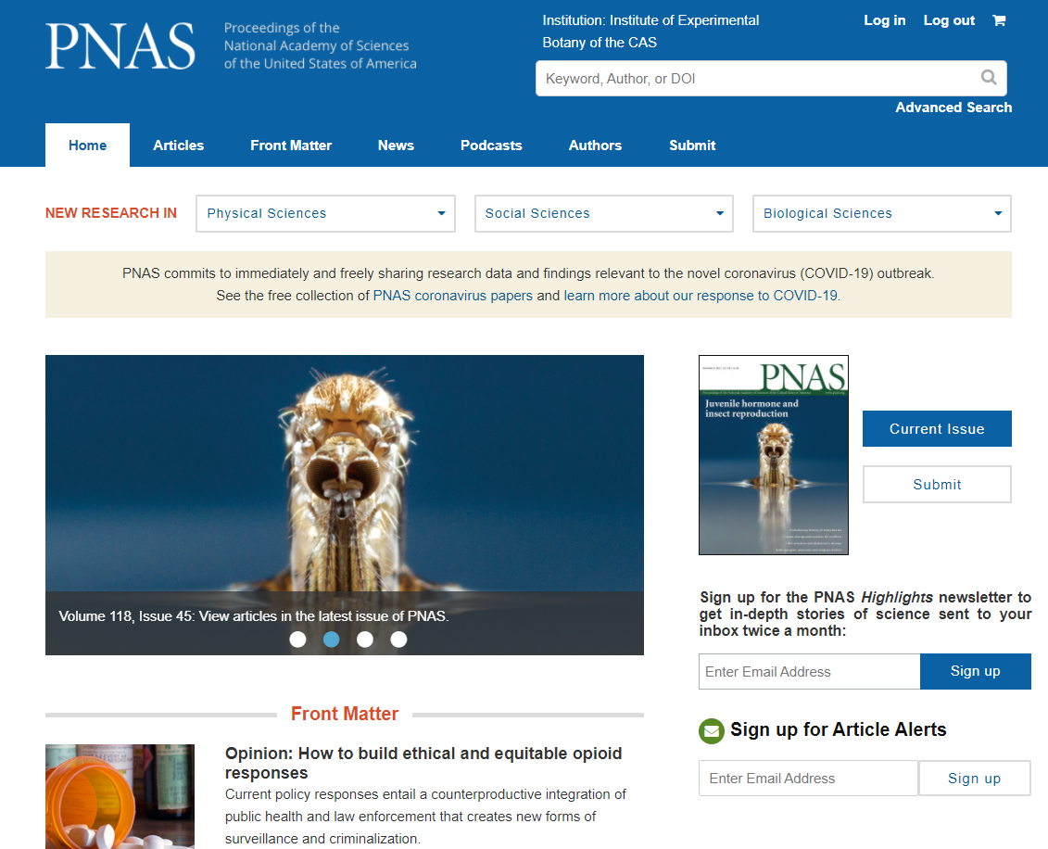
3. Scientific literature, Internet online resources
3.1 Types of scientific reports and their purpose
PNAS, from 1915
Main multidisciplinary scientific journals
Proceedings of the National Academy of Sciences of the United States of America
B130P16E: Practical basics of scientific work Department of Experimental Plant Biology, FS CU https://lhr.ueb.cas.cz/petrasek/B130P16E.htm

Slide 11
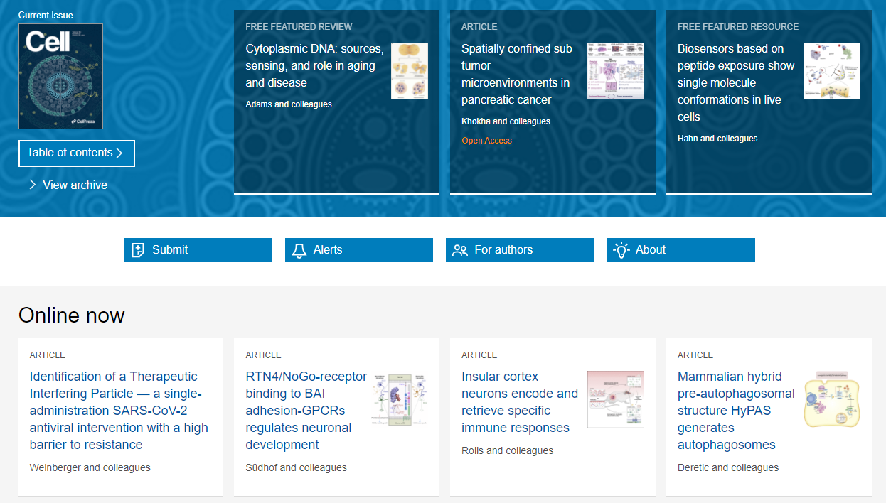
3. Scientific literature, Internet online resources
3.1 Types of scientific reports and their purpose
Cell, from 1974
Main experimental biology journals
B130P16E: Practical basics of scientific work Department of Experimental Plant Biology, FS CU https://lhr.ueb.cas.cz/petrasek/B130P16E.htm

Slide 12
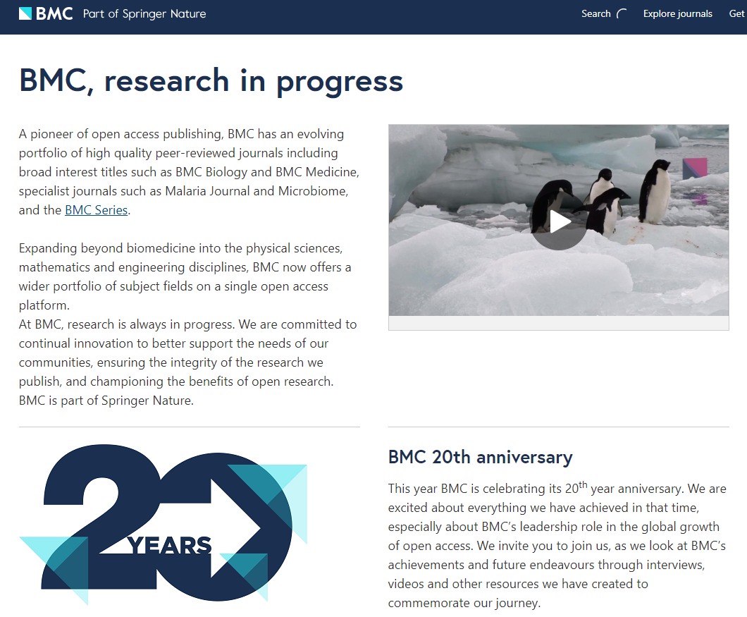
3. Scientific literature, Internet online resources
3.1 Types of scientific reports and their purpose
Online journals - open access publishers
BioMed Central - from 2000, now it is a part of Springer Nature
B130P16E: Practical basics of scientific work Department of Experimental Plant Biology, FS CU https://lhr.ueb.cas.cz/petrasek/B130P16E.htm

Slide 13
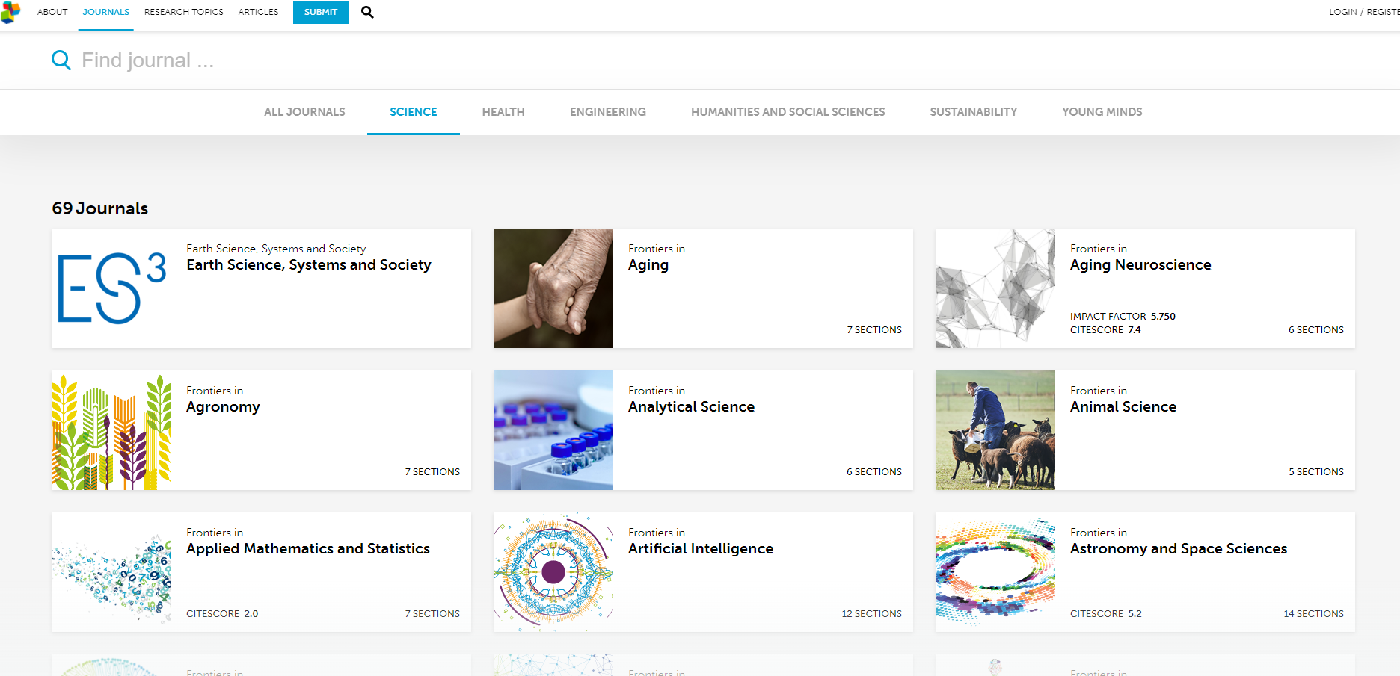
3. Scientific literature, Internet online resources
3.1 Types of scientific reports and their purpose
Online journals - open access publishers
Frontiers – from 2007
B130P16E: Practical basics of scientific work Department of Experimental Plant Biology, FS CU https://lhr.ueb.cas.cz/petrasek/B130P16E.htm

Slide 14
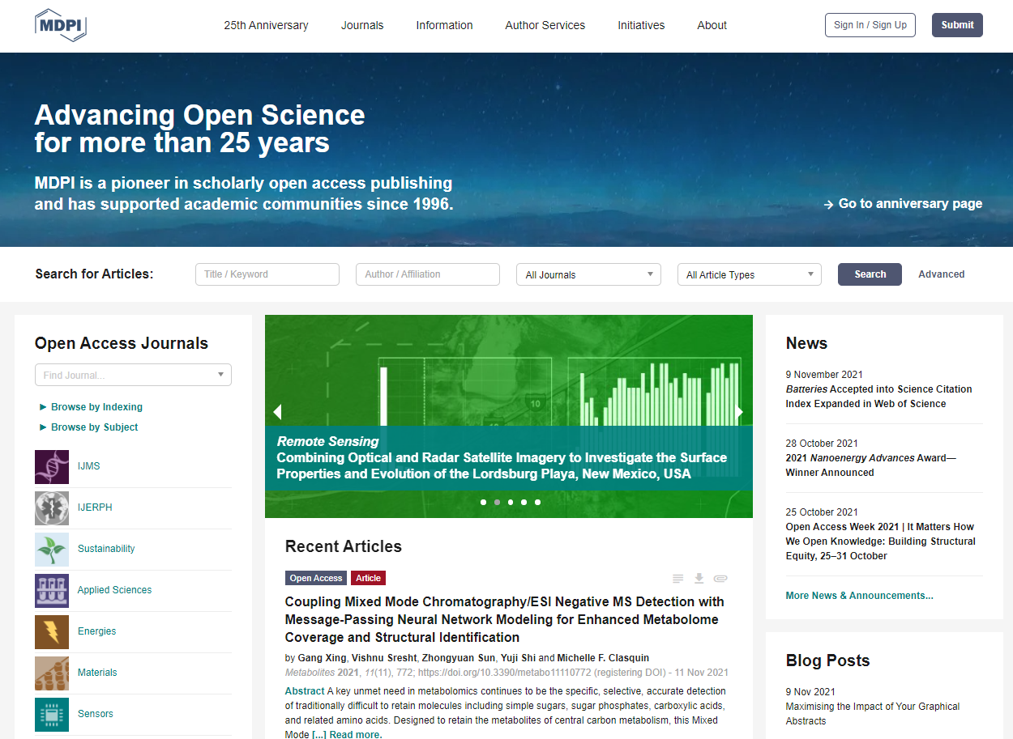
3. Scientific literature, Internet online resources
3.1 Types of scientific reports and their purpose
Online journals - open access publishers
MDPI - from 1996
MDPI - Multidisciplinary Digital Publishing Institute
B130P16E: Practical basics of scientific work Department of Experimental Plant Biology, FS CU https://lhr.ueb.cas.cz/petrasek/B130P16E.htm

Slide 15
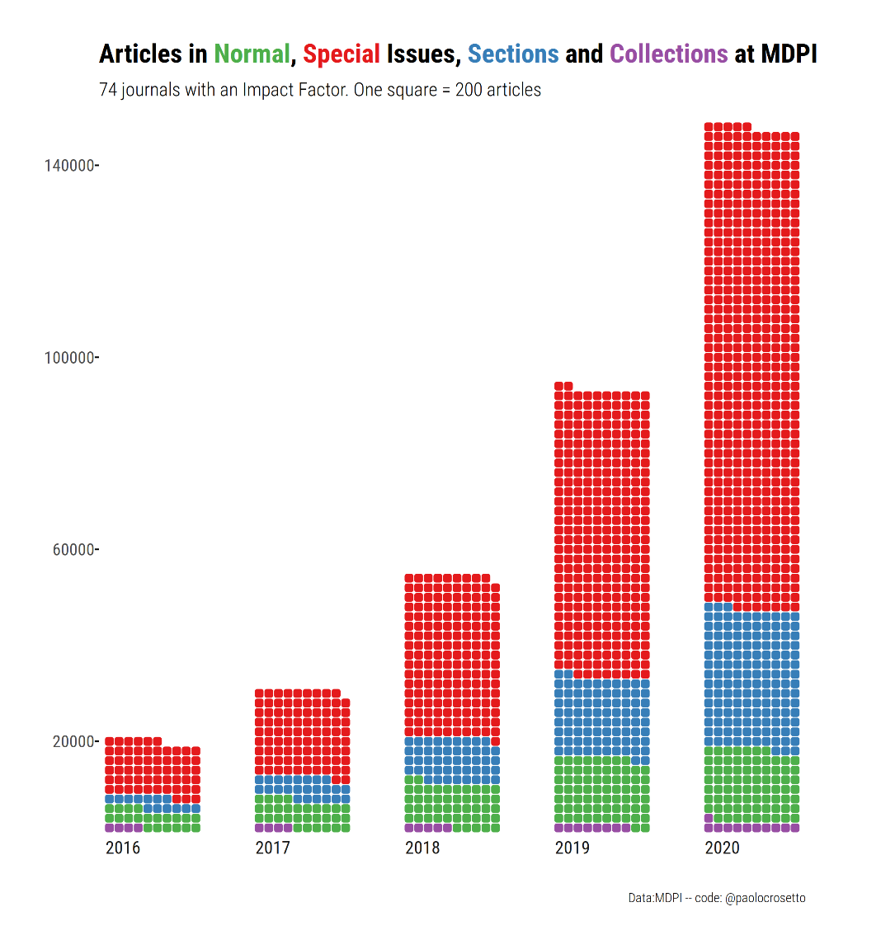
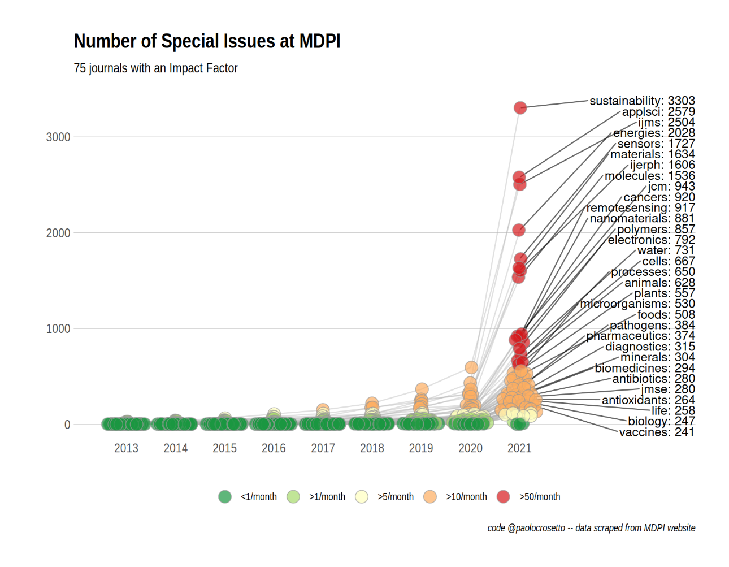
3. Scientific literature, Internet online resources
3.1 Types of scientific reports and their purpose
Online journals - the number of special issues is steadily increasing
Is MDPI a predatory publisher? – Paolo Crosetto (wordpress.com)
B130P16E: Practical basics of scientific work Department of Experimental Plant Biology, FS CU https://lhr.ueb.cas.cz/petrasek/B130P16E.htm

Slide 16
3. Scientific literature, Internet online resources
3.2 Internet information resources
Web search engines
From 1996
B130P16E: Practical basics of scientific work Department of Experimental Plant Biology, FS CU https://lhr.ueb.cas.cz/petrasek/B130P16E.htm

Slide 17
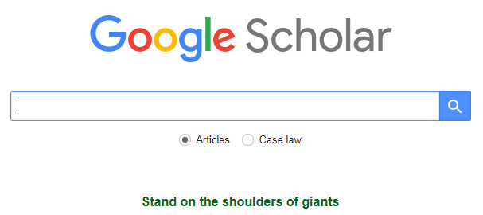
3. Scientific literature, Internet online resources
3.2 Internet information resources
Specialized search engines
Google Scholar
It searches for scholarly literature across many disciplines and sources, including theses, books, abstracts and articles
It searches primarily repositories of universities and publishers
How to use Google scholar: the ultimate guide - Paperpile
B130P16E: Practical basics of scientific work Department of Experimental Plant Biology, FS CU https://lhr.ueb.cas.cz/petrasek/B130P16E.htm

Slide 18
3. Scientific literature, Internet online resources
3.2 Internet information resources
Types of scientific literature databases
- Bibliographic - contain records of published scientific articles, books, conference abstracts, etc.
- Full text - in addition to a bibliographic record, they contain full length articles and books
- Personal - is maintained by users through constant updating, serves as a handy assistant for writing scientific texts
B130P16E: Practical basics of scientific work Department of Experimental Plant Biology, FS CU https://lhr.ueb.cas.cz/petrasek/B130P16E.htm

Slide 19
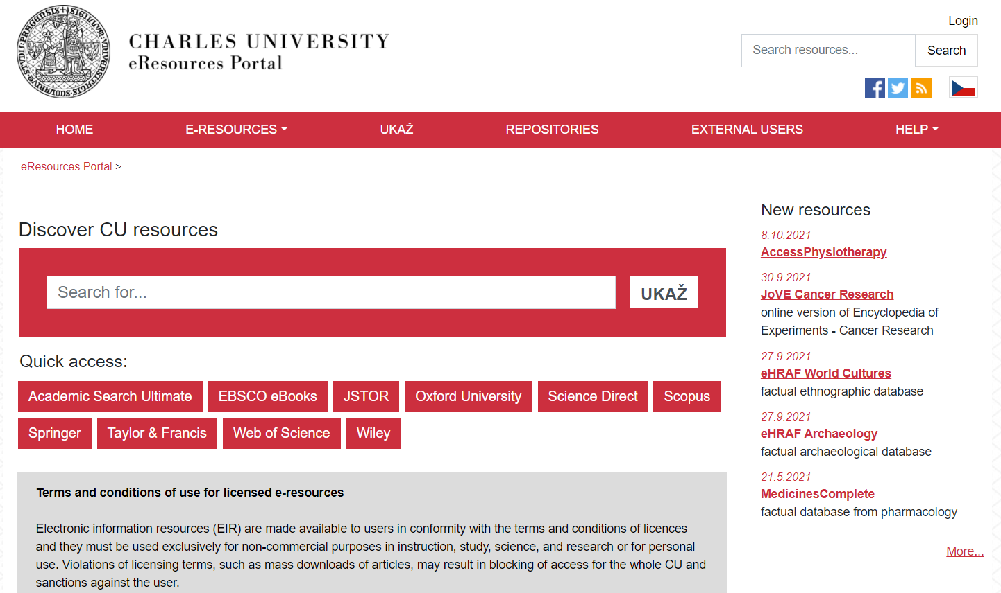
3. Scientific literature, Internet online resources
3.2 Internet information resources
Electronic resources at Charles University
- E-resources are listed for each faculty
- UKAŽ tool searches for printed, digitized and electronic resources at CU
- repositories of bachelor, master and dissertation theses
B130P16E: Practical basics of scientific work Department of Experimental Plant Biology, FS CU https://lhr.ueb.cas.cz/petrasek/B130P16E.htm

Slide 20
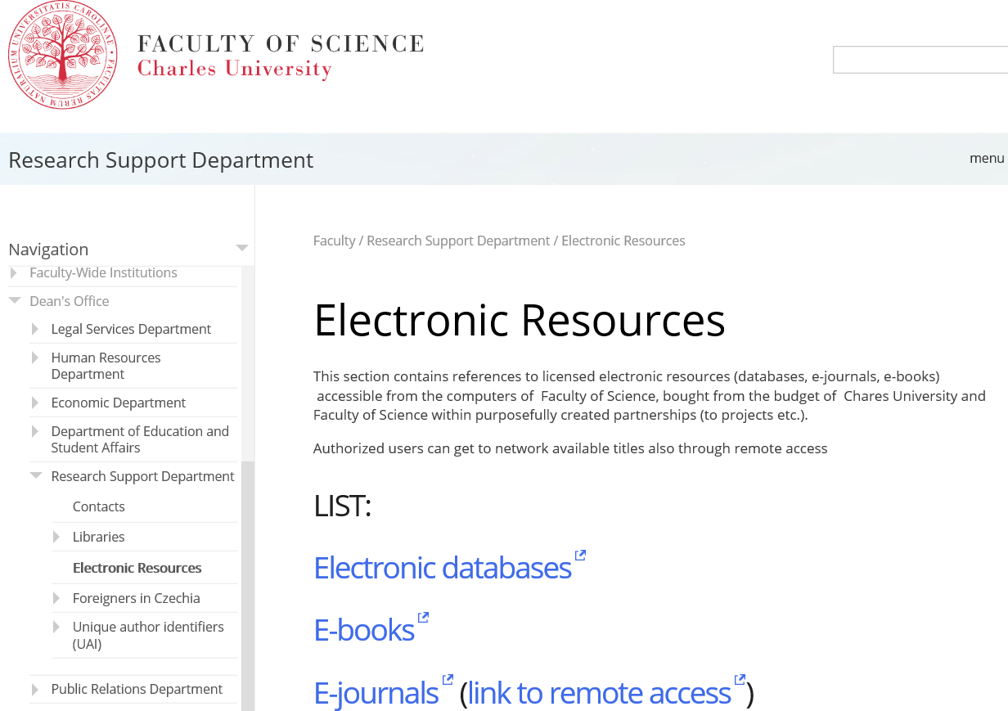
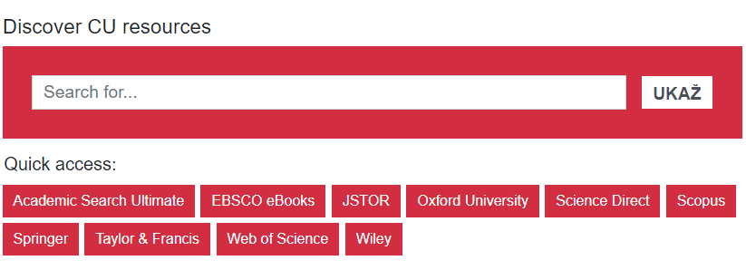
3. Scientific literature, Internet online resources
3.2 Internet information resources
Electronic resources at Faculty of Science, CU
List of electronic resources:
- subscribed bibliographic databases - ISI WOS, Scopus, etc.
- subscribed full text databases - EBSCO, JSTOR, Kluwer, Springer, Wiley, etc.
- free databases - Pubmed, Pubmed Central, High Wire press, etc.
B130P16E: Practical basics of scientific work Department of Experimental Plant Biology, FS CU https://lhr.ueb.cas.cz/petrasek/B130P16E.htm

Slide 21
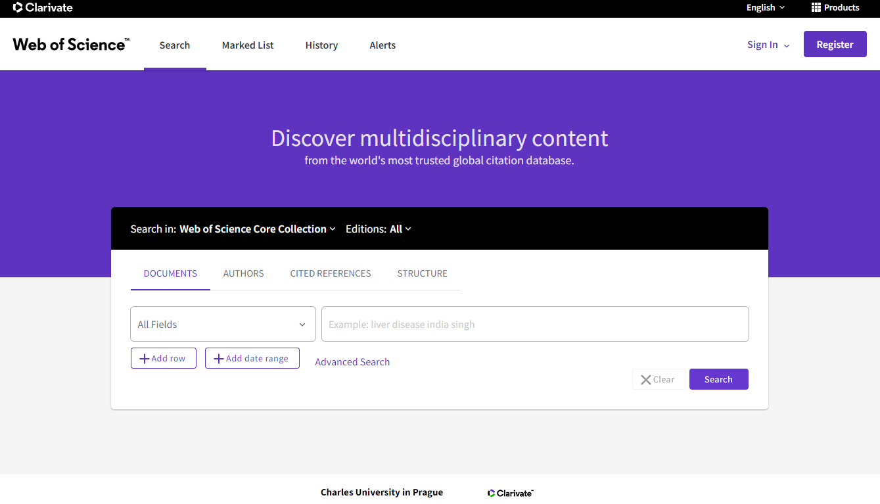
3. Scientific literature, Internet online resources
3.2 Internet information resources
Bibliographic databases available at Faculty of Science, CU
ISI Web of Knowledge
- a commercial bibliographic database of scientific literature, established by Thomson Reuters and maintained by Clarivate Analytics
- it is usually subscribed by the institution
- users can register to get much wider range of services
- links to full texts provided
- new interface from 2021
B130P16E: Practical basics of scientific work Department of Experimental Plant Biology, FS CU https://lhr.ueb.cas.cz/petrasek/B130P16E.htm

Slide 22
3. Scientific literature, Internet online resources
3.2 Internet information resources
Bibliographic databases available at Faculty of Science, CU
Scopus
- a commercial bibliographic database of scientific literature maintained by Elsevier
- it is usually subscribed by the institution
- users can register to get much wider range of services
- links to full texts provided
B130P16E: Practical basics of scientific work Department of Experimental Plant Biology, FS CU https://lhr.ueb.cas.cz/petrasek/B130P16E.htm

Slide 23
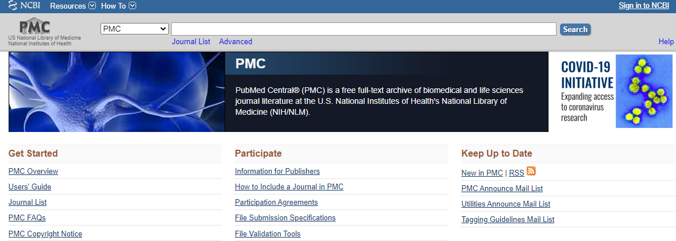
3. Scientific literature, Internet online resources
3.2 Internet information resources
Bibliographic databases available at Faculty of Science, CU
NCBI Pubmed
- free access, good coverage
- operated by NCBI (National Center for Biotechnology Information)
- online early and pre-print articles could be found here
- combination of bibliographic (Pubmed) and full text (Pubmed Central, PMC) databases
B130P16E: Practical basics of scientific work Department of Experimental Plant Biology, FS CU https://lhr.ueb.cas.cz/petrasek/B130P16E.htm

Slide 24
3. Scientific literature, Internet online resources
3.2 Internet information resources
Preprint servers
- free online archive for unpublished original contributions
- operated by Cold Spring Harbor Laboratory
- authors obtain a feedback from the scientific community before they submit the paper to peer-reviewed journals
- bioRxiv, medRxiv
B130P16E: Practical basics of scientific work Department of Experimental Plant Biology, FS CU https://lhr.ueb.cas.cz/petrasek/B130P16E.htm

