Slide 1
3. Scientific literature, Internet online resources
How to set your web browser to behave as a faculty computer?
Using CAS password through proxy server.
Instructions (in Czech):
http://www.natur.cuni.cz/faculty/cit/navody/pristup-k-elzdrojum
B130P16E: Practical basics of scientific work Department Experimental Plant Biology FSCU http:/lhr.ueb.cas.cz/petrasek

Slide 2
3. Scientific literature, Internet online resources
How to search for bibliographic records effectively?
1) Browsing through every individual journal volume online or in printed form
It is important to know, which journals are worth to browse through
You could be smashed by an enormous amount of articles
Searching is not so easy
2) Regular searching using bibliographic database
Complete information
You could be smashed by an enormous amount of records
Searching is very easy
B130P16E: Practical basics of scientific work Department Experimental Plant Biology FSCU http:/lhr.ueb.cas.cz/petrasek

Slide 3
3. Scientific literature, Internet online resources
How to search for bibliographic records effectively?
1) Browsing through every individual journal volume online or in printed form
http://www.plantcell.org
B130P16E: Practical basics of scientific work Department Experimental Plant Biology FSCU http:/lhr.ueb.cas.cz/petrasek

Slide 4
3. Scientific literature, Internet online resources
How to search for bibliographic records effectively?
2) Regular searching using bibliographic database
ISI Web of Knowledge
http://www.isiknowledge.com
Journals covered in WOS
B130P16E: Practical basics of scientific work Department Experimental Plant Biology FSCU http:/lhr.ueb.cas.cz/petrasek

Slide 5
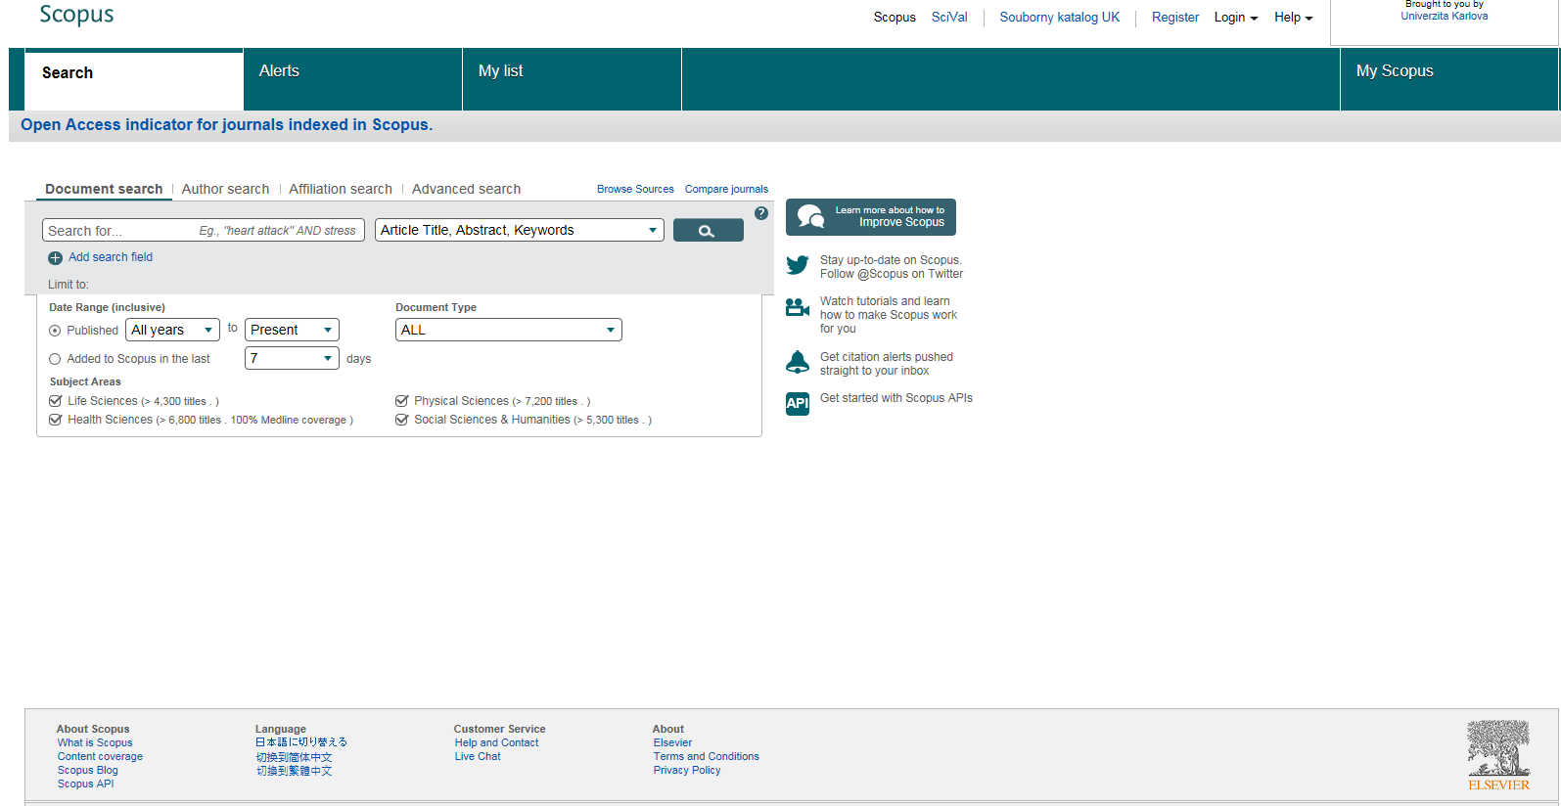
3. Scientific literature, Internet online resources
How to search for bibliographic records effectively?
2) Regular searching using bibliographic database
Scopus
http://www.scopus.com
B130P16E: Practical basics of scientific work Department Experimental Plant Biology FSCU http:/lhr.ueb.cas.cz/petrasek

Slide 6
3. Scientific literature, Internet online resources
How to search for bibliographic records effectively?
2) Regular searching using bibliographic database
Pubmed
http://www.ncbi.nlm.nih.gov/pubmed
B130P16E: Practical basics of scientific work Department Experimental Plant Biology FSCU http:/lhr.ueb.cas.cz/petrasek

